Slide 1
Procurement Road to Partnership
Department of Administrative Services
State Purchasing Division
May 9, 2016
Version 3.0
Technology Summit 2016
Sharing Information to Advance Citizen Services

Slide 2
Department of Administrative Services
Procurement Road to Partnership
Agenda
Partnership is key to the success of a Procurement initiative
During this hour we’ll articulate …
Importance of partnership between the State Entities, DOAS and GTA
Less cancelled RFP’s
Less protests
Easier and successful implementations
Best cost for the state
We will identify roles and responsibilities as we discuss the DOAS “Seven Stage Process”

Slide 3
Department of Administrative Services
Procurement Road to Partnership
IT Statewide Contracts
DOAS
CCTV Boxed Products
CCTV Products, Services, and Installation
Certified Audio Visual Product and Select Services
Computer Peripherals and General Audio Visual Products
Data Communications System
Desktop Printers
Electronic Monitoring
IT Networking Equipment
IT Staffing
Mailing Equipment
Multifunctional Devices Print/Copy/Scan/Fax (Segments 2-4)
Multifunctional Devices Print/Copy/Scan/Fax (Segments 5+)
PC Hardware, Related Equipment and Services
Servers/Storage
Storage/Backup and Recovery
Software
Two-Way Radio Hardware
GTA
Reseller for Oracle Products
Wireless Communications Devices and Services

Slide 4
Department of Administrative Services
Procurement Road to Partnership
Goods Statewide Contracts
DOAS
Vehicles - administrative, police pursuit, buses, mass transit, ATVs & UTVs/golf carts, trucks, vehicle lifts, chassis, parts and maintenance equipment
Medical & lab equipment and supplies, biological and regents, diagnostic instruments, pharmaceutical drugs/vaccines
Food items (bread, milk/ice cream)
Custodial and hospitality items (can liners, disposable food service items, personal paper items)
Office supply supplies (paper, toner, general office items, furniture)
Law enforcement equipment and supplies (fire arms, ammunition, etc.)
Fuel and gases (petroleum, propane, industrial & medical, diesel, natural gas)
Maintenance and operational supplies (facility/maintenance items, agricultural/landscaping, janitorial, tractors and mowers, tires/tubes and retreads, lamps and ballasts, electrical and industrial items, building materials, paint)

Slide 5
Department of Administrative Services
Procurement Road to Partnership
Services Statewide Contracts
DOAS
Fuel Card
Vehicle Maintenance and Garage Management
Auto Rental and Leasing
Media Buying
Purchase Card
Emergency Records Recovery
Translation Services
Sign Language
Indefinite Quantity Construction
Facility Maintenance Service
Rapid Copy
Background Checks
Security (Armed and Unarmed)
Offset Printing
Drug Testing
Temporary Staffing, Clerical and Light Industrial
Presort & Fulfillment Mail Services
Expedited Delivery Services
Capitol Hill Mailroom Management

Slide 6
Department of Administrative Services
Procurement Road to Partnership
Upcoming IT Statewide Contracts
Audio Visual Kim Ford 404-657-4295
Electronic Monitoring Carrie Steele 404-463-5556
Enterprise Infrastructure Beverly Denson 404-656-5345
(Servers, Storage & Cloud)
Integrated Security and Surveillance Carrie Steele 404-463-5556
(Access Control, CCTV, & Intrusion Alert)
Mailing Equipment Kim Ford 404-657-4295
Multifunctional Printers & Print Services Elizabeth Eason 404-657-6877
Network Equipment - Specialized Carrie Steele 404-463-5556
PC Hardware - Microsoft Surface Pro Steve Thornton 404-657-4282
Temporary Staffing IT Jan Pytelewski 404-656-5361
Two-Way Radios Kim Ford 404-657-4295

Slide 7
Department of Administrative Services
Procurement Road to Partnership
Agency Contracts
DRIVES - DOR & DDS
Pharmacy Rebates & Benefit Manager - DCH
Drivers License Card Rebid - DDS
Administrative Staffing - HRA
Care Management Org. - DCH
Employee Purchase Plan - HRA
Workers Comp. Managed Care - DOAS (Risk)
School Nutrition Software - DOE
EDS - DCH
Inmate Telephone - GDC
IT Staffing - HRA
VRM - DOAS, SAO
Insurance Brokers - DOAS (Risk)

Slide 8
Department of Administrative Services
Procurement Road to Partnership
Seven Stages of Procurement
Need Identification
Pre-Solicitation
Solicitation Preparation
Solicitation Process
Evaluation Process
Award Process
Contract Process

Slide 9
Department of Administrative Services
Procurement Road to Partnership
Seven Stages of Procurement
The “Seven Stages of Procurement” organizes the solicitation process into a series of steps from the identification of a needed good or service, through contract award and contract administration
Need Identification
Pre-Solicitation
Solicitation Preparation
Solicitation Process
Evaluation Process
Award Process
Contract Process

Slide 10
Department of Administrative Services
Procurement Road to Partnership
Seven Stages of Procurement
Need Identification
Pre-Solicitation
Solicitation Preparation
Solicitation Process
Evaluation Process
Award Process
Contract Process

Slide 11
Department of Administrative Services
Procurement Road to Partnership
Seven Stages of Procurement
Needs Identification - Stage 1
Need Identification
Pre-Solicitation
Solicitation Preparation
Solicitation Process
Evaluation Process
Award Process
Contract Process
Identify need for purchase
Identify exceptions to state purchasing act
Order of Precedence
Identify where a sourcing event is required
Review special approvals or restrictions
Identify most appropriate purchase method
Identify cross-functional team
Decide on required analysis
Estimate contract value or annual spend
Address market and budget constraints
Address delegated purchasing authority
Develop sourcing strategy
Generate evaluation criteria
Develop bid factors for sourcing
Generate questions for RFP
Create RFP according to format
Post eRFx advertisement or bid notice to the GPR
Conduct Q&A session
Conduct offeror conference
Select implementation path
Develop negotiation plan
Receive bids
Conduct administrative review
Analyze cost proposal
Evaluate technical proposal
Conduct negotiation
Select Suppliers
Finalize contract
Issue Intent to Award
Handle supplier protests
Issue Notice of Award
Document and store contract / purchase details
Implement new agreement
Create contract administration plan
Sustain results
Track contract performance
Track supplier performance

Slide 12
Department of Administrative Services
Procurement Road to Partnership
Seven Stages of Procurement
Needs Identification - Stage 1
GTA Value Add
An investment consultant can support through initiation and planning (for both GETS and non-GETS solutions). GTA will help determine whether the procurement is a technology event, based on functionality and data needs for the business. The Enterprise Portfolio Management Office (EPMO) has tools, templates and resources to assist in Business Case development to ensure that the selected solution will bring the most value to the agency
Need Identification
Pre-Solicitation
Solicitation Preparation
Solicitation Process
Evaluation Process
Award Process
Contract Process
DOAS Value Add
DOAS procurement assistance guides the State Entity on the procurement rules, existing contracts, laws and guidelines that can impact technology decisions down the road. This saves time and reduces risk. DOAS can help by utilizing strategic sourcing strategies to focus on the requirement
State Entity Value Add
State Entity identifies the business need and verifies budget. The entity develops a business case, identify SMEs and cross functional team members

Slide 13
Department of Administrative Services
Procurement Road to Partnership
Seven Stages of Procurement
Pre-Solicitation - Stage 2
Need Identification
Pre-Solicitation
Solicitation Preparation
Solicitation Process
Evaluation Process
Award Process
Contract Process
Identify need for purchase
Identify exceptions to state purchasing act
Order of Precedence
Identify where a sourcing event is required
Review special approvals or restrictions
Identify most appropriate purchase method
Identify cross-functional team
Decide on required analysis
Estimate contract value or annual spend
Address market and budget constraints
Address delegated purchasing authority
Develop sourcing strategy
Generate evaluation criteria
Develop bid factors for sourcing
Generate questions for RFP
Create RFP according to format
Post eRFx advertisement or bid notice to the GPR
Conduct Q&A session
Conduct offeror conference
Select implementation path
Develop negotiation plan
Receive bids
Conduct administrative review
Analyze cost proposal
Evaluate technical proposal
Conduct negotiation
Select Suppliers
Finalize contract
Issue Intent to Award
Handle supplier protests
Issue Notice of Award
Document and store contract / purchase details
Implement new agreement
Create contract administration plan
Sustain results
Track contract performance
Track supplier performance

Slide 14
Department of Administrative Services
Procurement Road to Partnership
Seven Stages of Procurement
Pre-Solicitation - Stage 2
GTA Value Add
GTA maintains a state application inventory to identify opportunities for leveraging existing technology. GTA shares best practices for similar technology procurements and provides input to RFx and contract language. GTA can also provide SMEs to advise during the solicitation, if needed
Need Identification
Pre-Solicitation
Solicitation Preparation
Solicitation Process
Evaluation Process
Award Process
Contract Process
DOAS Value Add
DOAS will identify most appropriate purchase method and type of RFx needed for the sourcing of IT and non-IT goods and services
State Entity Value Add
State Entity can provide historical view (system and spend), identify best practices and market analysis

Slide 15
Department of Administrative Services
Procurement Road to Partnership
Seven Stages of Procurement
Solicitation Preparation - Stage 3
Need Identification
Pre-Solicitation
Solicitation Preparation
Solicitation Process
Evaluation Process
Award Process
Contract Process
Identify need for purchase
Identify exceptions to state purchasing act
Order of Precedence
Identify where a sourcing event is required
Review special approvals or restrictions
Identify most appropriate purchase method
Identify cross-functional team
Decide on required analysis
Estimate contract value or annual spend
Address market and budget constraints
Address delegated purchasing authority
Develop sourcing strategy
Generate evaluation criteria
Develop bid factors for sourcing
Generate questions for RFP
Create RFP according to format
Post eRFx advertisement or bid notice to the GPR
Conduct Q&A session
Conduct offeror conference
Select implementation path
Develop negotiation plan
Receive bids
Conduct administrative review
Analyze cost proposal
Evaluate technical proposal
Conduct negotiation
Select Suppliers
Finalize contract
Issue Intent to Award
Handle supplier protests
Issue Notice of Award
Document and store contract / purchase details
Implement new agreement
Create contract administration plan
Sustain results
Track contract performance
Track supplier performance

Slide 16
Department of Administrative Services
Procurement Road to Partnership
Seven Stages of Procurement
Solicitation Preparation - Stage 3
GTA Value Add
GTA is the keeper of enterprise technical policies and standards. If a potential solution may fall outside of the state standards, GTA assists in requesting an exemption. For solutions that will require support from the state’s infrastructure service providers, EPMO ensures that appropriate GETS representatives are engaged. All procurements receive comments and recommendations from the State CTO
Need Identification
Pre-Solicitation
Solicitation Preparation
Solicitation Process
Evaluation Process
Award Process
Contract Process
DOAS Value Add
DOAS will collaborate with the State Entity and SMEs to provide the best solution model of cross industry proven technology. DOAS will assist with sourcing tools, solicitation templates, evaluation documents, and contract templates. DOAS will work with the State Entities legal, to develop terms and conditions language
State Entity Value Add
State Entity will provide specifications, review RFP and all attachments, secure State Entity approvals to move forward and help with evaluation forms

Slide 17
Department of Administrative Services
Procurement Road to Partnership
Seven Stages of Procurement
Solicitation Process - Stage 4
Need Identification
Pre-Solicitation
Solicitation Preparation
Solicitation Process
Evaluation Process
Award Process
Contract Process
Identify need for purchase
Identify exceptions to state purchasing act
Order of Precedence
Identify where a sourcing event is required
Review special approvals or restrictions
Identify most appropriate purchase method
Identify cross-functional team
Decide on required analysis
Estimate contract value or annual spend
Address market and budget constraints
Address delegated purchasing authority
Develop sourcing strategy
Generate evaluation criteria
Develop bid factors for sourcing
Generate questions for RFP
Create RFP according to format
Post eRFx advertisement or bid notice to the GPR
Conduct Q&A session
Conduct offeror conference
Select implementation path
Develop negotiation plan
Receive bids
Conduct administrative review
Analyze cost proposal
Evaluate technical proposal
Conduct negotiation
Select Suppliers
Finalize contract
Issue Intent to Award
Handle supplier protests
Issue Notice of Award
Document and store contract / purchase details
Implement new agreement
Create contract administration plan
Sustain results
Track contract performance
Track supplier performance

Slide 18
Department of Administrative Services
Procurement Road to Partnership
Seven Stages of Procurement
Solicitation Process - Stage 4
GTA Value Add
GTA can assist with answering technical questions from Question and Answer sessions and review contract for specific IT language or exceptions
Need Identification
Pre-Solicitation
Solicitation Preparation
Solicitation Process
Evaluation Process
Award Process
Contract Process
DOAS Value Add
DOAS or the State Entity will post the solicitation according to set state processes to provide qualified bidders an opportunity to bid on the request. DOAS will provide administrative functions (eg: Questions and Answers, Offerors Conferences, and Addendums to the RFP)
State Entity Value Add
State Entity provides aid in answering questions and answers. They participate in conferences if needed

Slide 19
Department of Administrative Services
Procurement Road to Partnership
Seven Stages of Procurement
Evaluation Process - Stage 5
Need Identification
Pre-Solicitation
Solicitation Preparation
Solicitation Process
Evaluation Process
Award Process
Contract Process
Identify need for purchase
Identify exceptions to state purchasing act
Order of Precedence
Identify where a sourcing event is required
Review special approvals or restrictions
Identify most appropriate purchase method
Identify cross-functional team
Decide on required analysis
Estimate contract value or annual spend
Address market and budget constraints
Address delegated purchasing authority
Develop sourcing strategy
Generate evaluation criteria
Develop bid factors for sourcing
Generate questions for RFP
Create RFP according to format
Post eRFx advertisement or bid notice to the GPR
Conduct Q&A session
Conduct offeror conference
Select implementation path
Develop negotiation plan
Receive bids
Conduct administrative review
Analyze cost proposal
Evaluate technical proposal
Conduct negotiation
Select Suppliers
Finalize contract
Issue Intent to Award
Handle supplier protests
Issue Notice of Award
Document and store contract / purchase details
Implement new agreement
Create contract administration plan
Sustain results
Track contract performance
Track supplier performance

Slide 20
Department of Administrative Services
Procurement Road to Partnership
Seven Stages of Procurement
Evaluation Process - Stage 5
GTA Value Add
GTA can provide SMEs to assist in an advisory capacity during evaluations of the technology proposals
Need Identification
Pre-Solicitation
Solicitation Preparation
Solicitation Process
Evaluation Process
Award Process
Contract Process
DOAS Value Add
DOAS will thoroughly evaluate bidders for qualifications, tax compliance and financial eligibility for compliance to be a supplier
State Entity Value Add
State Entity provides evaluation team for technical responses and financial review if needed

Slide 21
Department of Administrative Services
Procurement Road to Partnership
Seven Stages of Procurement
Award Process - Stage 6
Need Identification
Pre-Solicitation
Solicitation Preparation
Solicitation Process
Evaluation Process
Award Process
Contract Process
Identify need for purchase
Identify exceptions to state purchasing act
Order of Precedence
Identify where a sourcing event is required
Review special approvals or restrictions
Identify most appropriate purchase method
Identify cross-functional team
Decide on required analysis
Estimate contract value or annual spend
Address market and budget constraints
Address delegated purchasing authority
Develop sourcing strategy
Generate evaluation criteria
Develop bid factors for sourcing
Generate questions for RFP
Create RFP according to format
Post eRFx advertisement or bid notice to the GPR
Conduct Q&A session
Conduct offeror conference
Select implementation path
Develop negotiation plan
Receive bids
Conduct administrative review
Analyze cost proposal
Evaluate technical proposal
Conduct negotiation
Select Suppliers
Finalize contract
Issue Intent to Award
Handle supplier protests
Issue Notice of Award
Document and store contract / purchase details
Implement new agreement
Create contract administration plan
Sustain results
Track contract performance
Track supplier performance

Slide 22
Department of Administrative Services
Procurement Road to Partnership
Seven Stages of Procurement
Award Process - Stage 6
DOAS Value Add
DOAS or State Entity will post the NOA (Notification of Award) and the award, to the winner of the solicitation
Need Identification
Pre-Solicitation
Solicitation Preparation
Solicitation Process
Evaluation Process
Award Process
Contract Process

Slide 23
Department of Administrative Services
Procurement Road to Partnership
Seven Stages of Procurement
Contract Process - Stage 7
Need Identification
Pre-Solicitation
Solicitation Preparation
Solicitation Process
Evaluation Process
Award Process
Contract Process
Identify need for purchase
Identify exceptions to state purchasing act
Order of Precedence
Identify where a sourcing event is required
Review special approvals or restrictions
Identify most appropriate purchase method
Identify cross-functional team
Decide on required analysis
Estimate contract value or annual spend
Address market and budget constraints
Address delegated purchasing authority
Develop sourcing strategy
Generate evaluation criteria
Develop bid factors for sourcing
Generate questions for RFP
Create RFP according to format
Post eRFx advertisement or bid notice to the GPR
Conduct Q&A session
Conduct offeror conference
Select implementation path
Develop negotiation plan
Receive bids
Conduct administrative review
Analyze cost proposal
Evaluate technical proposal
Conduct negotiation
Select Suppliers
Finalize contract
Issue Intent to Award
Handle supplier protests
Issue Notice of Award
Document and store contract / purchase details
Implement new agreement
Create contract administration plan
Sustain results
Track contract performance
Track supplier performance

Slide 24
Department of Administrative Services
Procurement Road to Partnership
Seven Stages of Procurement
Contract Process - Stage 7
GTA Value Add
GTA can provide best practices for project management and will monitor the implementation process once awarded (if appropriate). GTA works with the State Entity to enhance communication across suppliers when implementing within the state infrastructure
Need Identification
Pre-Solicitation
Solicitation Preparation
Solicitation Process
Evaluation Process
Award Process
Contract Process
DOAS Value Add
DOAS will put in place the appropriate contracts and forms to enable the state agencies to utilize the supplier for goods and services
State Entity Value Add
State Entity receives contract and applicable files. They will aid in the implementation and monitor supplier’s performance

Slide 25
Department of Administrative Services
Procurement Road to Partnership
Questions?

Slide 26
Department of Administrative Services
Procurement Road to Partnership
State Purchasing Division
Beverly Alexander Denson IT Group Category Manager Georgia Department of Administrative Services (404) 656-5345 beverly.denson@doas.ga.gov

Slide 27
Department of Administrative Services
Procurement Road to Partnership

Slide 28
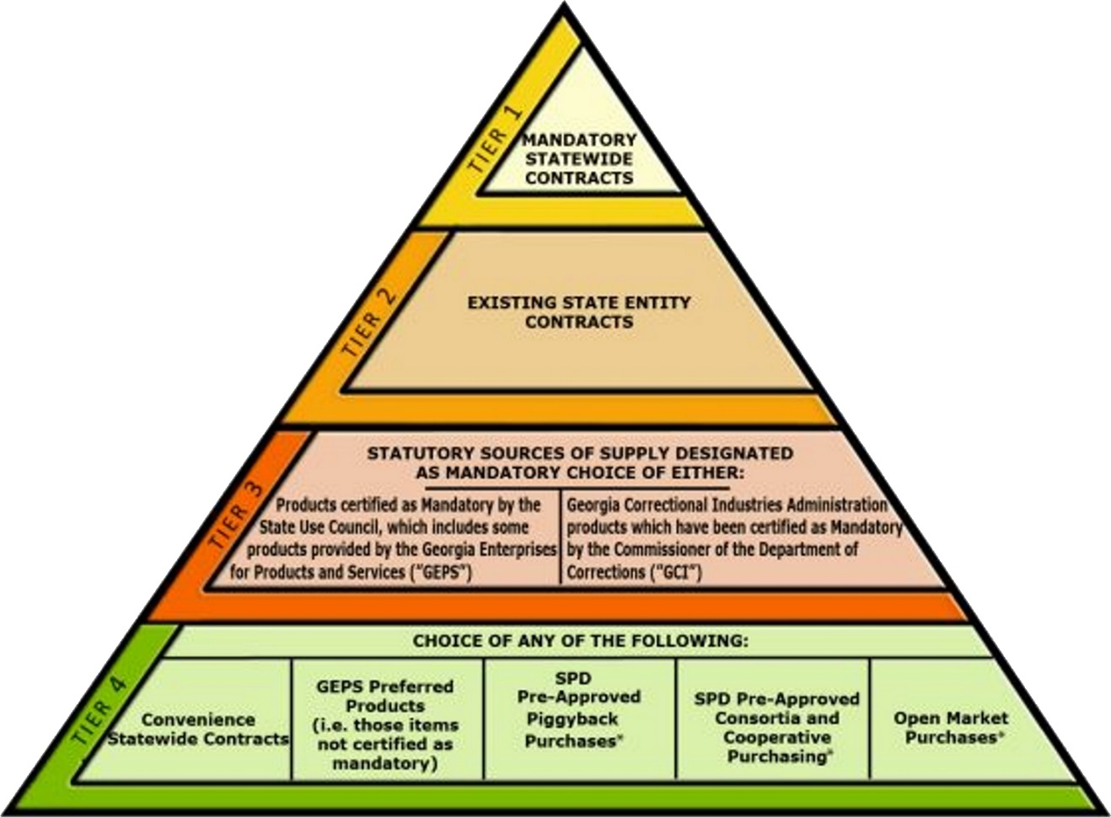
Department of Administrative Services
Procurement Road to Partnership
Order of Precedence

