Slide 1
Georgia Enterprise Management Suite (GEMS) Training
Created & Presented by GTA EPMO
Hank Oelze, PMP 404-463-5303
Version 3.5

Slide 2
GEMS Origin
“Agencies told us they needed help keeping large projects on track,” said Tom Fruman, director of GTA's Enterprise Governance and Planning Division. “We believe this portfolio and project management system will give them insight they didn't have before. They will be able to monitor the health and status of projects using a combination of traditional operational data and qualitative assessment data from multiple stakeholders.”
GEMS includes selected modules from CAI's project portfolio management application, ITBuzz Enterprise Management Suite, which provides visibility and analytics for the purpose of risk alerts and avoidance. CAI refers to the tool/application as: Advanced Management Insight (AMI).
GTA has opted to use the Portfolio Management, Automated Project Office, and Issues Resolution Management modules.

Slide 3
What’s New in GEM Training Version 3.5?
Removed redundant slides (adding people, roles, etc.)
Eliminated unessential slides, e.g., tool to EPLC alignment, downloading attachments
Added slides based on user input, e.g., delete an issue
Updated Issue & Risk sections
Added Project Portfolio Questionnaire option

Slide 4
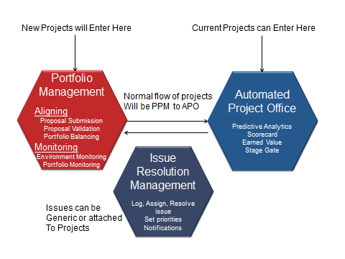
Process Flow
PPM
APO

Slide 5
Training Index
PPM Slides 6-64
Adding Resources 22
Scheduling a Questionnaire 32
APO Slides 65-109
Issues 68
Risks 81
Stage Gate Reviews 94
Critical Panel 107

Slide 6
GEMS Phase I Training
PPM – Proposal, New Projects Phase

Slide 7
PPM Versus APO
Easiest Way to Remember GEMS Process:
PPM (Project Portfolio Management) is Proposal Phase
APO (Automated Project Office) is Project Phase

Slide 8
Initial Login Screen - Video

Slide 9
Creating a Proposal or Project - Video

Slide 10
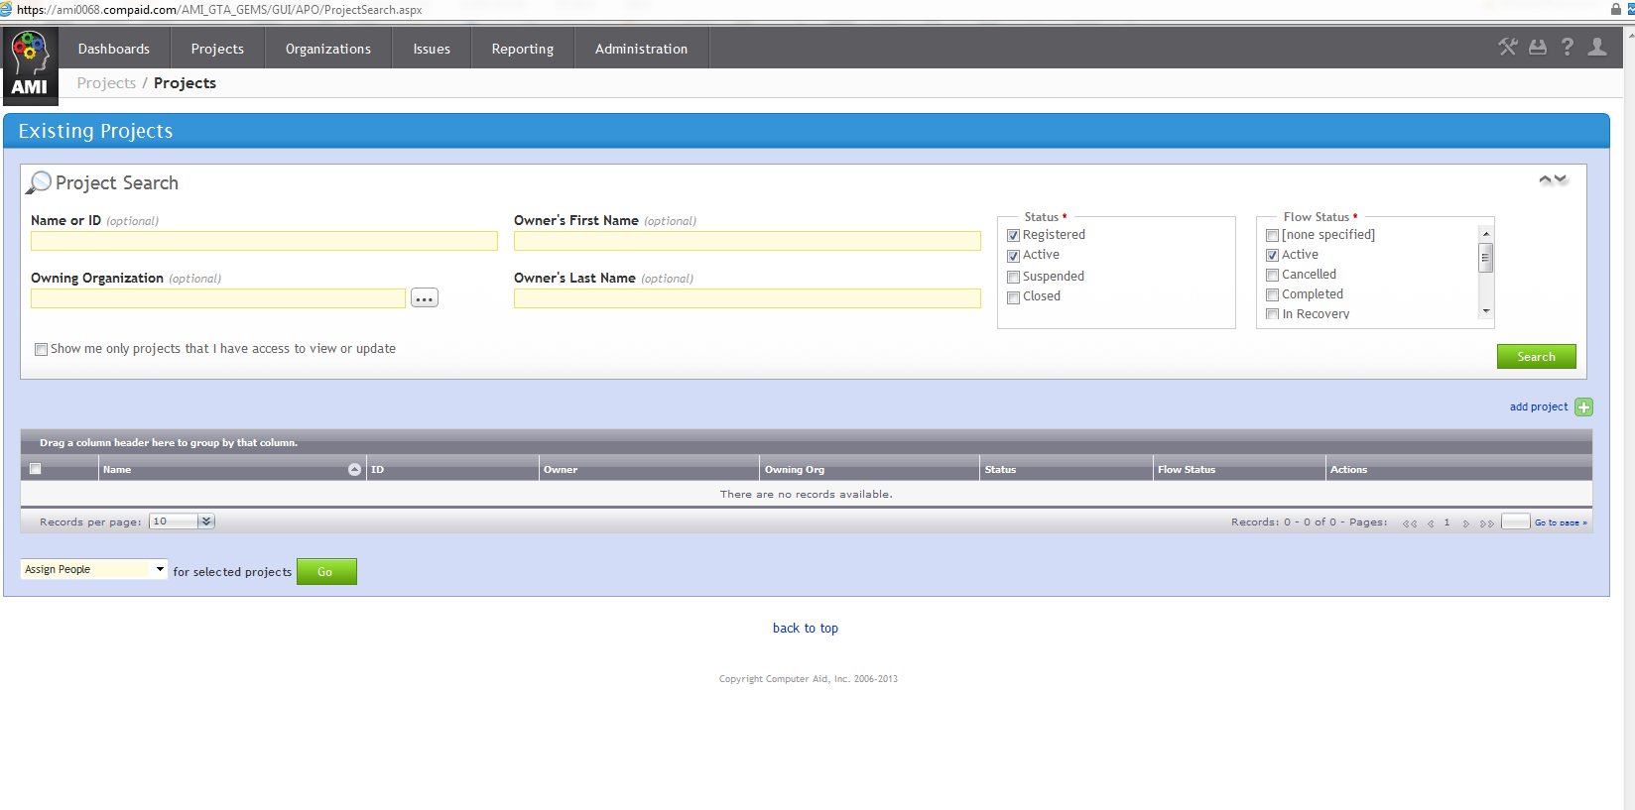
Initial Screen – GEMS

Slide 11
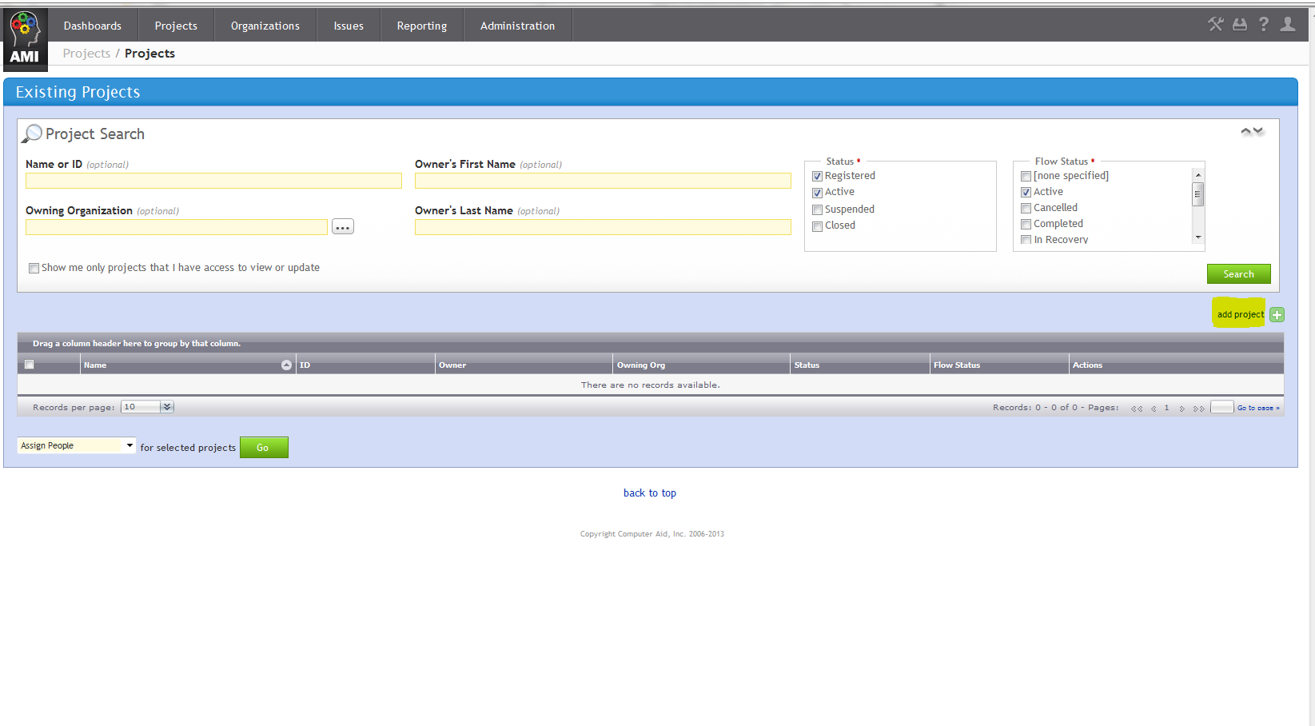
Create a New Proposal or Project
+
Select “add project”

Slide 12
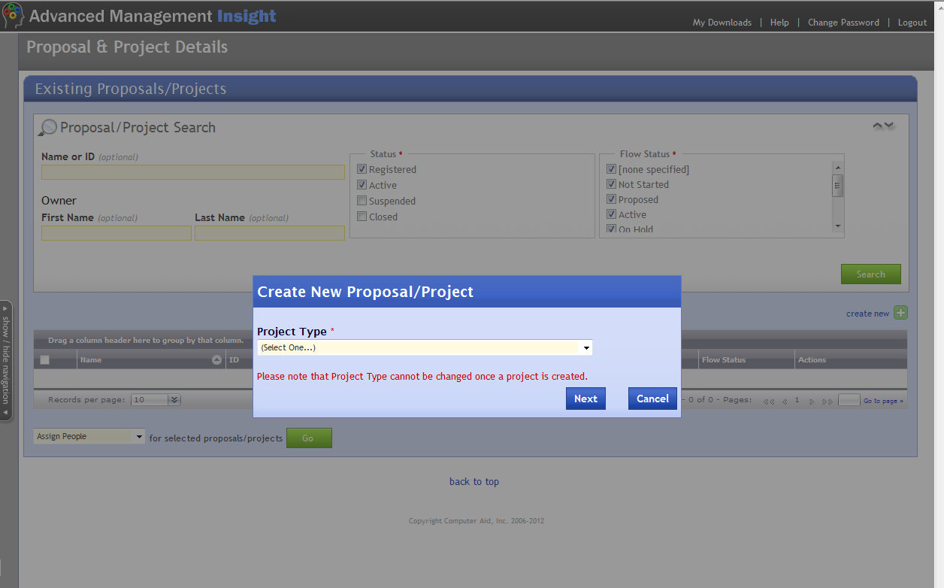
Select Project Type then Next
Select App Dev
IMPORTANT

Slide 13
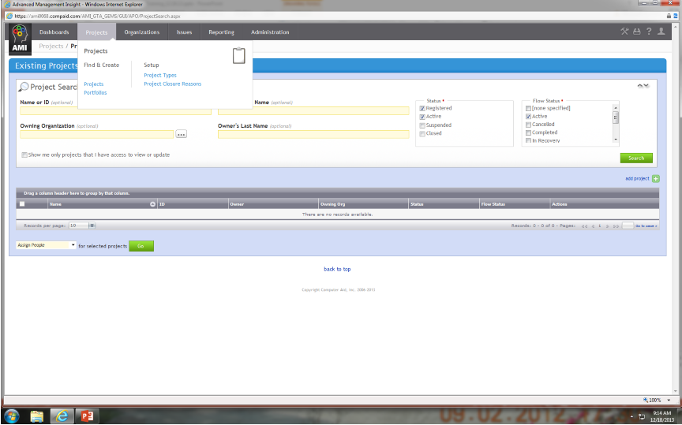
Project Types
1. Select “Projects” Tab
2. Select “Project Types”

Slide 14
Project Types
Drop Down Choices

Slide 15
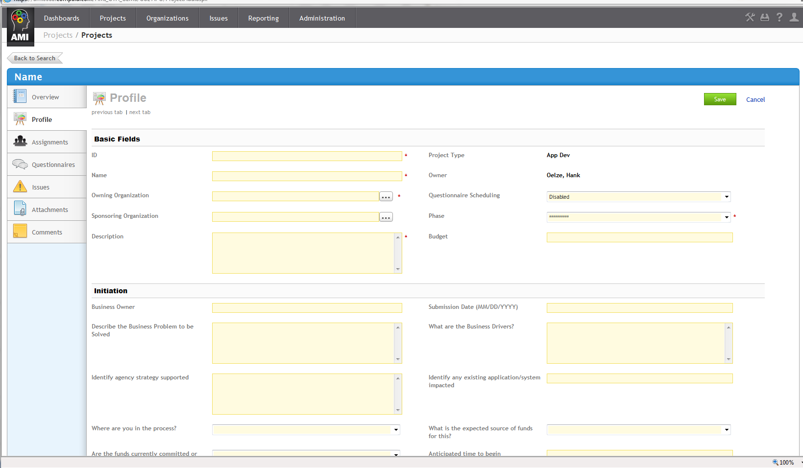
New Project Entry Screen Appears

Slide 16
Enter Profile Basic Fields
ID: Three letter agency ID – YYYYMMDD (DOR-20140828)*
Name: Descriptive Name
Owning Organization: Select from Drop Down
Questionnaire Scheduling: Select “Enabled” from Drop Down
Sponsoring Organization: Select from Drop Down
Project Phase: Initiate, if this is a new project
Description: Short description of project
Budget: 1287345 ALL cost amounts are entered without $, no commas, whole dollars only.
* If multiple entries occur in one day add suffix(a,b,c etc.)
Fields with an asterisk (*) are mandatory.
Notes:
Describe the difference between Owning and Sponsoring organizations (they can be the same)
The Sponsoring Organization is not a required field, but should be completed. The name is used in some e-mail notifications throughout the system.

Slide 17
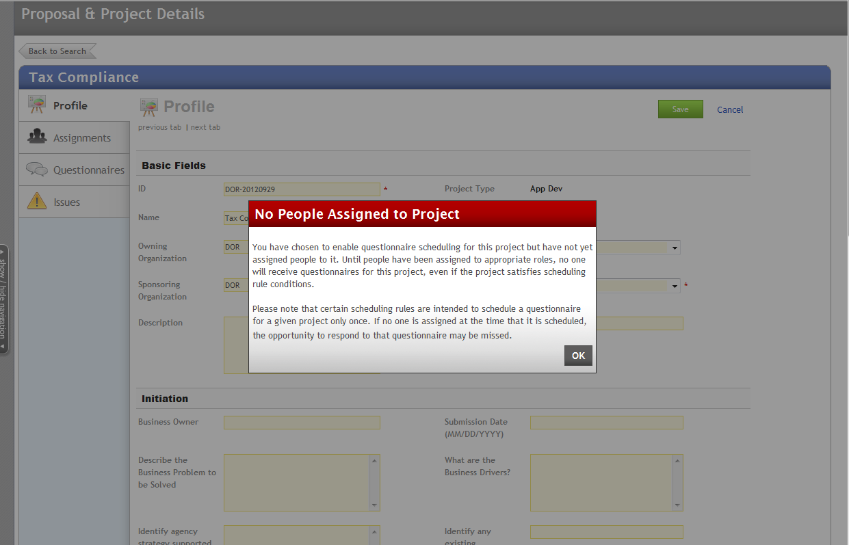
Warning Message, Select OK

Slide 18
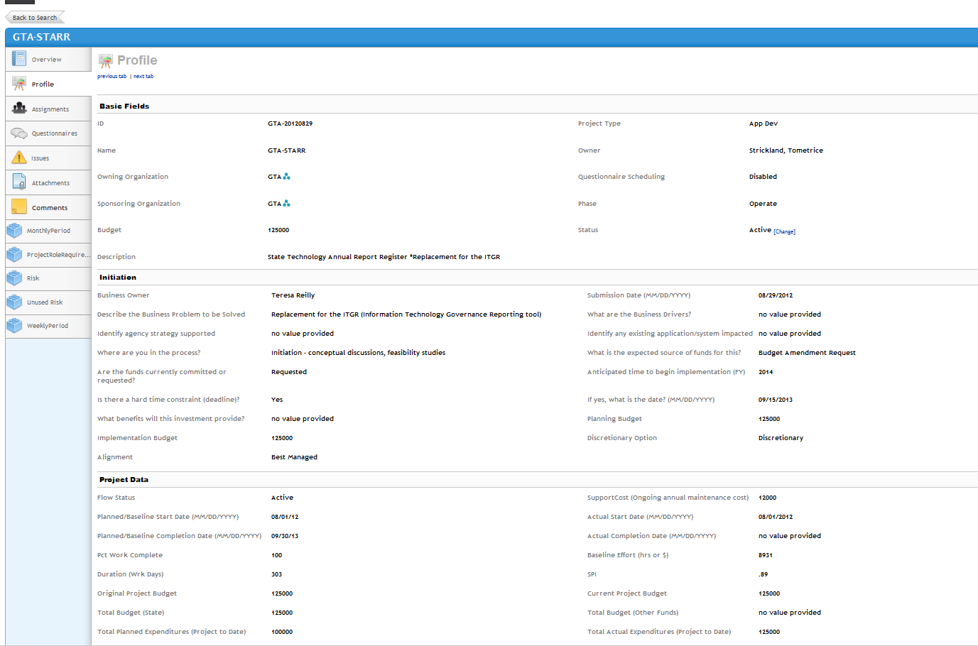
Profile Data Screens
Basic Fields
Initiation
This initiation information was previously captured in the APR. If you are using GEMS, you will no longer be required to submit a separate APR.
Project Data
Notes:
The old APR form has been replaced by completing these fields
If you are using GEMS, you will no longer be required to submit a separate APR

Slide 19
Enter Initiation Data
Business Owner: Someone in your Agency
Submission Date: Today’s Date (6/21/2014 format)
Describe the Business Problems to be Solved: Enter text
What are the Business Drivers: Enter Text
Identify agency strategy supported: Enter Text
Identify any existing application/system Impacted: Enter Text
Where are you in the process? Select from dropdown
What is the expected source of funds for this? Select from dropdown
Are the funds currently committed or requested? Select from dropdown
Anticipated time to begin implementation: Enter year YYYY
Is there a hard time constraint (deadline)? Select YES/No
If yes, what is the date: Enter 6/30/2015 format
What benefits will this investment provide? Enter Text
Planning Budget: Enter whole number Implementation Budget: whole number
Discretionary Option: Select from dropdown Alignment: Select from dropdown
Notes:
The Business Owner should be the business executive in your organization that is accountable for the success of the program this technology will support
You might want to highlight the fields that will populate the PPM dashboard so they can see the relationship later
Agency Strategy should be the strategy in your agency strategic plan that this proposal is aligned with (alignment with the state strategies is identified in a later field – “Alignment”)
Planning budget will be used primarily for federally funded projects where funding is provided through a PAPD or long-term
Define “Discretionary Option”

Slide 20
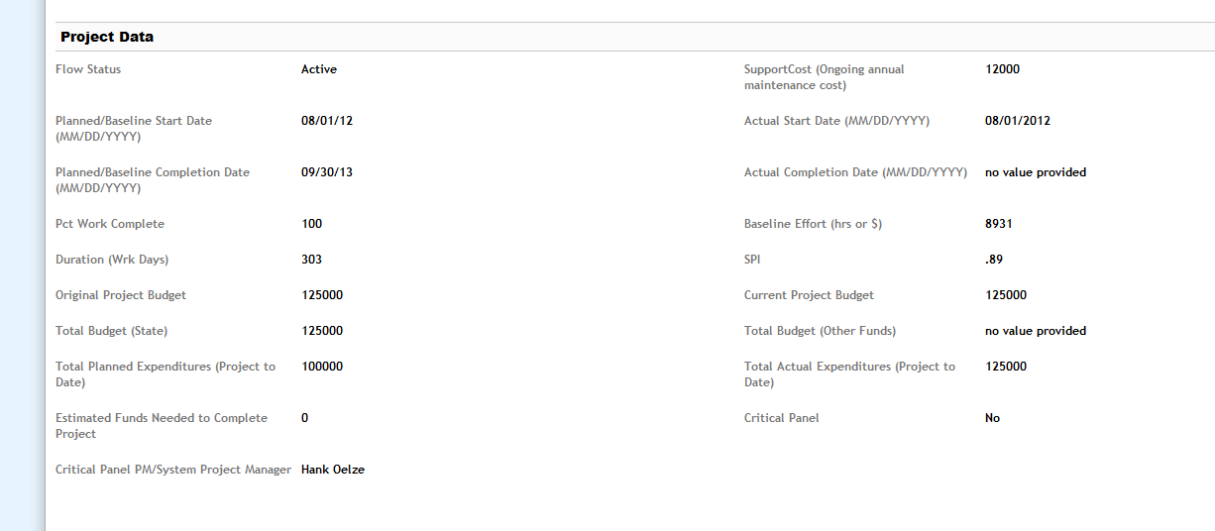
Scroll Down to Project Data

Slide 21
Enter Project Data
Many of these fields may be unknown during this planning phase of the project, if so, leave them blank.
Flow Status: Select “Proposed”* from the Drop Down
Planned Baseline Start: mm/dd/yyyy format
Planned/Baseline Completion Date: mm/dd/yyyy format
Original Project Budget:
Estimated Funds Needed to Complete Project: Enter whole dollars
Click “SAVE” on bottom right corner.
* Status must be changed to Proposed to view on Dashboard

Slide 22
Assign Resources & Roles - Video

Slide 23
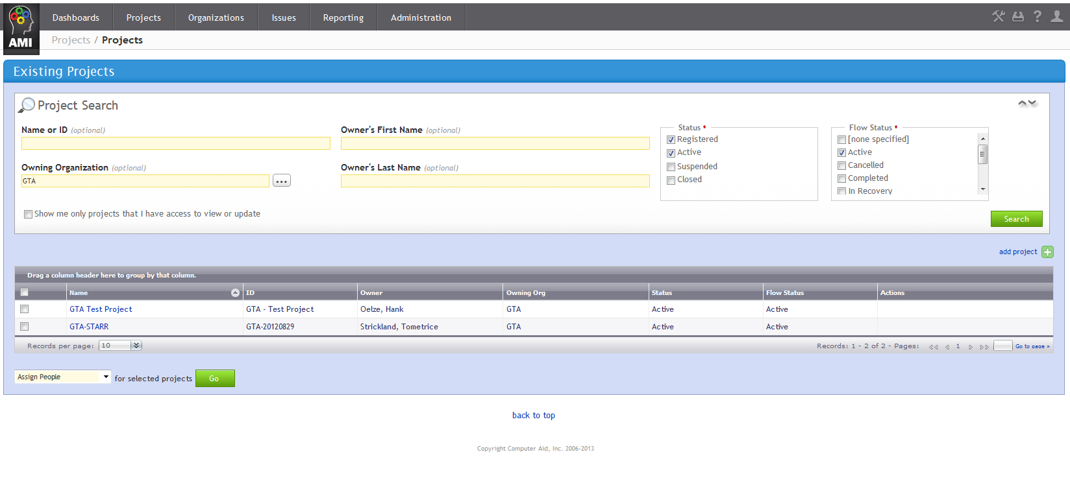
Search for Project (Proposal)
1. Select “Projects”
2. Enter search criteria (Name or Agency)
3. Click Search
4. Results

Slide 24
Select Project
Double click on the Project Name

Slide 25
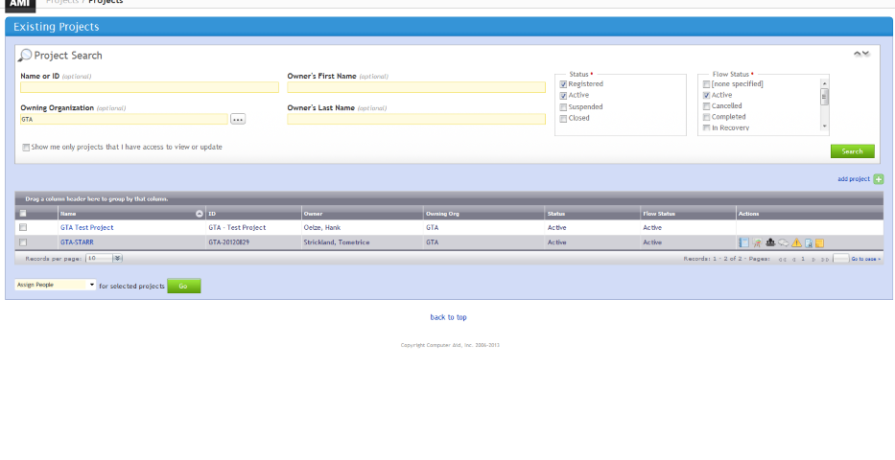
Select Assignments, Option A
Select Assignments Icon

Slide 26
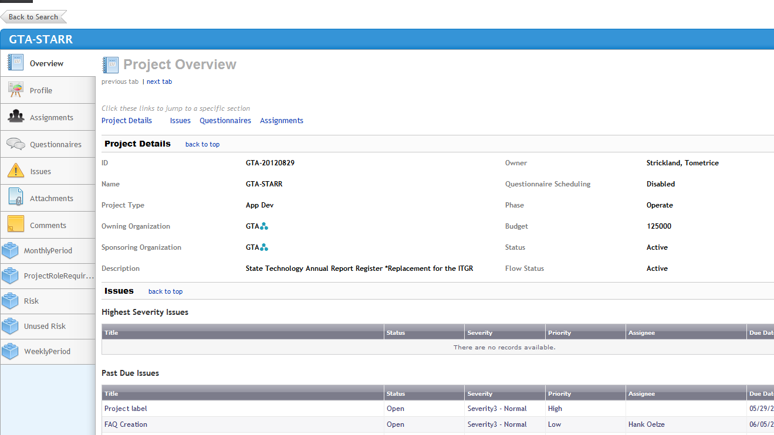
Select Assignments, Option B
Select Project & “Assignments”

Slide 27
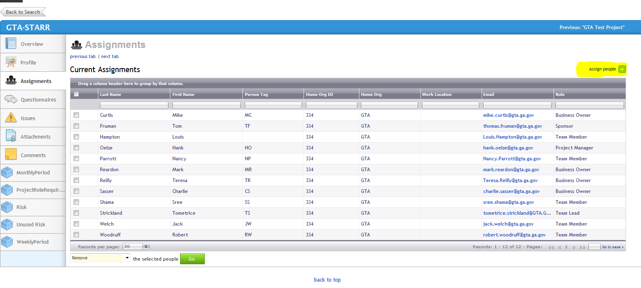
Select Assign People
Note: if the person you want to assign is not listed send their: first name, last name, organization and email address to the support team listed at the end of this presentation.

Slide 28
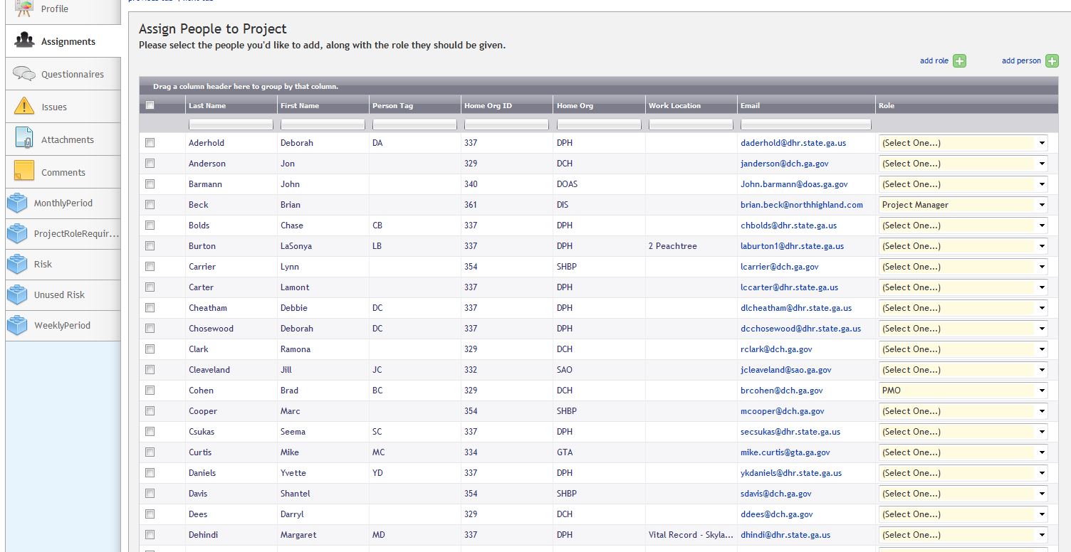
Select People & Roles
Select People and Role from Drop Down
Note: List contains all system resources
Select Assign Selected People
At a minimum, you MUST assign a Sponsor, PM/PMO, CIO and a Business Owner

Slide 29
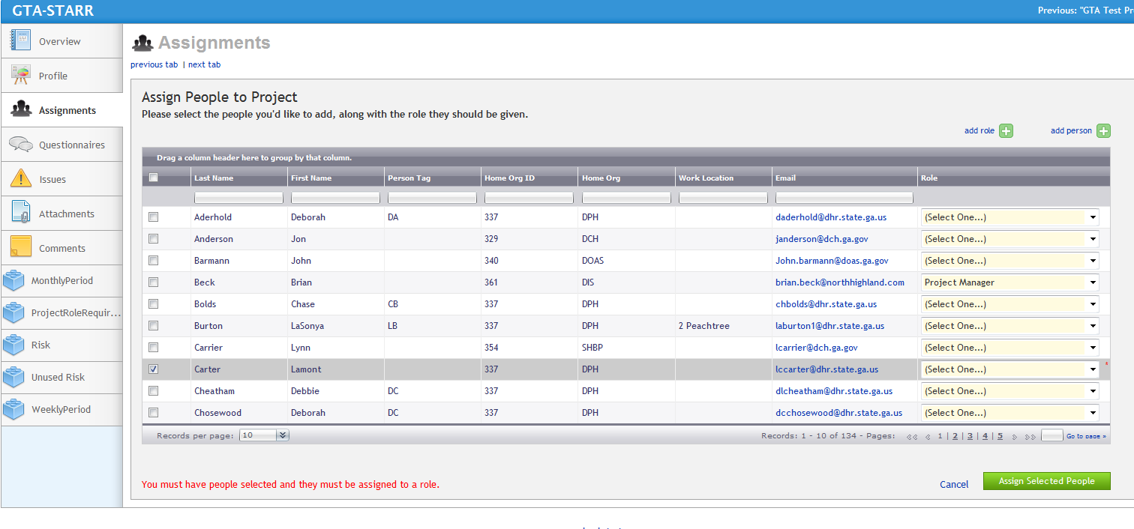
Assign All Roles and Save
All resources MUST be assigned a role in order to save.

Slide 30
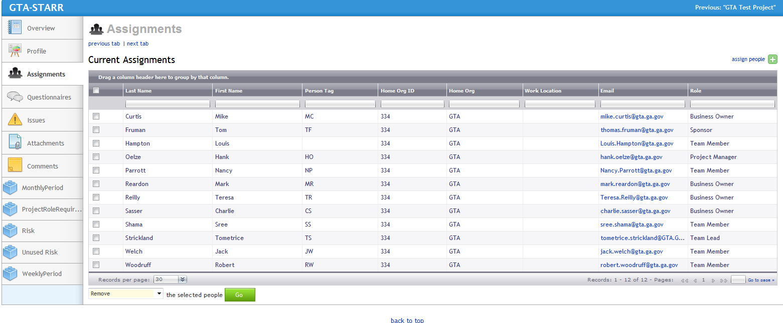
Validate Assignments
Verify People & Roles

Slide 31
Proposal Evaluation
Once the resources are assigned, they can be sent questionnaires in order to evaluate the validity of the proposal.
The questionnaires may (and should) be sent out repeatedly as the evaluation process occurs.
The PPM questionnaires are focused on the alignment of the Business Case to the proposed solution.

Slide 32
Manually Scheduling a Questionnaire - Video

Slide 33
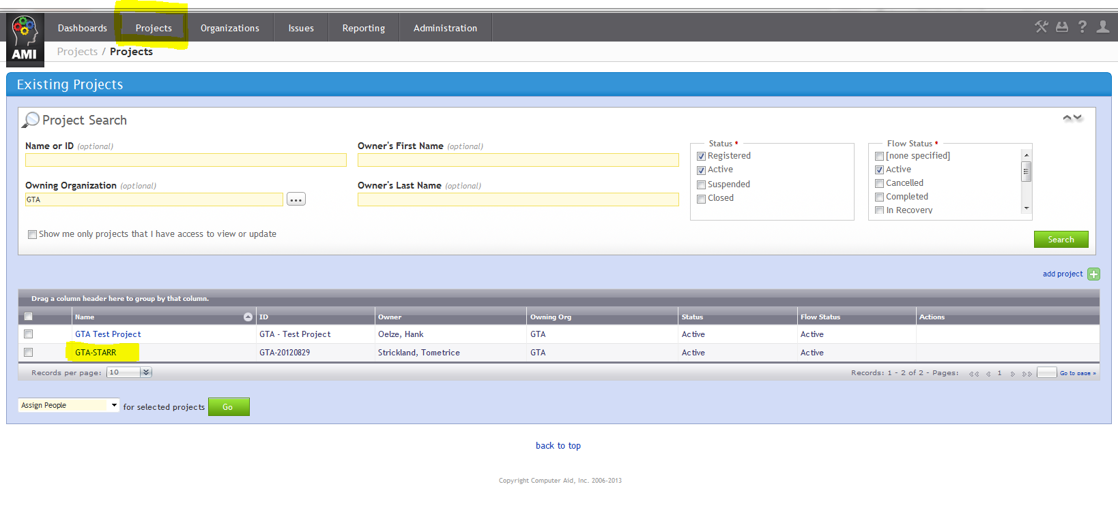
Schedule PPM Validation Questionnaire
1. Select Projects, Find/Create Projects
2. Enter your search criteria
3. Select Search
4. Double click on your project

Slide 34
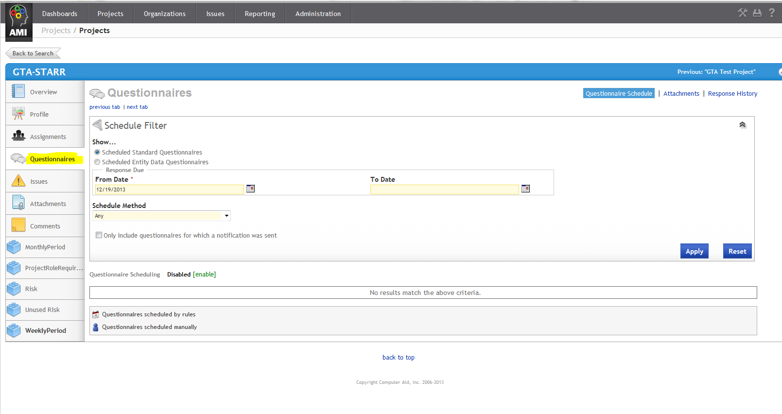
Schedule Questionnaire
Click on the Questionnaires Link

Slide 35
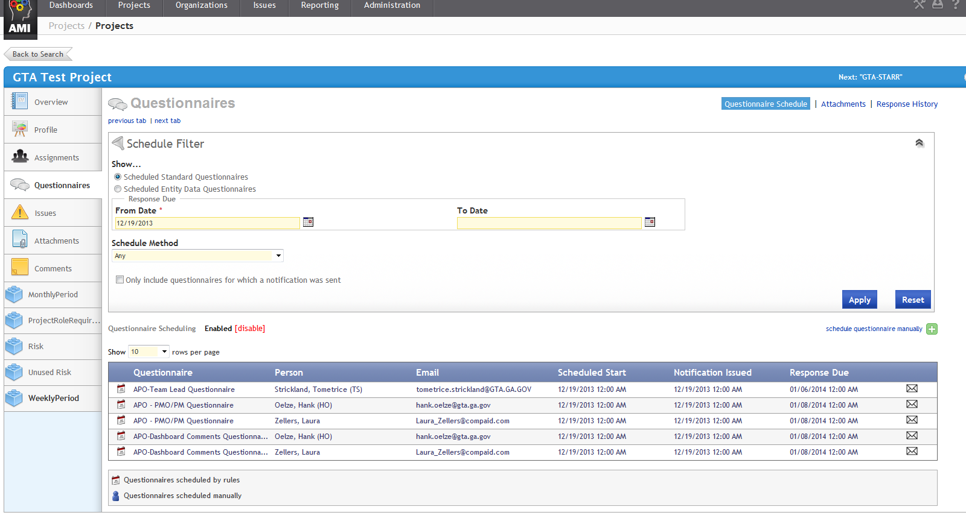
Schedule Questionnaire
Click on Schedule Questionnaire Manually button
NOTE: Initially, agencies can only schedule questionnaires manually. Event-triggered questionnaires (CPR) will be managed by GTA

Slide 36
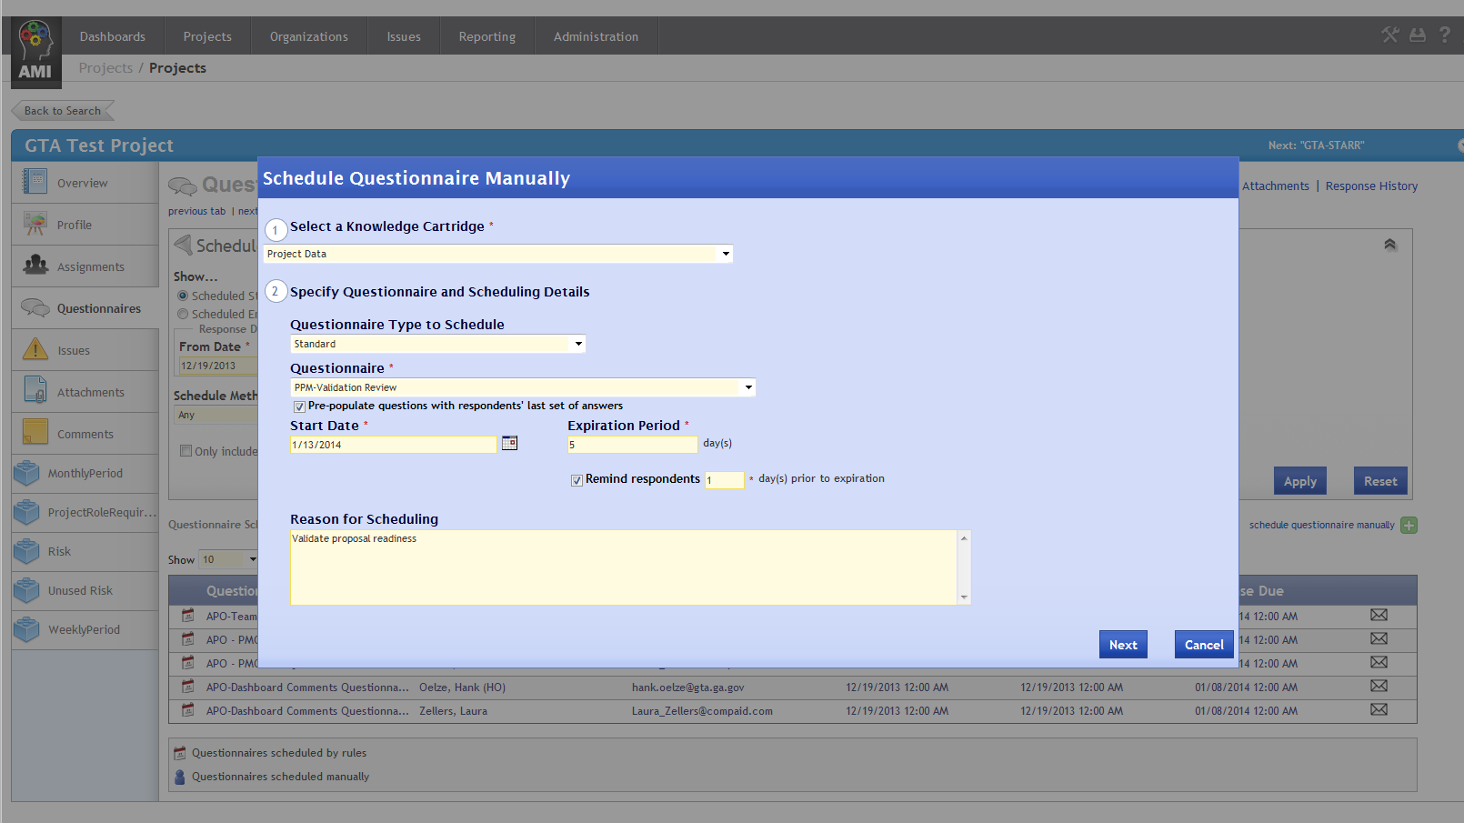
Complete Questionnaire Screen
1. Select Project Data
2. Default is Standard
3. Select PPM Validation Review from Drop Down
4. Insert today’s date
5. Enter “5”
6. Enter “1”
7. Enter the reason for Questionnaire
8. Select Next
NOTE: The system will default to having the questionnaires pre-populated with answers from earlier iterations. If you do not want this option, remove the checkmark.

Slide 37
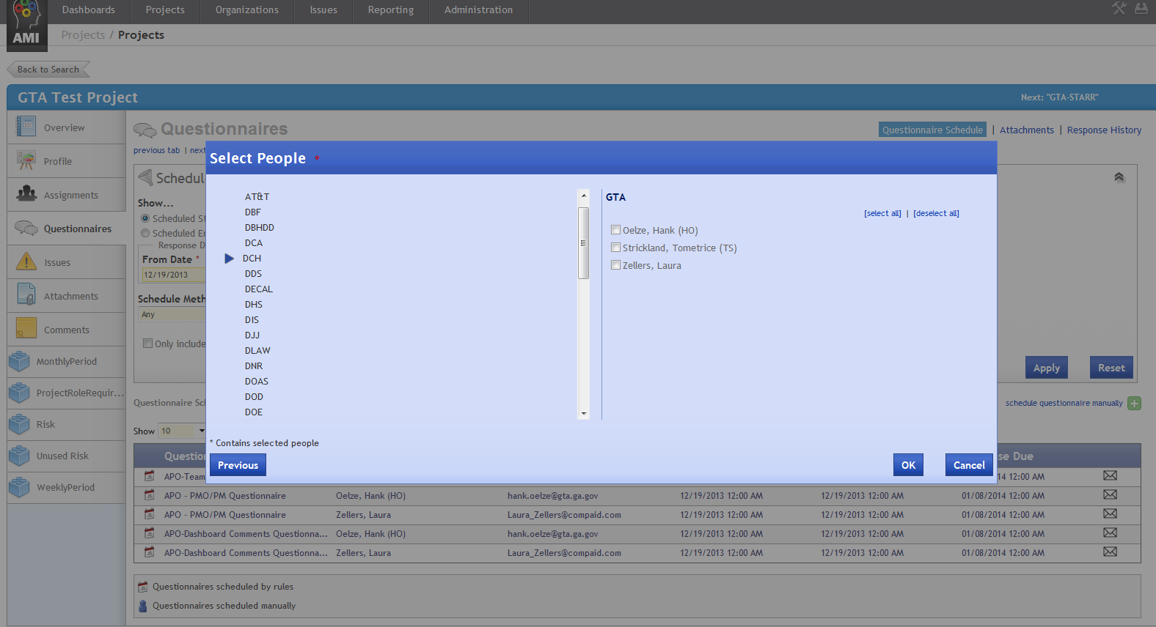
Select Respondents
2. Select Individuals to receive questionnaires
1. Select agency from Drop Down
NOTE: Only individuals assigned to the project display
Select OK

Slide 38
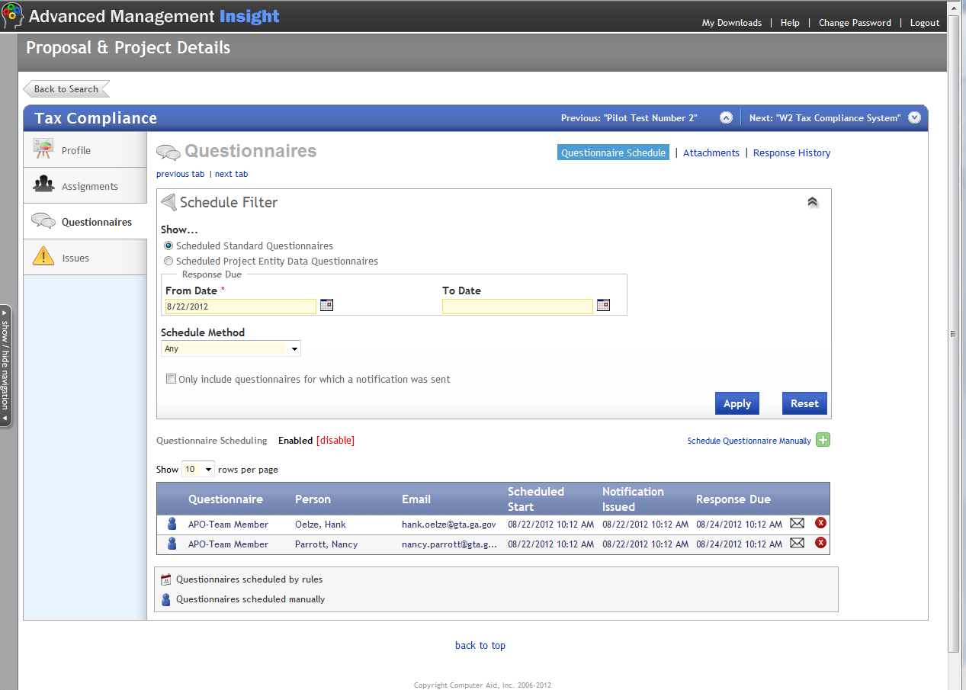
Questionnaire Validation
1. Verify: Two questionnaires scheduled

Slide 39
Responding to a Questionnaire - Video

Slide 40
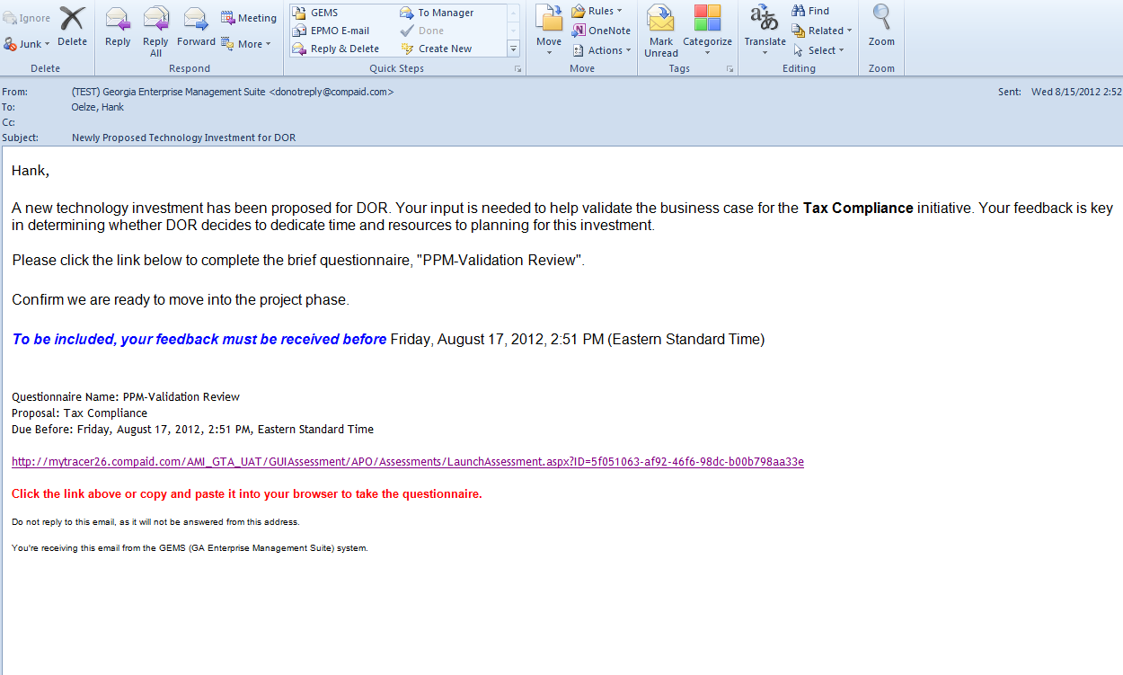
Questionnaire email
1. You will receive an automated email from GEMS
2. Verify Project
3. Verify questionnaire
4. This displays “Reason for Scheduling” text
5. Click on this link

Slide 41
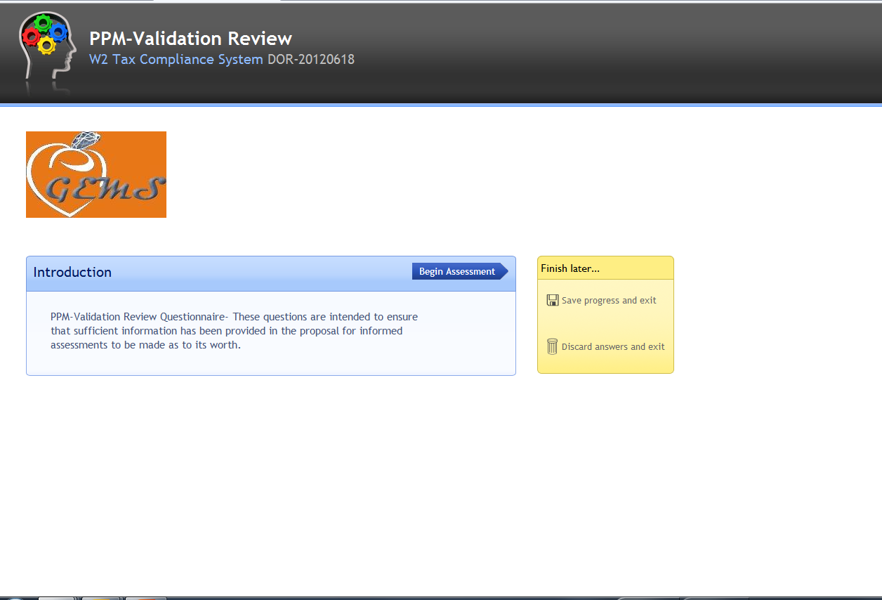
Questionnaire Response
Click on Begin Assessment

Slide 42
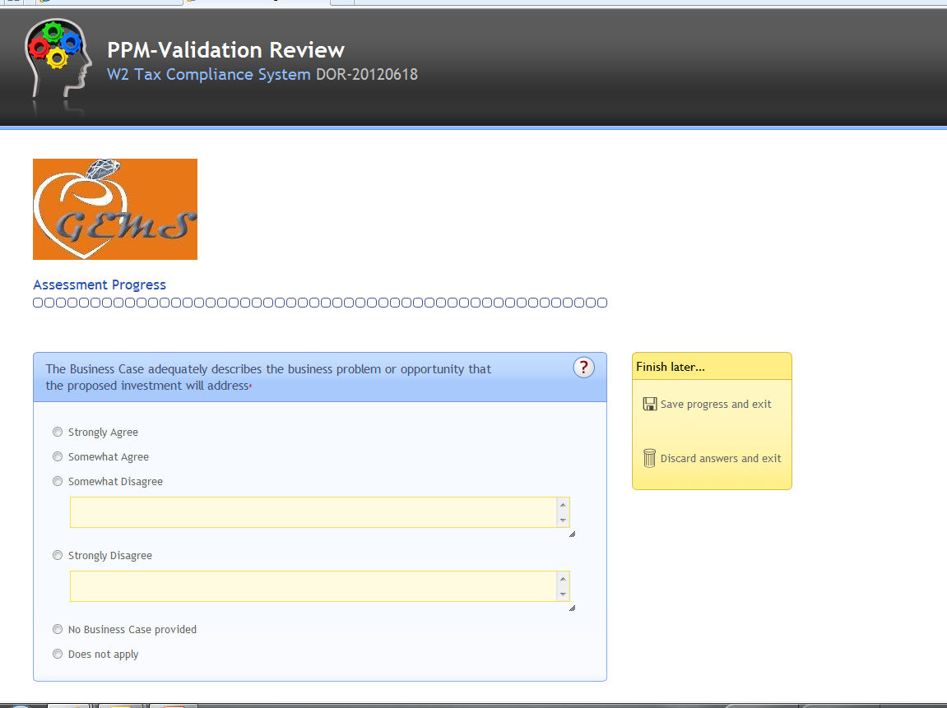
Begin Assessment
Answer All questions
NOTE: For those questions followed by a text box, text is required. The system will not allow you to move forward without entering text.

Slide 43
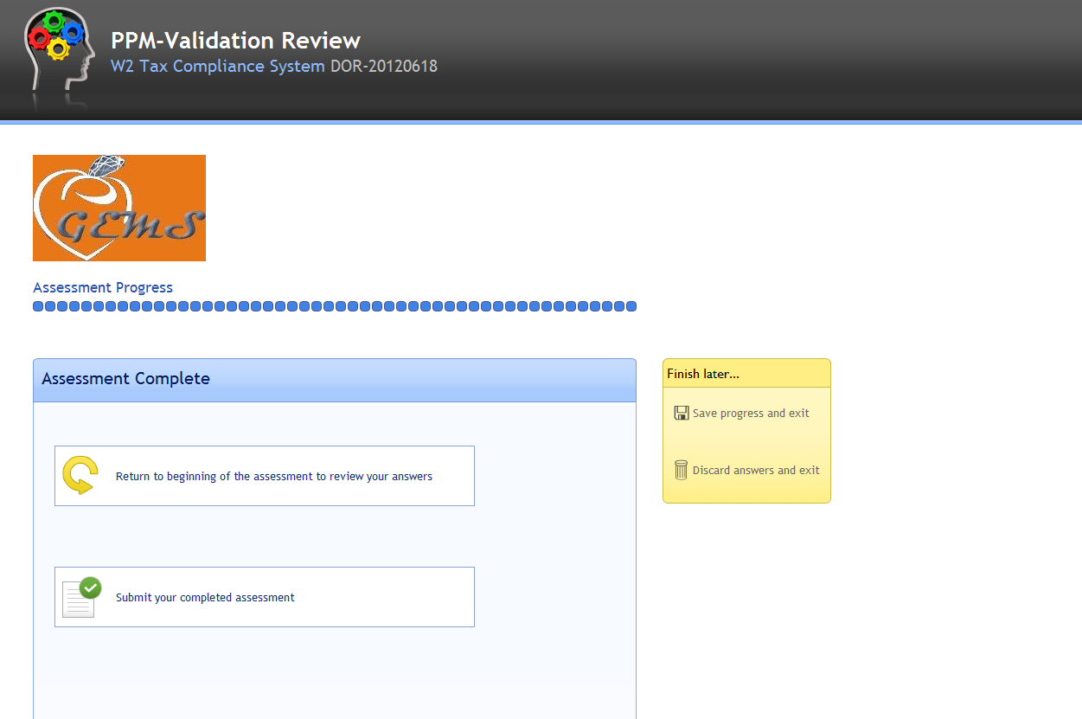
Assessment Complete
Progress Indicators
Three Options:
1. Submit
2. Save & Exit
3. Discard & Exit

Slide 44
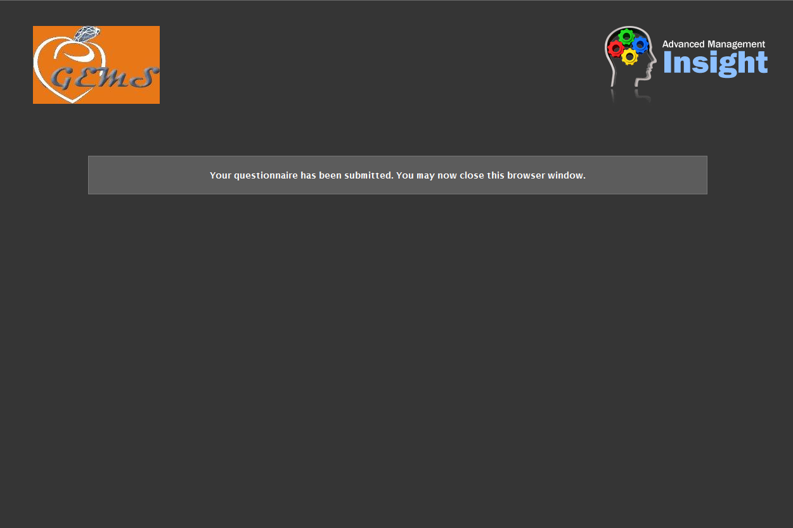
Assessment Complete
NOTE: You will need to wait until the Production site is updated (48 minutes after the hour) to view results of questionnaire response.

Slide 45
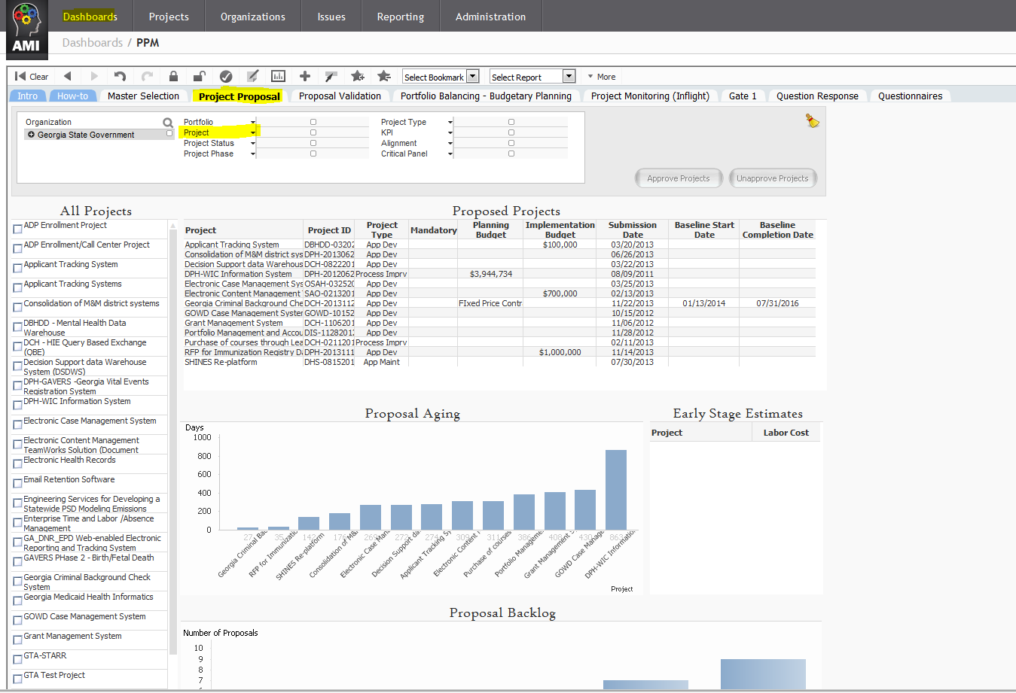
Validate Proposal Responses
2. Select the Project Proposal Tab
1. Select Dashboards, and then PPM
3. Select Project and then your project from drop down

Slide 46
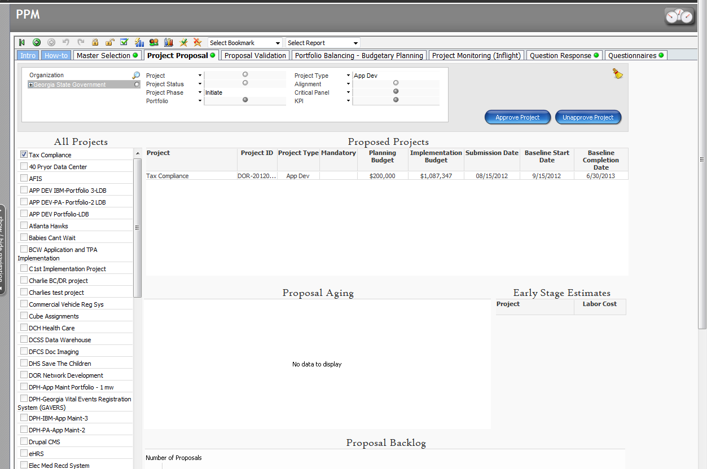
View Proposal

Slide 47
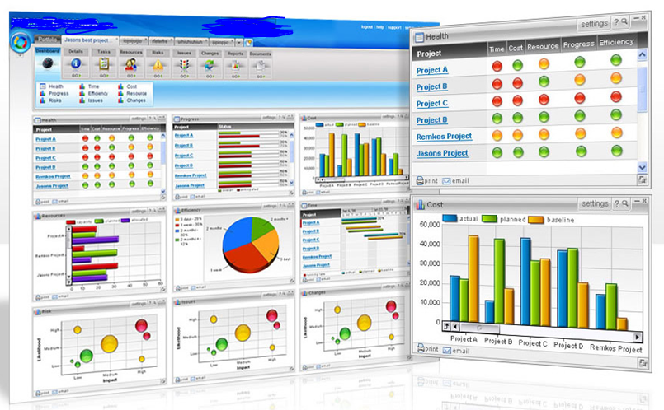
Review PPM Dashboard - Video

Slide 48
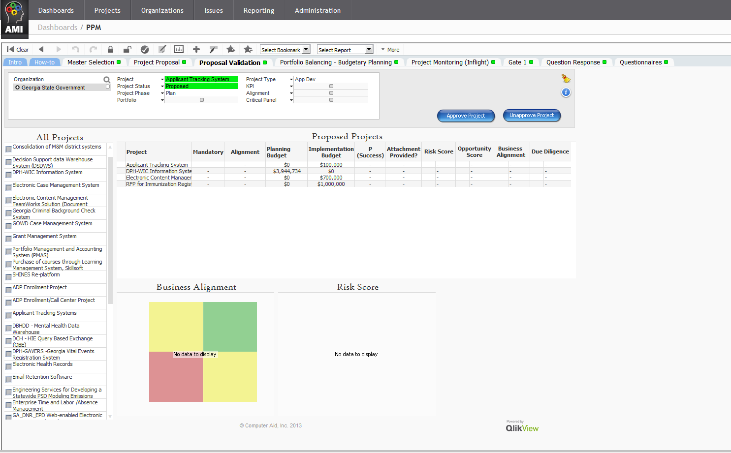
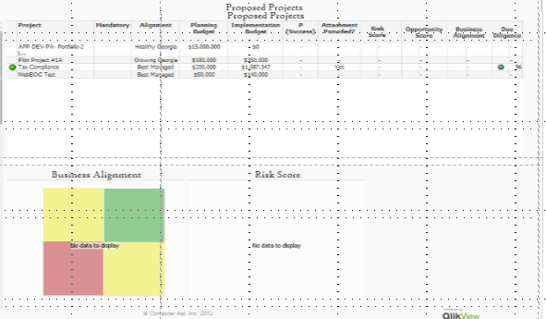
PPM Dashboard
1. Select Dashboards, PPM
2. Select Proposal Validation
2. Click on Proposal Validation Tab

Slide 49
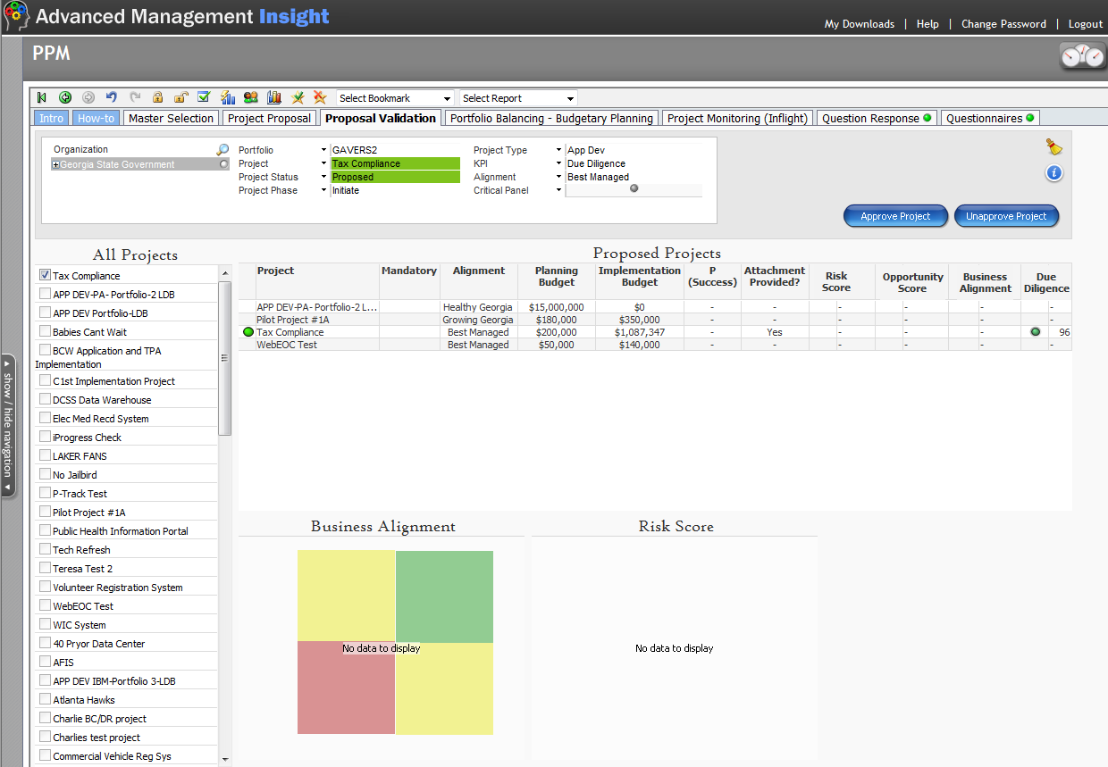
Validate Results
1. Select Project
3. Verify Attachment. (Business Case)
2. Check Overall Score
4. Confirm Due Diligence Score
5. Exit Dashboard

Slide 50
Validate Results - Video

Slide 51
Send Out Additional PPM Questionnaires
The following PPM-Specific Questionnaires should be manually sent to each of your team members. You can send a single questionnaire to multiple people. For example, the Business Owner and Business Analysts can be sent the PPM-Business-Business Owner questionnaire.
PPM-Business-Business Owner
PPM-Business-Sponsor
PPM-CIO
PPM-IT-Development
PPM-IT-Support
PPM-PMO

Slide 52
Send Out Additional Questionnaires
At this stage you may want to add additional project resources, architect roles for example, that may not have been assigned during the early initiation phase.
The process is the same, add the resource from the GEMS pool to your project and send them a manual questionnaire.

Slide 53
Verify Questionnaire Results - Video

Slide 54
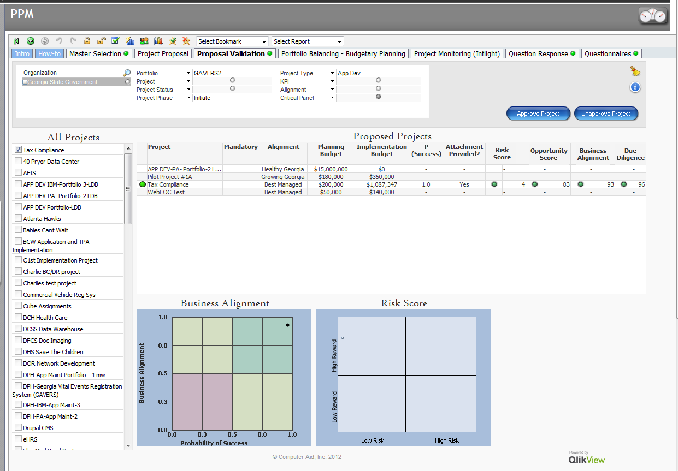
Proposal Scores
Review Scores based on Questionnaires

Slide 55
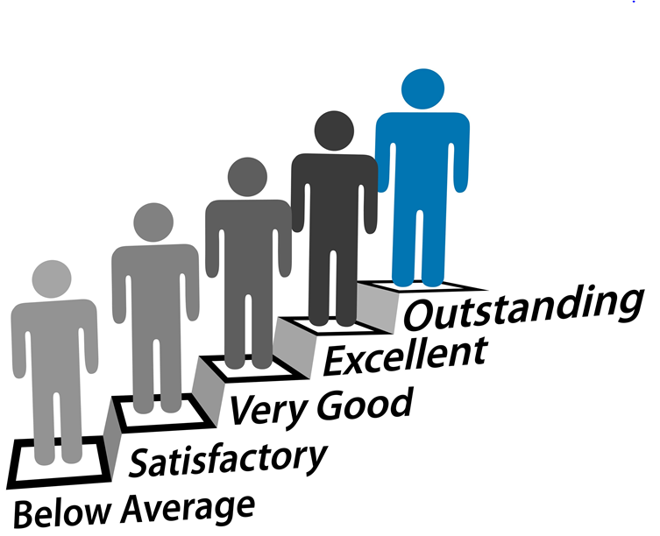
Evaluate Specific Questions - Video

Slide 56
Move from Proposal (PPM) to Project (APO)
Verify the completeness of the data.
Update Project Data as Necessary
Add additional resources and/or roles
Assign a “System PM” if your project is selected for the monthly Enterprise Critical Panel Review (name displays on CPR Dashboard)
Confirm project flow status was moved from “Proposed” to “Active”

Slide 57
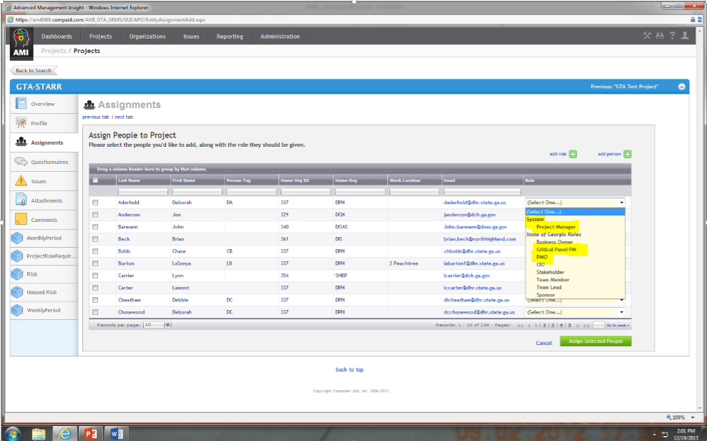
Adding a Critical Panel PM
You can assign a System Project Manager, Critical Panel PM & PMO; however the PMO will not receive the monthly PM status and comments questionnaires.
3 Separate “PM” Roles

Slide 58
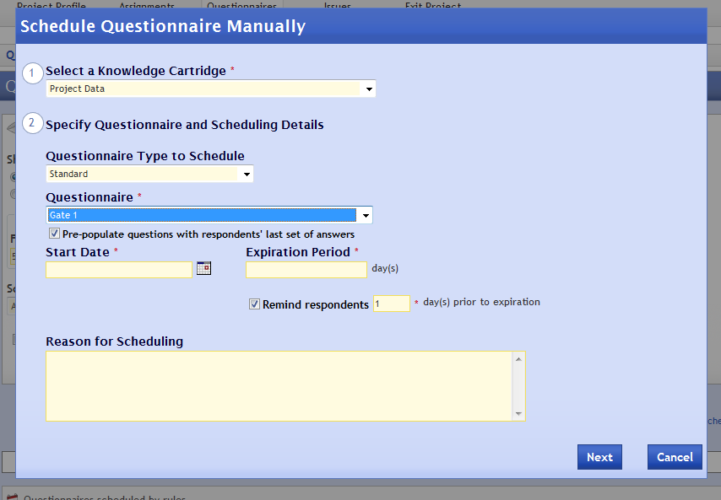
Complete Gate 1 (Major Milestone)
NOTE: 2 Options for Gate 1
Option 1:
Send a Manual Questionnaire for Gate 1 to PM

Slide 59
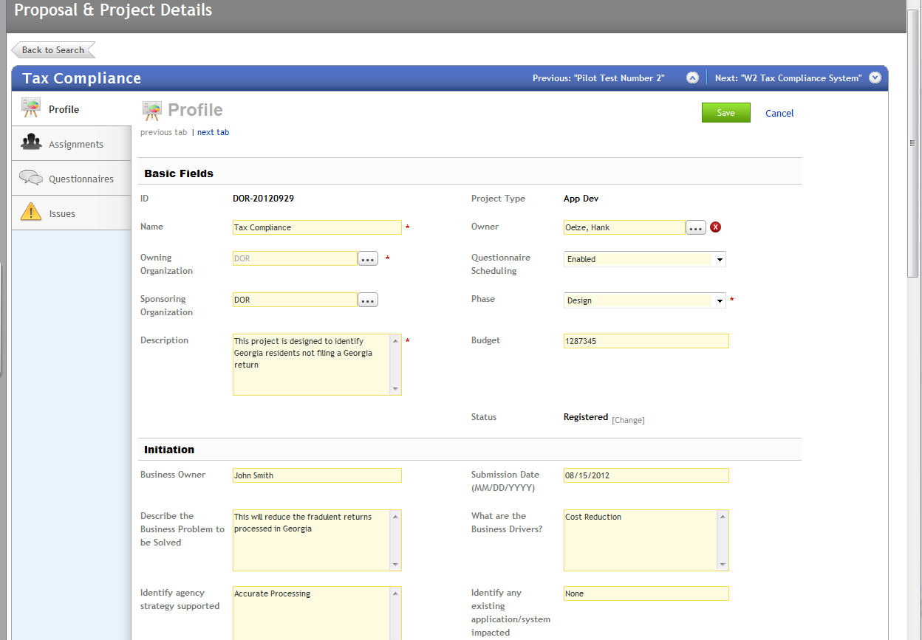
Complete Gate 1 (Major Milestone)
Option 2
Change Project Phase to Design
Gate 1 Questionnaire will automatically be sent to PM/PMO.

Slide 60
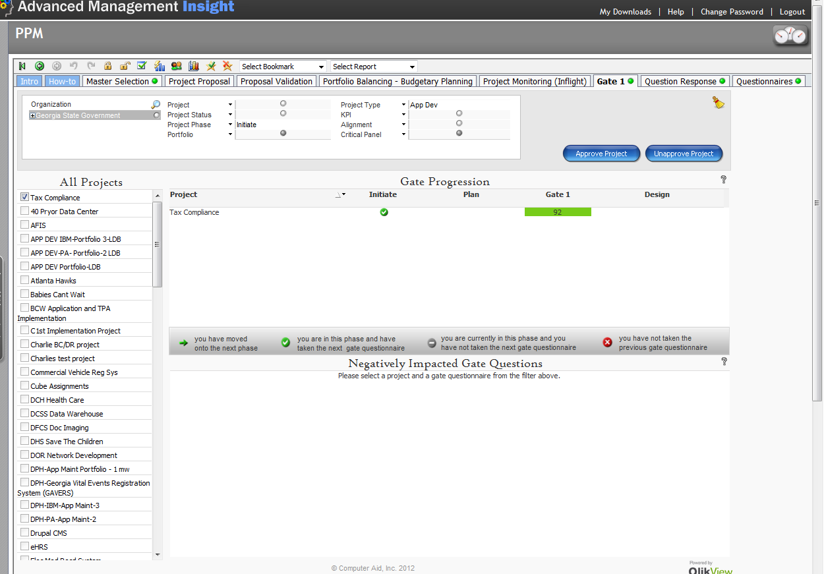
Confirm Gate 1
1. Select Dashboards PPM
2. Select Gate 1 Tab
3. Select Project from Drop Down
4. Confirm Gate Progression

Slide 61
Approve and Unapprove Projects - Video

Slide 62
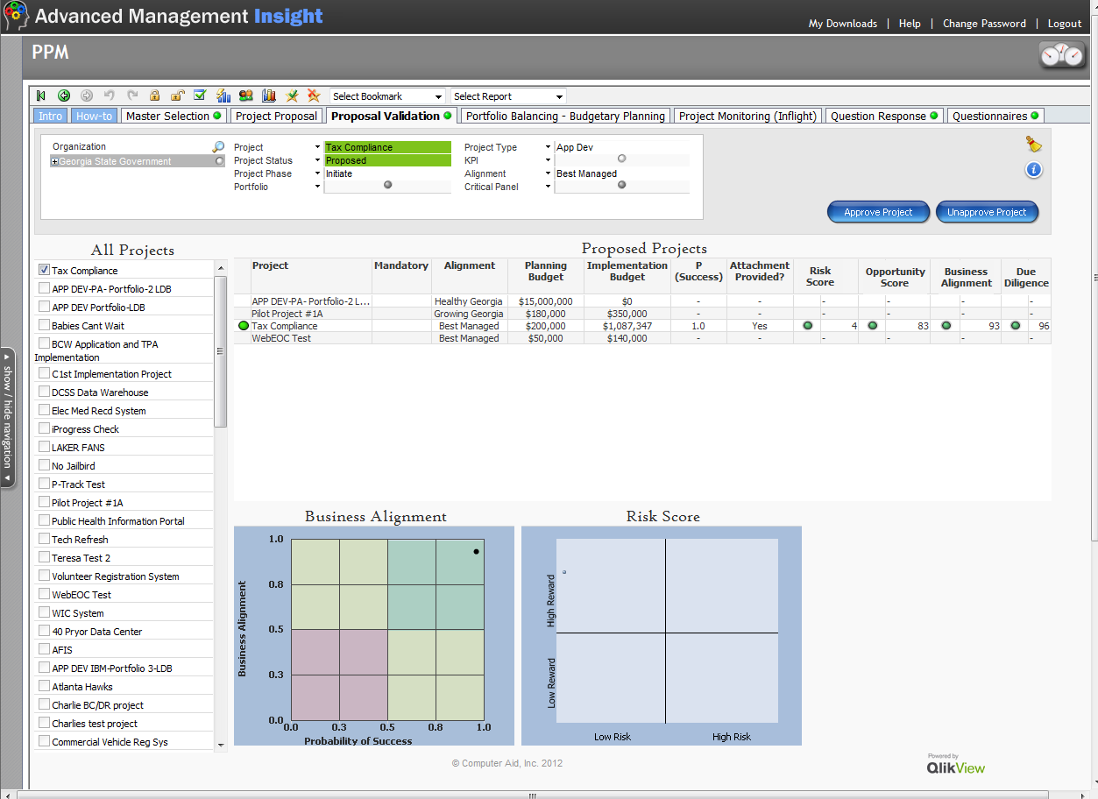
Approve Project
1. Select Proposal Validation Tab in PPM
2. Select your Project
3. Select Approve Project

Slide 63
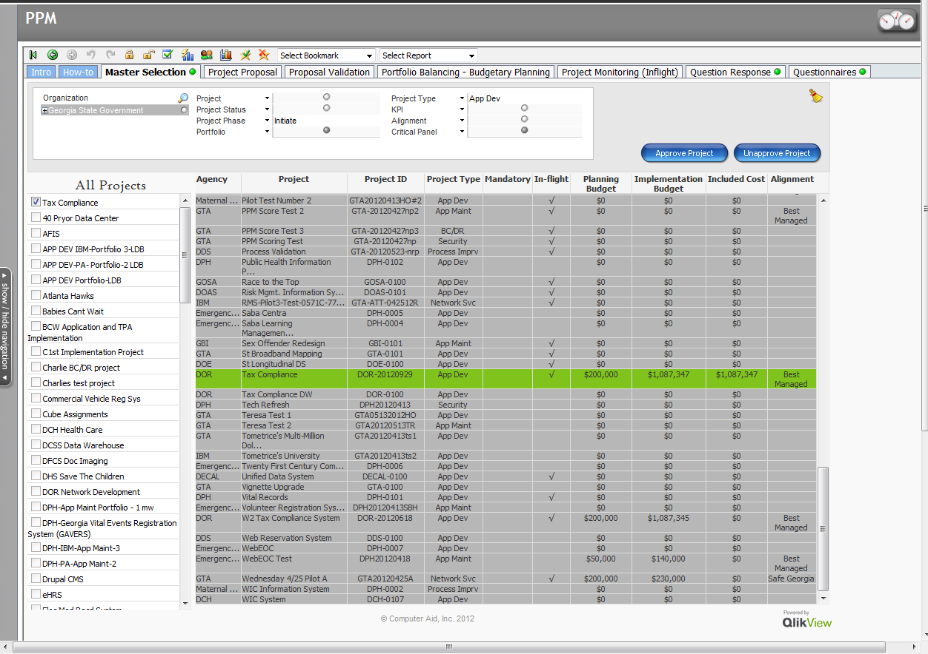
Approval Validation
1. Select Master Selection Tab
Check Mark (In-flight) = Approved Project
2. Select your Project
Note: You must wait for the refresh for the ✓ to appear

Slide 64
PPM Summary
Congratulations!
You have entered a proposal, assigned resources to evaluate the proposed project, received evaluations from key stakeholders, completed Gate 1 and approved the project.
The implementation phase and all subsequent phases are monitored through the APO (Automated Project Office) view.

Slide 65
GEMS Phase II Training
APO – New Projects Phase

Slide 66
PM Responsibilities
Monitor gate reviews
Create/change project assignments (at a minimum add a Team Lead and/or Team Member)
Review questionnaire responses
Evaluate project on APO Dashboard
Log and manage issues
Log and manage risks
Perform monthly project updates
Schedule
Budget
Critical Project Comments (as required)

Slide 67
Monitor Project - Video

Slide 68
Issue Management

Slide 69
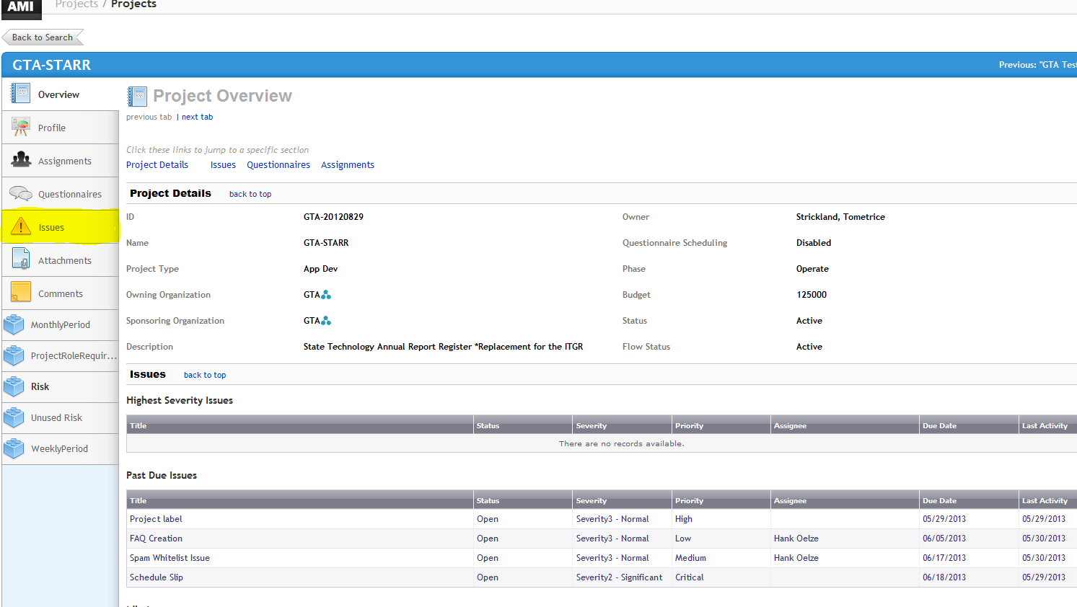
Manage Issues
1. Select your project
2. Select Issues

Slide 70
Create An Issue - Video

Slide 71
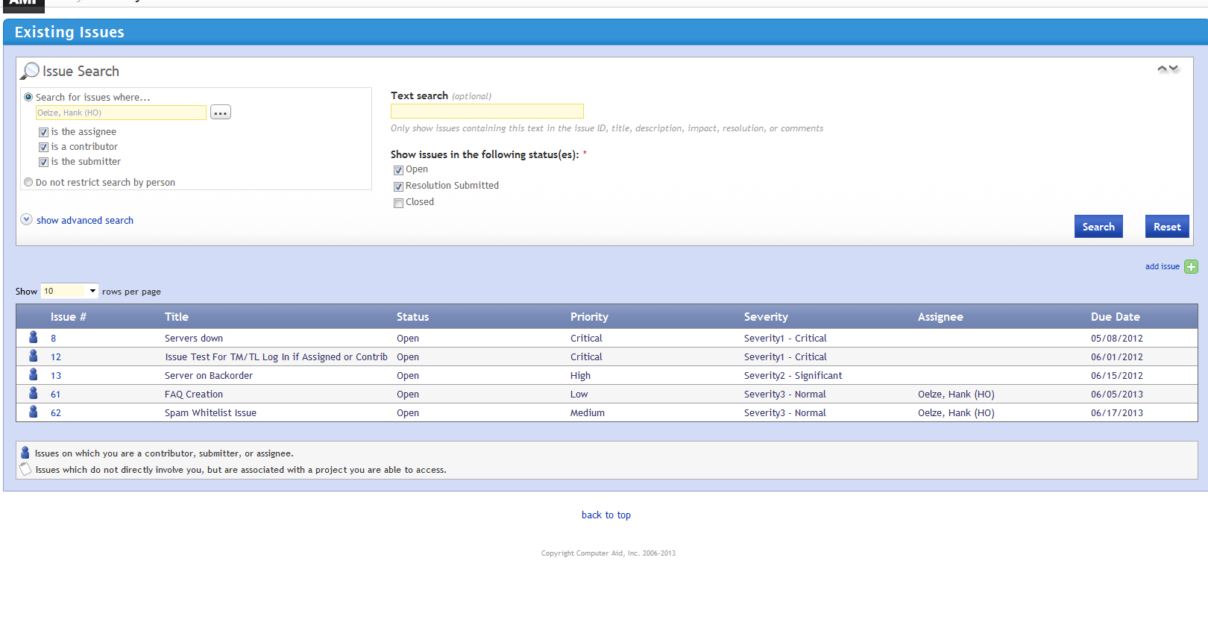
Create a New Issue
Select add issue

Slide 72
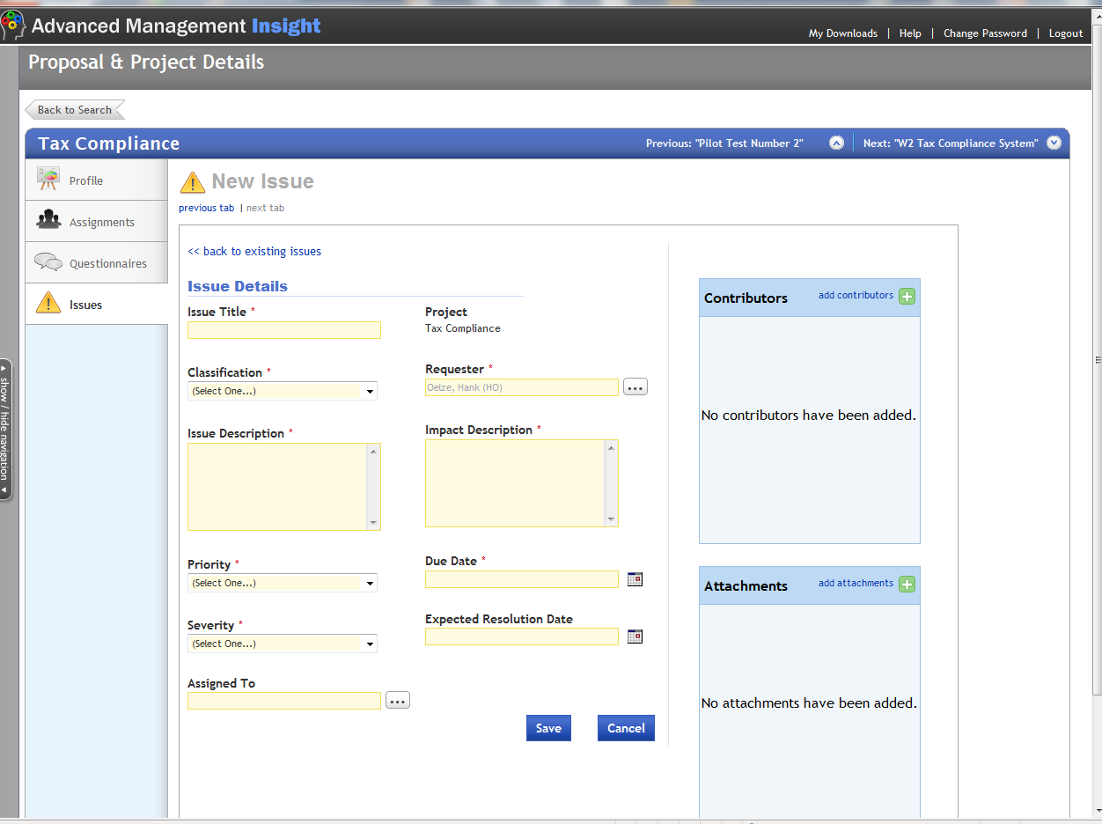
Enter New Issue
1. Enter Title
2. Enter
Classification
3. Confirm Requestor
4. Enter
Description
5. Describe Impact
6. Select
Priority
7. Enter due date
8. Select
Severity
9. Enter Resolution Date
10. Select person to resolve issue

Slide 73
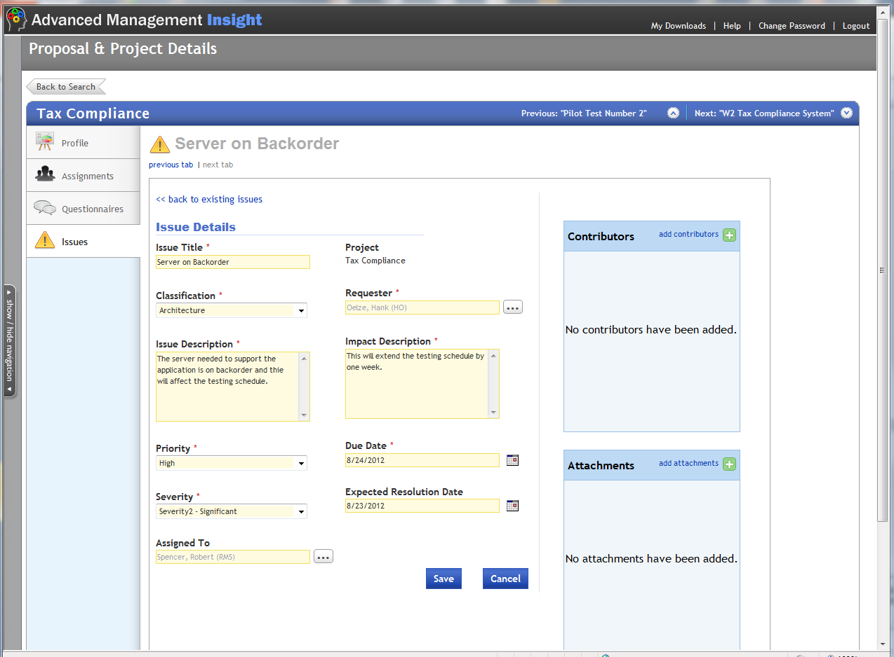
Finalize Issue
1. Add additional contributors as necessary
2. Add attachments as necessary
3. Click Save

Slide 74
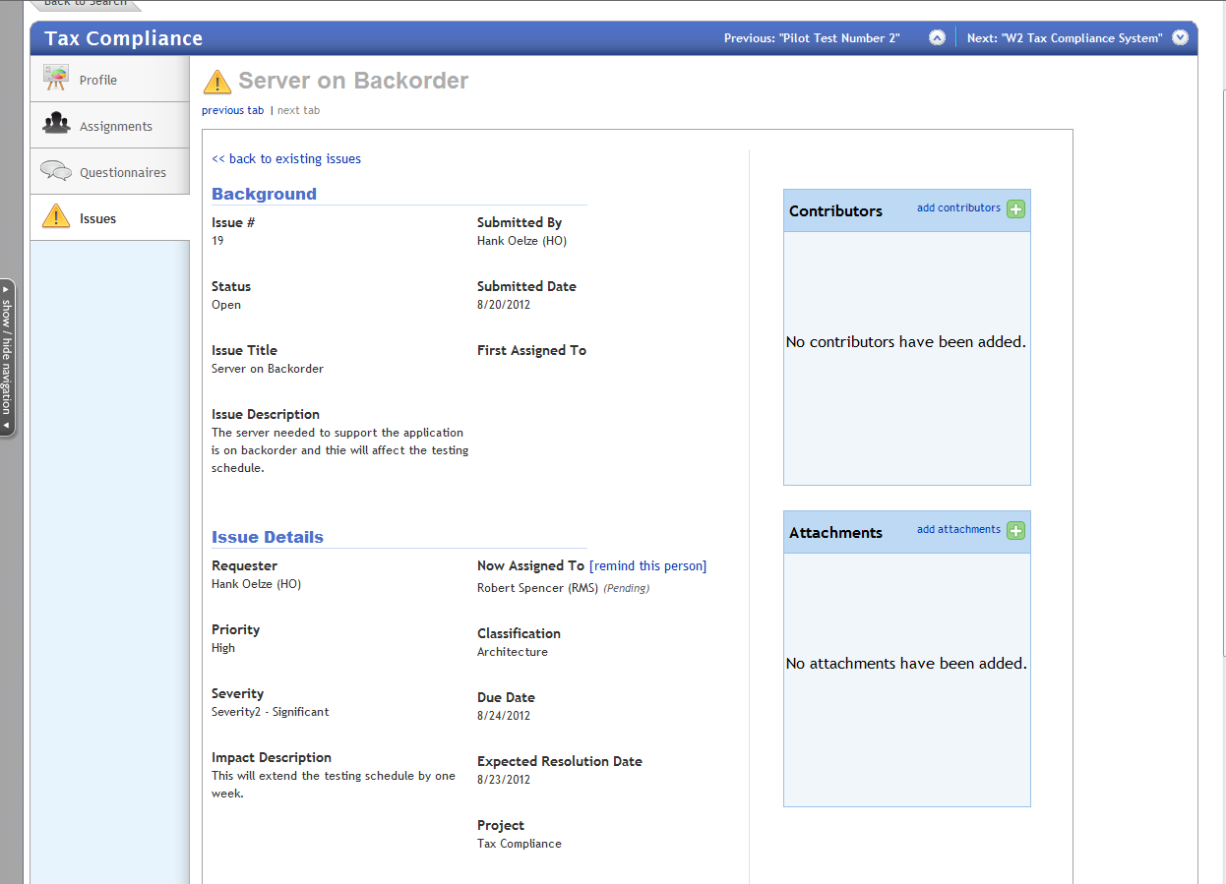
Completed Issue

Slide 75
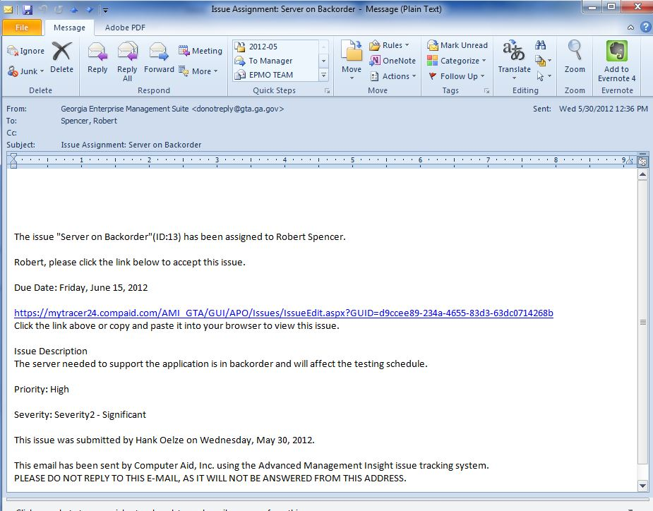
Issue Assignment email

Slide 76
Responding to Issue email notification
If you receive a notification you must either accept or reject the assignment by clicking the link on the email.
Anyone can be assigned an issue, you DO NOT need access to GEMS to accept, comment or close an issue.
Once you log in to GEMS a dialog box will display and you may enter text describing the issue resolution.

Slide 77
Issue - Update and Accept - Video

Slide 78
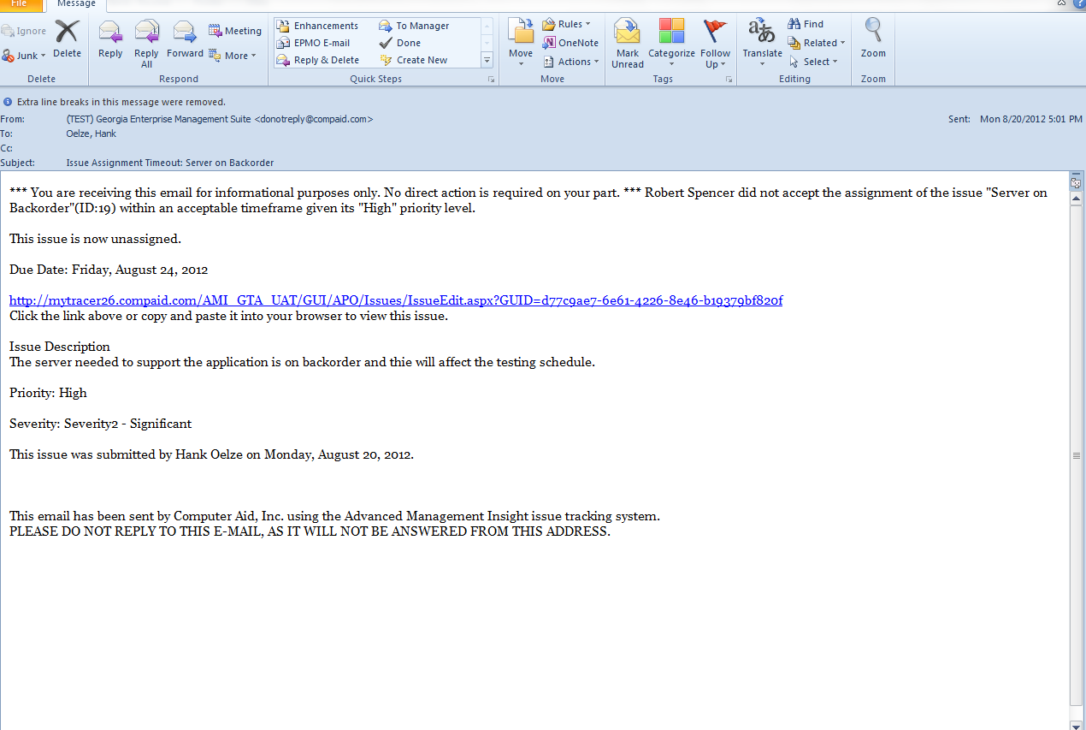
Notification of Unassigned Issue
Your action would be to reassign the Issue

Slide 79
Issue Report, Track and Close - Video

Slide 80
Issue Management
If you need to close an issue and the assignee is no longer available, assign the issue to yourself (as PM). You then have the ability to reassign or close the issue.
Issues should be reviewed once a month, at a minimum.

Slide 81
Risk Management

Slide 82
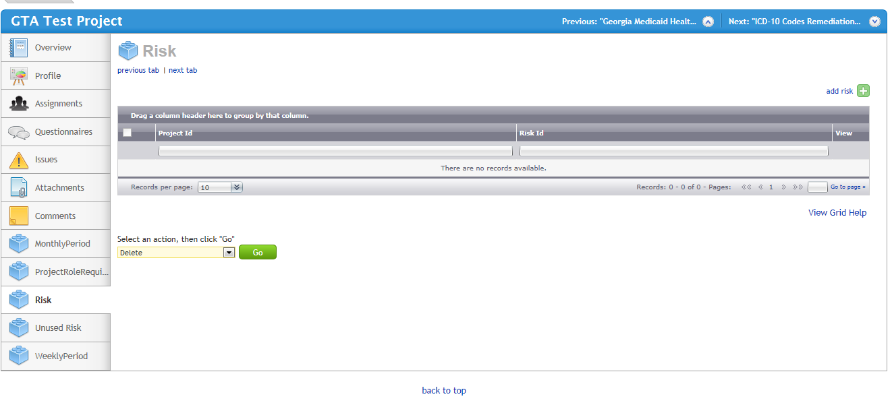
Risk Management - Option 1 Keyed
Select add risk
Select the Risk Tab

Slide 83
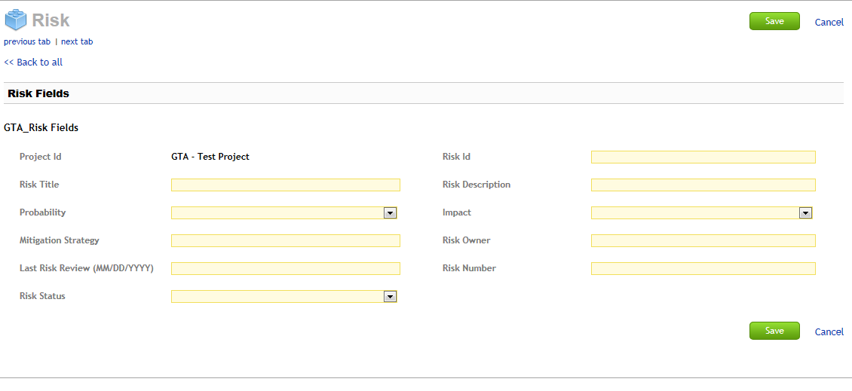
Risk Management - Option 1 Keyed
Select Save when complete
Select add risk
Complete all fields
Update monthly
Select the Risk Tab
Repeat process for all key risks

Slide 84
Risk Management - Option 2 Import
Best method for 10+ risks
You must use the standard template (Excel) it contains dropdowns to facilitate the import
Mandatory Fields (cannot exceed 255 characters in length):
Project ID Mitigation Strategy
Risk Id Risk Owner
Risk Title Last Risk Review
Risk Description Risk Number
Probability Risk Status
Impact
Save your Excel file as a CSV (Comma delimited)
Risks can be imported as often as necessary or you can update via Risk tab

Slide 85
Import the Risk Log
1. Select Administration
2. Select Data Import

Slide 86
Import the Risk Log
1 Select Risk (Project Data) from drop down
2 Browse for your CSV file
3 Select GTA Risk Fields Option

Slide 87
Import Screen
1. Confirm Content
Select Import

Slide 88
Import Confirmation
Select OK

Slide 89
Check Import Activity
Current Risk Log Import Status
Completed Imports
NOTE: Selecting the magnifying glass will display reason for failed imports.

Slide 90
View or Print Risk Log
2. Select Risk Tab
1. Select Dashboards, APO
3. Select Project
4. Right Click in Risk Log to copy, print or export.

Slide 91
PM Monthly Updates
Use GEMS to Assess Project Health
Revise Project Assignments as Necessary
Schedule and Ensure Completion of Questionnaires
Update project (key project data or Profile Questionnaire)
Update Risk Log
Update Issues

Slide 92
Printing Blank Questionnaires
2. Select Questionnaire Details
1. Select Reporting

Slide 93
Select the Questionnaire
1. Select Project Data
2. Select the Questionnaire
3. Select Refresh
4. Dropdown, you can save as Excel, PDF or Word. PDF is best.

Slide 94
Stage Gate Review Process
There are Two methods to Execute a Stage Gate Review
The PM manually initiates a Gate Questionnaire
The project moves into a new phase: (Next Slide)
Gate 1 > Design
Gate 2 > Develop
Gate 3 > Deploy
Gate 4 > Operate

Slide 95
Stage Gate Review Process
PM Moves the Project to the Next Phase

Slide 96
Monitor Project - Video

Slide 97
Additional PM Monthly Updates
Update Project Schedule and Budget Data. Information can be keyed into the Project Data or loaded via the Project Profile Questionnaire.
Planned Baseline Start Date
Actual Start Date
Planned Baseline Finish Date
Actual Finish Date
Percent Work Complete
Baseline Effort
Duration
SPI
Total Budget (State)
Total Budget (Other Funds)
Total Planned Expenditures
Total Actual Expenditures
Estimated Funds Needed to Complete

Slide 98
Required Project Schedule Data
Summary data from your project plan is entered into GEMS
Baseline Start
Actual Start
Baseline Finish
Actual Finish
% Work Complete
Baseline Work
Duration
SPI

Slide 99
Schedule & Budget Data Entry in GEMS
Fields Requiring Monthly Updates

Slide 100
Scorecards and KPIs - Video

Slide 101
Project Schedule Request
Dashboard Comments Questionnaire
Specific Request
Do NOT Attach File From Here

Slide 102
Project Schedule - Attachments
Select add attachment
Select the Attachments tab
Locate your project schedule via the Browse, change Description and Attachment name to reflect “GEMS Project Name & Date”, example, STARR 05.30.14.
Select “Add”

Slide 103
Monitor Questionnaire Responses
Remember – Questionnaires drive the dials.
You, as the PM, should monitor the responses to ensure there are no surprises.
The responses should be evaluated before you enter your monthly comments.

Slide 104
Key Performance Indicators
Communication
Quality of communication, both upwards and downwards
Level of training for customers/users
Sufficiency of project status reporting to all stakeholders
Requirements defined and communicated well enough to move forward
Cost
Confidence that budget contingency amount is sufficient
Sustainability model that is defined and regularly reviewed
Project-to-date costs meeting expectations
Issue Management
Effectiveness of issue management occurring
Escalation path in place for all issues
Timely resolution of issues

Slide 105
Key Performance Indicators
Quality
Acceptability of deliverables reviewed during last reporting period
Satisfaction with quality of work product to date
Success criteria well defined
Risk Management
Effectiveness of risk management occurring
Documented response strategies for risks
Level of risk carried by the project
Schedule
Confidence in viability of the schedule
Performance against the schedule (SPI)
Changes to schedule expectations
Submission of schedule into tool

Slide 106
Reviewing Questionnaire Responses - Video

Slide 107
Critical Panel Requirements
Revise Project Assignments as Necessary
Ensure Completion of Questionnaires
Update Risk Log
Update Issues
Update and Attach the Project Schedule
Update Project Data (Information can be keyed into the Project Data or loaded via the Project Profile Questionnaire)
Complete Dashboard Comments Questionnaire
Update Portfolio/Program Comments (if applicable)

Slide 108
Critical Panel View
2. Select Project
1. Select Critical Projects Tab
3. Dials are driven by Questionnaires ONLY
5. Comments Are Directly From Dashboard Comments Questionnaire
4. Six Month Trend
250 Character Max

Slide 109
Critical Panel Timeline (Approximate)
7 days
Ensure All Questionnaires are Answered
5 days
Review Answers and Identify Exceptions
3 days
Review results with Management (and IV&V if applicable)
1 day
Complete Comments Questionnaire
CPR
GTA Dashboard Due Date

Slide 110
GEMS Quality Control
Sent monthly to the PM
Repeated errors are escalated to CIO, Agency Head
Checklist includes questionnaire respondent list
Schedule (.mpp) is also QC’d

Slide 111
GEMS Quality Control
Disclaimer: This data was not updated
NOTE: If your project is not updated by the due date, the previous months CPR View will be included in the CPR binder with this disclaimer.

Slide 112
Additional GEMS Training Resources
Online Help

Slide 113
GEMS Training Videos
Select Help
All Videos are Available

Slide 114
GTA EPMO GEMS Toolkit
Each agency will be provided a thumb drive containing the following:
This PowerPoint Presentation
Individual Training/Test Scripts
Sample project plan
Risk Logs in both .xls and .csv format
Sample Business Case
All videos linked to this presentation
Information on how the scores are computed
EPLC Process Maps
Project Schedule and Budget updates to GEMS

Slide 115
GEMS Support
Hank Oelze, hank.oelze@gta.ga.gov
O: 404-463-5303
C: 404-782-2743
Tometrice Strickland, tometrice.strickland@gta.ga.gov
O:404.463.8474
C: 404.207.0301

Slide 116
Questions

Slide 117
Portfolio/Program Comments
The following slides pertain to agencies that manage projects at a Program and/or Portfolio level and need to provide comments on each KPI on their respective dashboards.
Comments remain on your dashboard until you manually update the comments. For example, the Cost KPI dashboard dial displays within the green area in June and within the yellow area in July. Unless you manually change the comment before the Critical Panel review meeting, the comment will still reflect June’s KPI results.

Slide 118
Creating a New Portfolio/Program
Select Projects
Select Portfolios

Slide 119
Creating a New Portfolio/Program
Select add portfolio

Slide 120
Creating a Static Portfolio/Program
Select Static Portfolio
Create Name
Select Active
Short Description
Select Save
Move Projects from Available to Included

Slide 121
Adding Portfolio/Program Comments
As of 12/31/13: Enter comments
Select Portfolio
Select KPI
Enter Comments, (for Overall KPI, add as of date)
Select Save

Slide 122
Portfolio/Program Comments
Select CPR View
Select Portfolio
Review Comments
Note As Of Date

Slide 123
GEMS Support
Hank Oelze, hank.oelze@gta.ga.gov
O: 404-463-5303
C: 404-782-2743
Tometrice Strickland, tometrice.strickland@gta.ga.gov
O:404.463.8474
C: 404.207.0301

