Slide 1
    State Technology Annual Report Register (STARR)
    CIO Training

Slide 2
Training Agenda
STARR Overview Training
  STARR Roles
  STARR Data Collection Timeline
  STARR Role Based Training (CIO)
    Application Inventory Questionnaire
    IT Spend Questionnaire
    Secure, Reliable, Sustainable (SRS)Maturity Questionnaire
  Helpful Tips
  When to Contact Agency Super User
  Questions

Slide 3
STARR Roles
Agency Super User
  agency point of contact for STARR
  responsible for the agency profile questionnaire
  has the ability to produce reports
Business Owner (BO)
  answers questionnaire on Secure, Reliable, and Sustainable Maturity (SRS Maturity)
Business Continuity Planner (BCP)
  answers questionnaire regarding business continuity planning

Slide 4
STARR Roles
Senior Agency Information Security Officer (SAISO)
  answers questionnaires regarding agency IT systems and security
Chief Information Officer (CIO )
  answers questionnaire regarding business application inventory
  answers questionnaire about agency IT Spend
  answers questionnaire on Agency Maturity (SRS)
Chief Financial Officer (CFO)
  answers questionnaire on the agency IT Spend
Agency Head / Commissioner
  will receive a questionnaire to validate agency IT information

Slide 5
STARR Schedule

Slide 6
STARR Application Inventory
Data is prepopulated from last year’s data
We are only tracking applications that you use to run your business
Update FY to 2014 and you must enter mandatory fields (*)
New Enhancements
New cost fields have been added for SaaS/Hosted Solution, License Fees/Maintenance Costs and Other Application Costs.
The “I Certify” questions have been removed.
Help Text is included for each question.
The questions are grouped (General, Technical, Application Cost and Security) to facilitate responses.

Slide 7
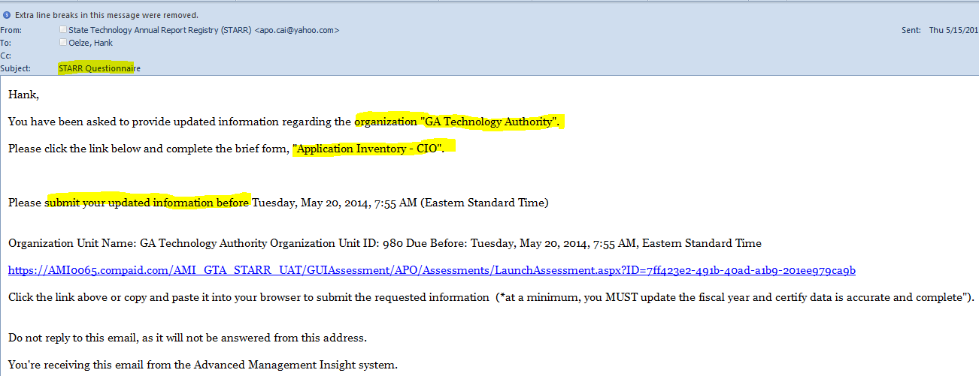
Sample App Inv CIO Email
State Technology Annual Report Registry (STARR)
Your Agency Name
Questionnaire Type: Application Inventory – CIO”
Expiration date of questionnaire
Click on Link to launch your specific questionnaire

Slide 8
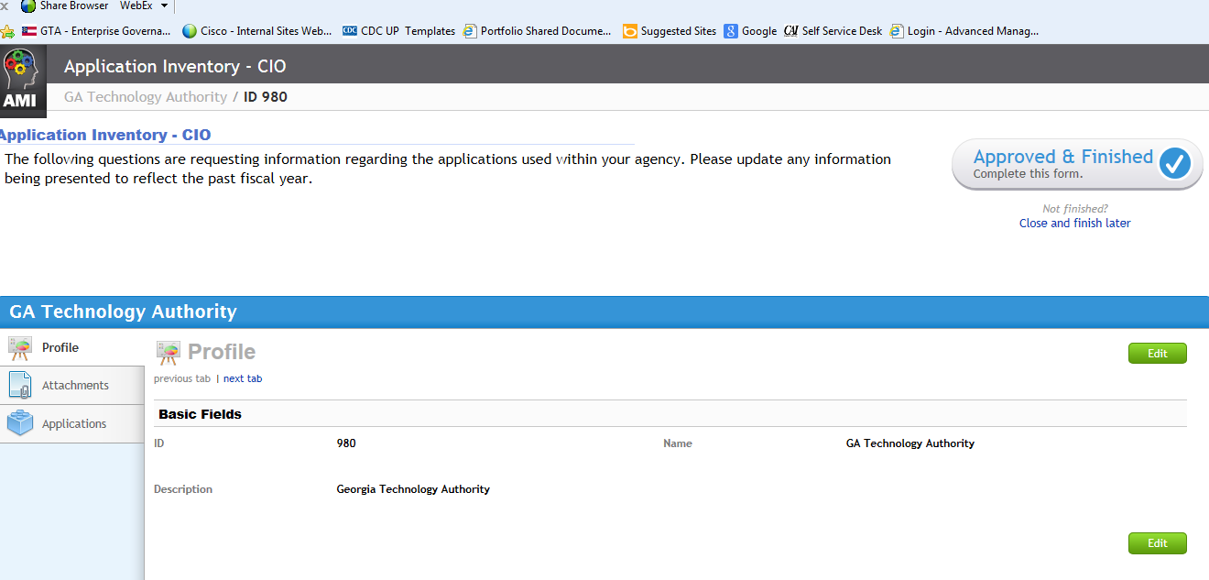
Application Inventory
The questionnaire
opens in the Profile view
Basic fields are shown on this screen
Select the “Applications” tab to display all applications that have been loaded into the system

Slide 9
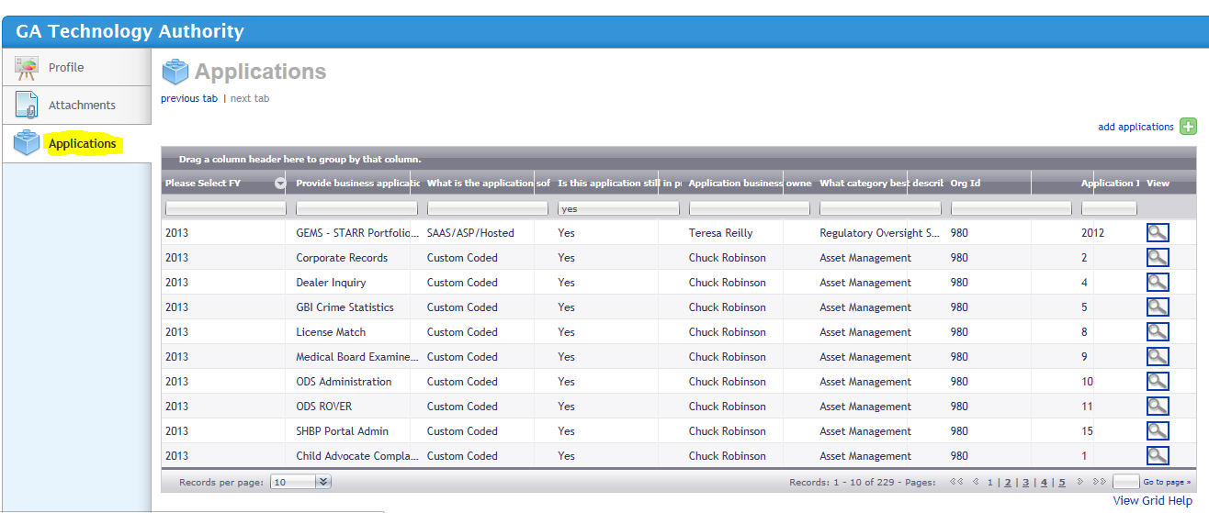
Application Inventory
The filter boxes provides you with the ability to filter your application summary list

Slide 10
Application Inventory
Add new application by clicking
on “add applications” link
Click on the Magnifying Glass to select the application to update the application
Select drop-down to view more records

Slide 11
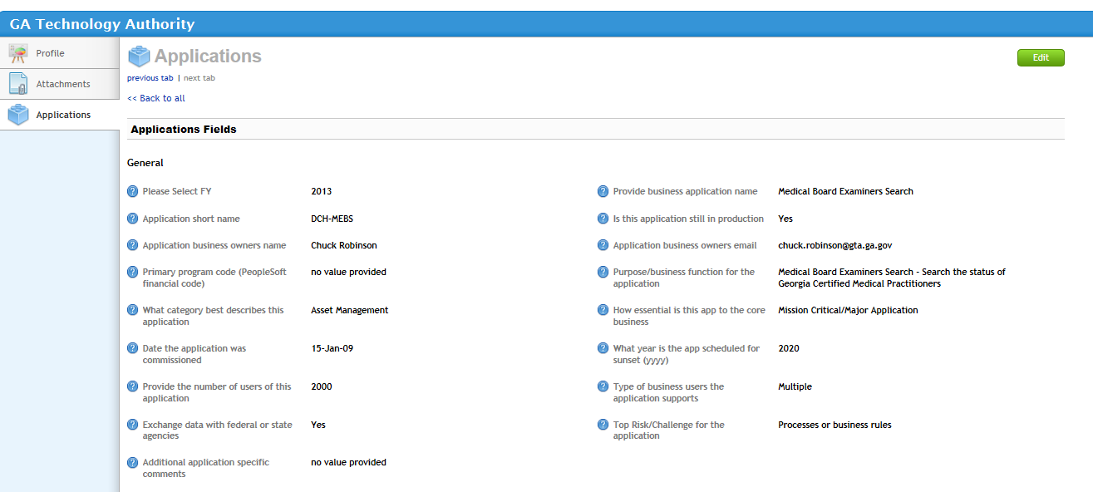
Application Inventory
Click on “Edit” button to update information including the FY
This field MUST be changed to 2014
? = Help Text Available

Slide 12
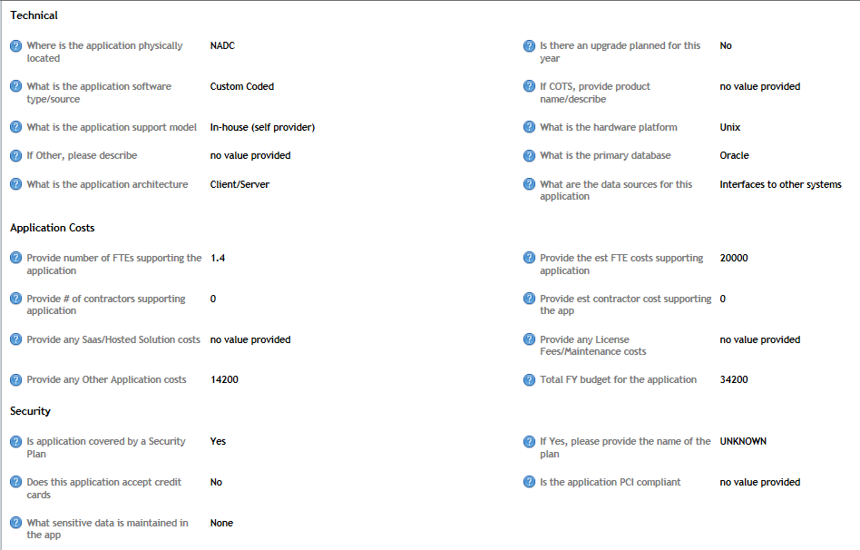

Application Inventory
New Groupings for FY14
Important Change: These 3 fields will be accumulated for all applications and pre-populated on the IT Spend Questionnaire
Save your Edits

Slide 13
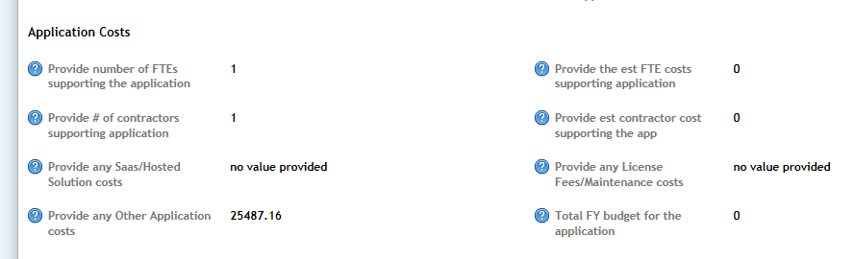
Application Inventory Costs
Important : Last year we only collected FTE and contractor costs. The difference between these two totals and your “Total YTD Expenditure for the application” is prepopulated in this field.
FY2013 Example:
FTE Cost $100 + Contractor Cost $100 = $200
Total YTD Expenditure : $250
Other Application Cost: $50

Slide 14
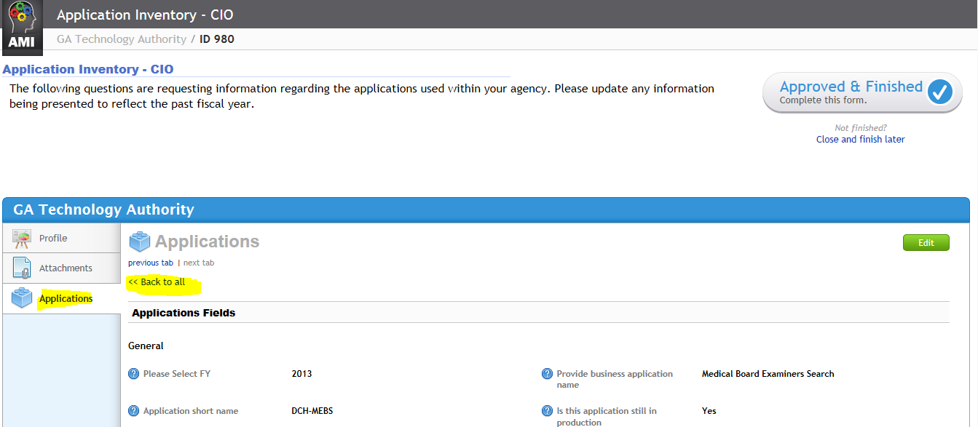
Application Inventory
Once ALL applications are updated & saved, click on the Approved & Finished button to complete the questionnaire
Click on the “Back to all” link to review and update all of the applications.

Slide 15
Application Inventory Dashboard
The Application Inventory Graph compiles a summary view of the Agency’s Application Inventory Data segmented by:
Application Spend vs. Budgeted Amount
Application Inventory
  Contractor Labor Costs
  Employee Labor Costs
SaaS
License Fees/Maintenance Costs
Other Application Costs

Slide 16
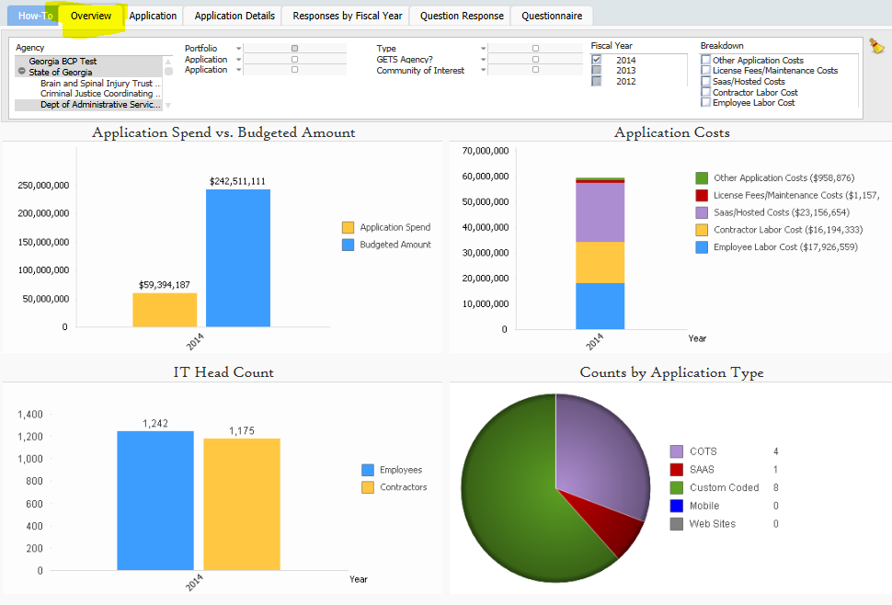
Sample App Inventory Dashboard

Slide 17
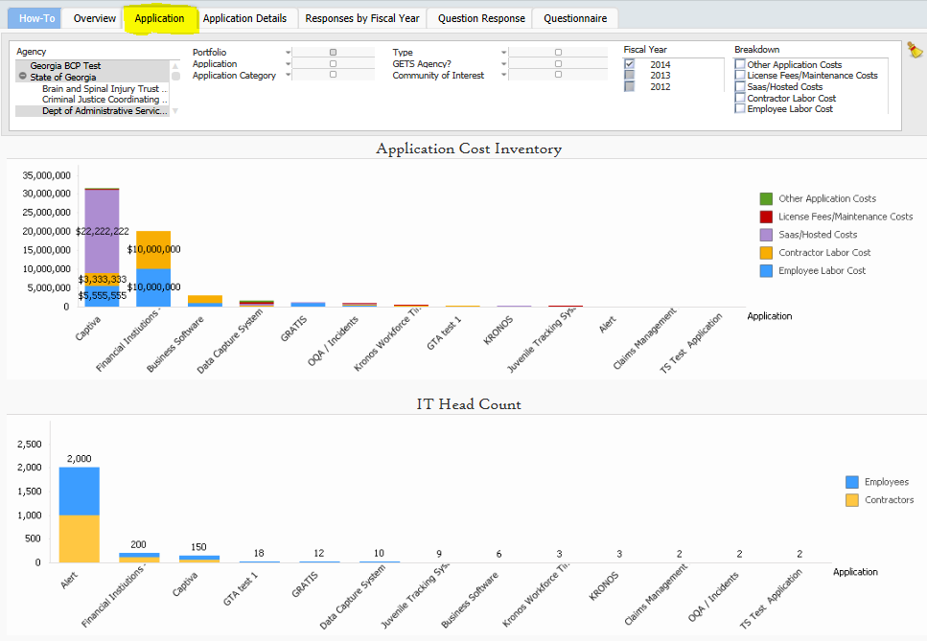
Sample App Inventory Dashboard

Slide 18
IT Spend Questionnaire
Your assessment for the State Technology Annual Report Registry (STARR)
has been submitted. You may now close this browser window.

Slide 19
IT Spend FY14 Enhancements
SaaS/Hosted Solution, License Fees/Maintenance Costs and Other Application Costs will be accumulated from the Application Inventory and prepopulated in the IT Spend questionnaire.
A new field is added for Mobile Service/Mobile Hardware costs.
A new field for IT Admin/Shared Cots is added to capture CIO/SAISO overhead, PMO costs, etc. that were not allocated to specific applications.
The questions are grouped (applications, infrastructure, network, etc.) to facilitate responses.
Help Text is included for each question.
For GETS agencies, the Infrastructure, Network and Oracle license fees invoiced through GTA will be pre-populated. In addition, the FTE and Covendis contractor count will be loaded.

Slide 20
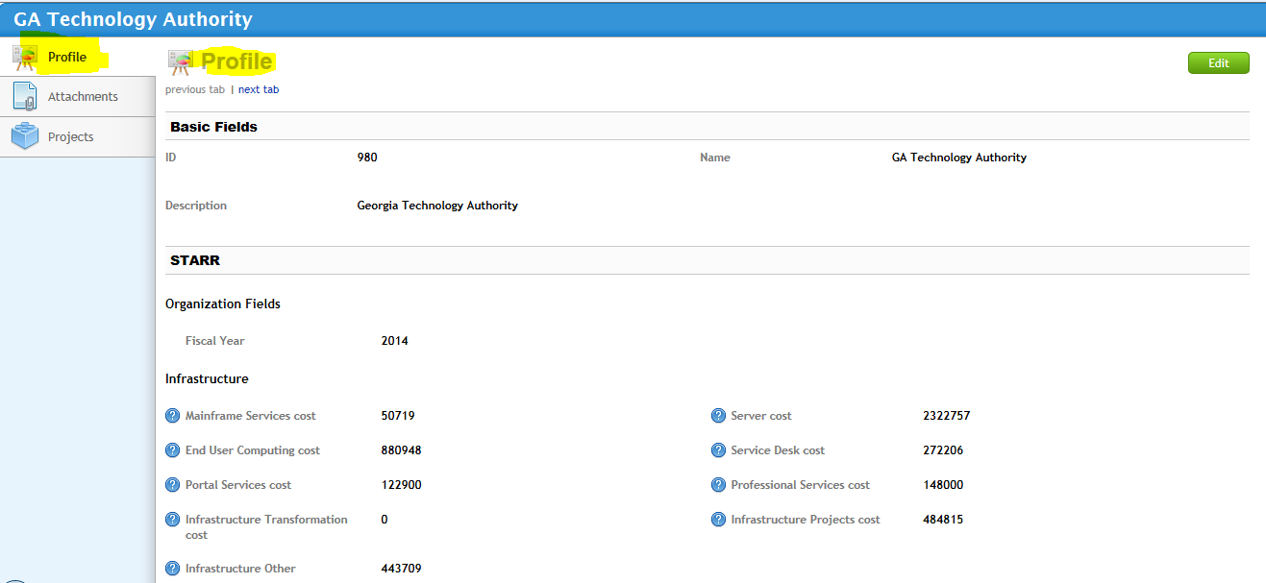
IT Spend
The questionnaire
opens in the Profile view
Select Edit
New for FY14, costs are grouped
This field MUST be changed to 2014
? = Help Text

Slide 21
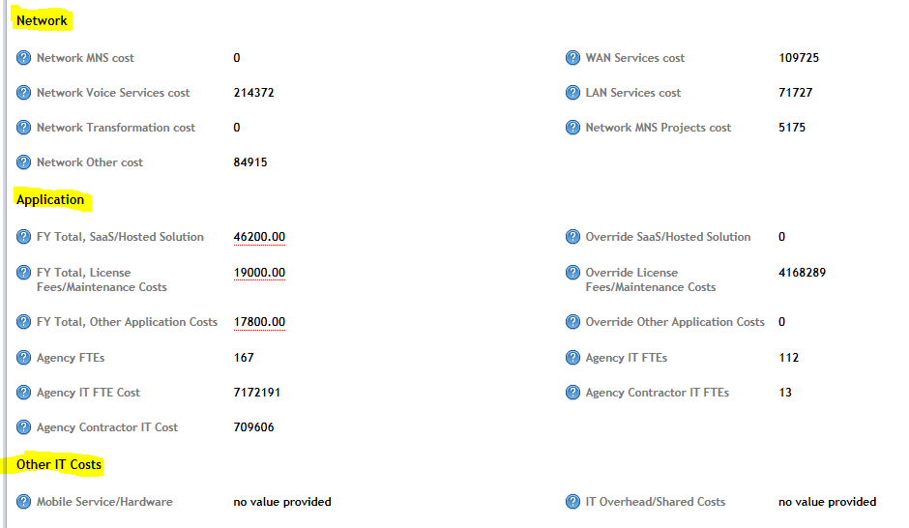
IT Spend
New Groupings
Important Change: These were extracted from your Application Inventory
You can override costs here
New Fields

Slide 22
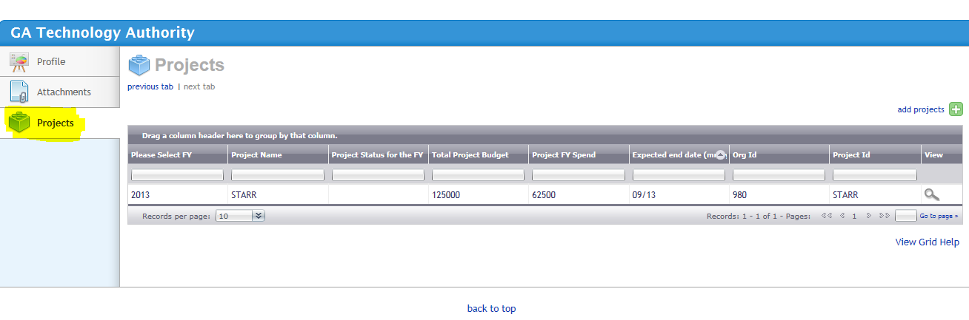
IT Projects
New Groupings
Important Change: These were extracted from your Application Inventory
Select the add projects button to list a new project
Select the Projects tab
You can override costs here
Select the Magnifying Glass to edit a project

Slide 23
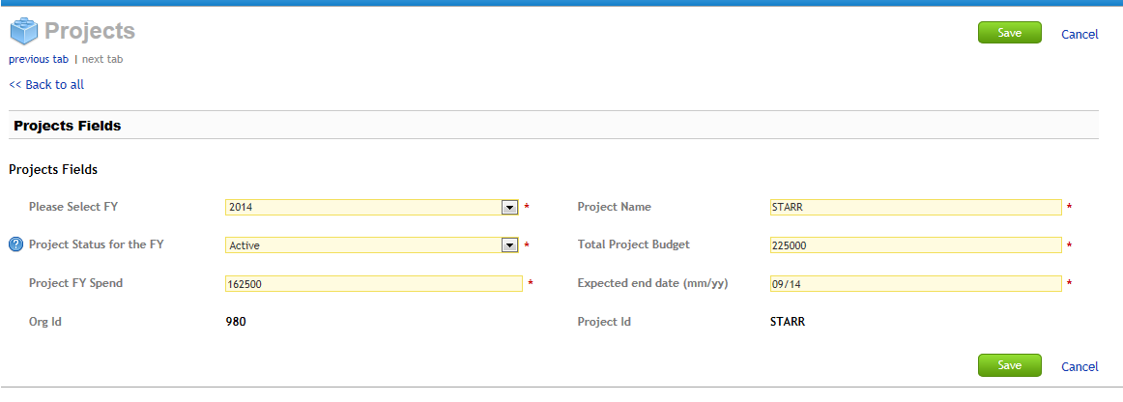
IT Projects
This field MUST be changed to 2014
Select “Active” if he project was in-flight 7/1 – 6/30
FY 2014 Spend
Select Save

Slide 24
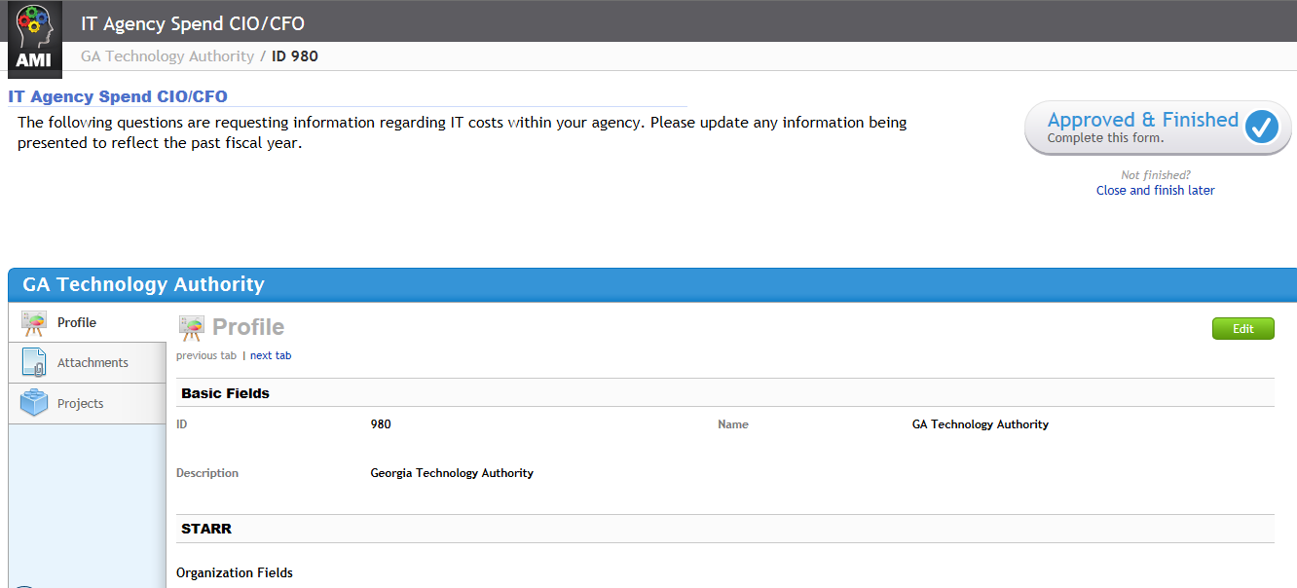
IT Spend Completion
When you have updated & SAVED the IT Spend & Projects, Select “Approved & Finished”. Once approved you no longer have access without re-issuing the questionnaire

Slide 25
IT Spend Dashboard
The IT Agency Spend Graph compiles a summary view of IT Agency Spend segmented out by Cost Categories
Total Infrastructure Costs
Total Network Costs
Total Application Costs
Total Other Costs
Total Project Costs (Fiscal Year Spend)

Slide 26
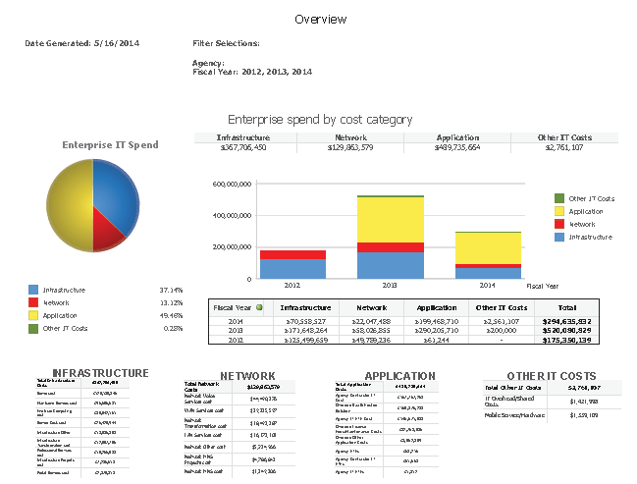
Sample IT Spend Dashboard

Slide 27
Secure, Reliable, Sustainable Questionnaire
Your assessment for the State Technology Annual Report Registry (STARR)
has been submitted. You may now close this browser window.

Slide 28
SRS Maturity Dashboard
The SRS Maturity Dashboard represent cumulative operational responses from Business Owners and CIOs input related to the current state of their agency; data, systems and IT security. The SRS Maturity dials represented on the following page identify:
  Secure
  Reliable
  Sustainable
  Overall SRS Average

Slide 29
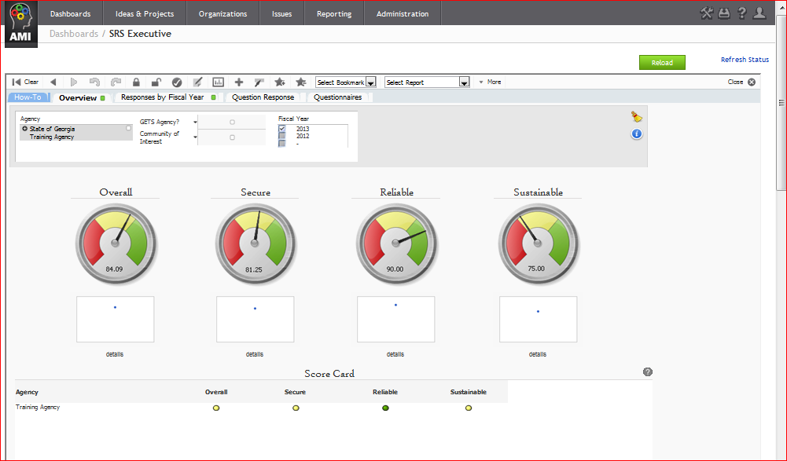
Sample SRS Dashboard

Slide 30
STARR Helpful Tips

Slide 31
Forwarding Questionnaires
  You can forward a questionnaire to another responsible party prior to your final submission; once a questionnaire is submitted the questionnaire cannot be re-launched
  If a questionnaire is forwarded to another party, your identity (original questionnaire recipient) remains linked to the questionnaire
  If a questionnaire has expired, you will not be able to launch the questionnaire; you will need to contact your Agency Super User to request a reissue

Slide 32
Helpful Tips
The STARR tool supports the following Browsers.
  Internet Explorer - 7
  Internet Explorer - 8 and 9 (Preference)
  Internet Explorer – 10 (works only in IE9 compatibility mode, by clicking F12 and choosing IE9)
  Firefox - 11 and higher
  Safari - 5 and higher
  Chrome - most recent production version

Slide 33
Helpful Tips
Make sure you complete your questionnaire prior to the expiration date
  Contact your Agency Super User to request a reissue of your questionnaire or to Request Copy of Agency Reports
Make sure your responses are saved prior to leaving your computer for an extended length of time. In a time-out scenario, your responses will not be saved

Slide 34
GTA Contact Information
STARR Admin Support (Tier 1):
Tometrice Strickland - (404) 463-8474
ITReports@gta.ga.gov
STARR Admin Support (Tier 2):
Hank Oelze - Hank.Oelze@gta.ga.gov
STARR Business Owner:
Teresa Reilly – Teresa.Reilly@gta.ga.gov

Slide 35


Questions

