Slide 1
    State Technology Annual Report Register (STARR)
    SAISO Training

Slide 2
Training Agenda
STARR Overview Training
  STARR Roles
  STARR Data Collection Timeline
  STARR Role Based Training (SAISO)
    Security Questionnaire
    Systems Security Questionnaire
  Helpful Tips
  When to Contact Agency Super User
  Questions

Slide 3
STARR Roles
Agency Super User
  agency point of contact for STARR
  responsible for the agency profile questionnaire
  has the ability to produce reports
Business Owner (BO)
  answers questionnaire on Secure, Reliable, and Sustainable Maturity (SRS Maturity)
Business Continuity Planner (BCP)
  answers questionnaire regarding business continuity planning

Slide 4
STARR Roles
Senior Agency Information Security Officer (SAISO)
  answers questionnaires regarding agency IT systems and security
Chief Information Officer (CIO )
  answers questionnaire regarding business application inventory
  answers questionnaire about agency IT Spend
  answers questionnaire on Agency Maturity (SRS)
Chief Financial Officer (CFO)
  answers questionnaire on the agency IT Spend
Agency Head / Commissioner
  will receive a questionnaire to validate agency IT information

Slide 5
STARR Schedule

Slide 6
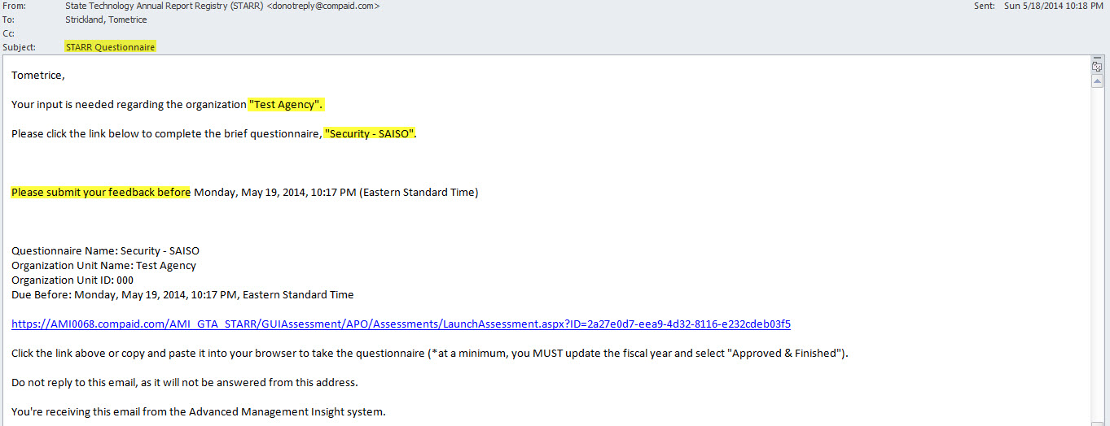
Sample Security Email
State Technology Annual Report Registry (STARR)
Your Agency Name
Questionnaire Type: “Security – SAISO”
Expiration date of questionnaire
Click on Link to launch your specific questionnaire

Slide 7
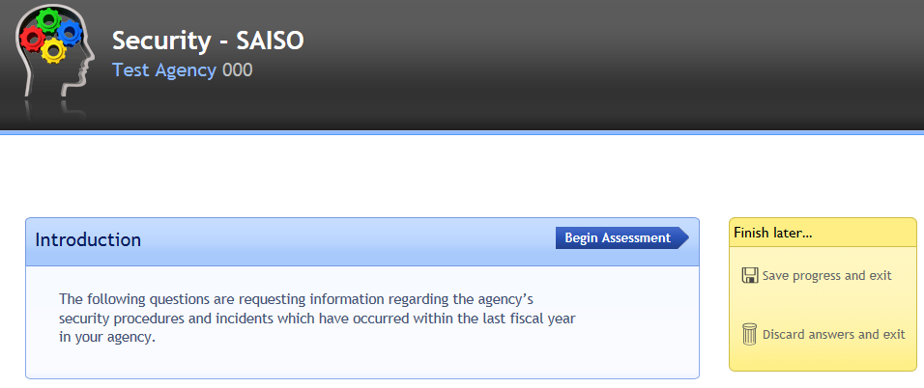
Sample Security Questionnaire

Slide 8
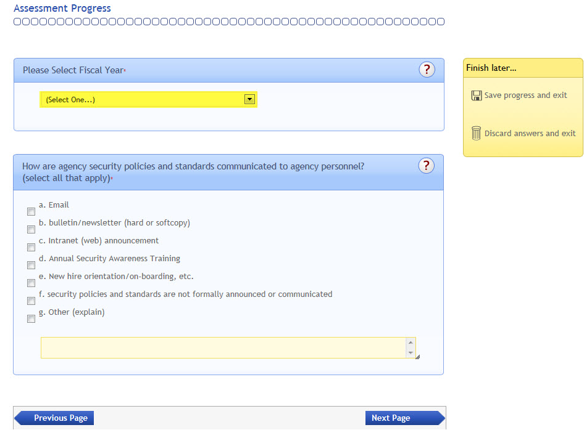
Sample Security Questionnaire
Click to Save answers and finish later or Discard your answers
This field MUST be changed to 2014
Required Fields
? = Help Text

Slide 9
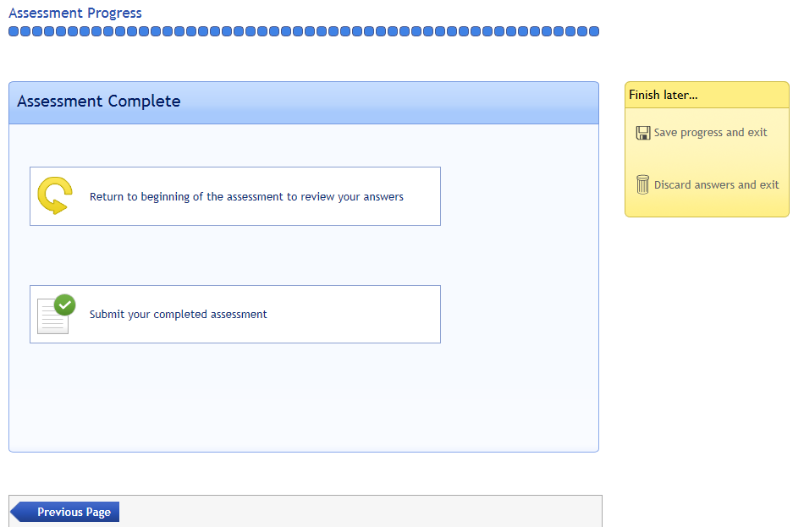
Sample Security Questionnaire
Click to return to the beginning and review your answers
Once ALL Security questions are updated click on the Submit button to complete the questionnaire

Slide 10
Security Dashboard
IT Security Dashboard reports Agency’s:
Security Awareness Training
  Security Awareness Training for agency staff (Staff and Contractors)
  Record keeping for Security Awareness Training
Security Governance
  Confirmation of a formal documented security program as required by Enterprise Information Security Infrastructure Standard (SS-08-005.01)
  Agency's information security governance process

Slide 11
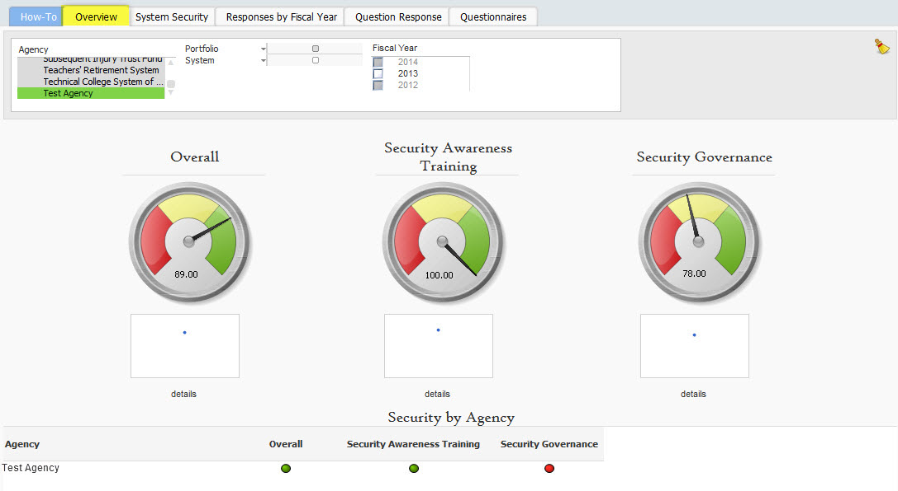
Sample Security Dashboard

Slide 12
System Security Questionnaire
Your assessment for the State Technology Annual Report Registry (STARR)
has been submitted. You may now close this browser window.

Slide 13
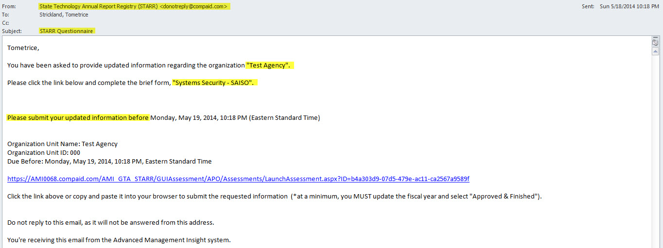
Sample System Security Email
State Technology Annual Report Registry (STARR)
Your Agency Name
Questionnaire Type: “Systems Security – SAISO”
Expiration date of questionnaire
Click on Link to launch your specific questionnaire

Slide 14
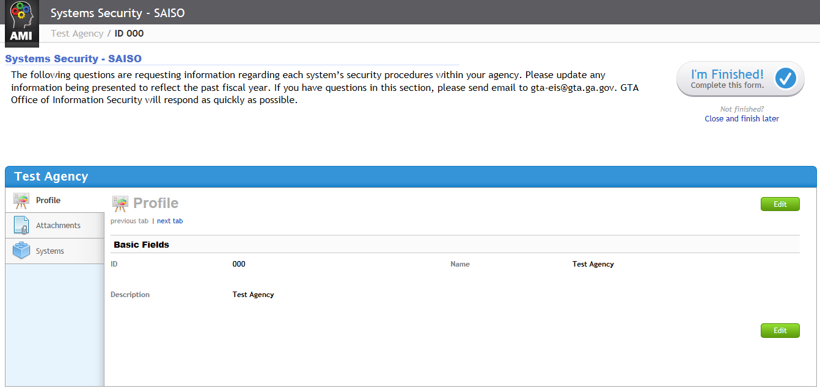
Systems Inventory
The questionnaire
opens in the Profile view
Basic fields are shown on this screen
Select the “Systems” tab to display all systems that have been loaded into STARR
Click on “Edit” button to update information including the FY

Slide 15
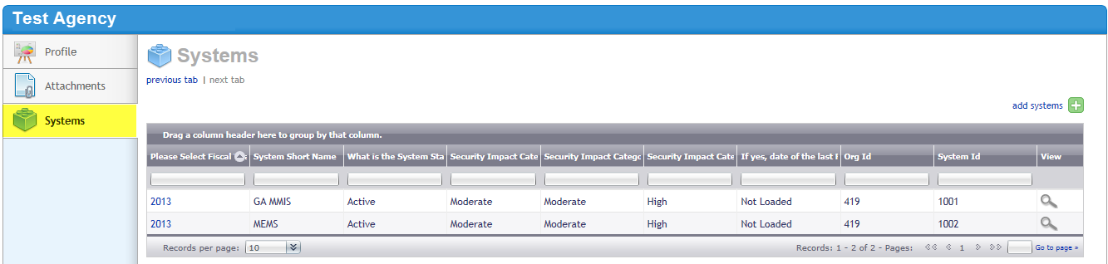
Systems Inventory
The filter boxes provides you with the ability to filter your systems summary list

Slide 16
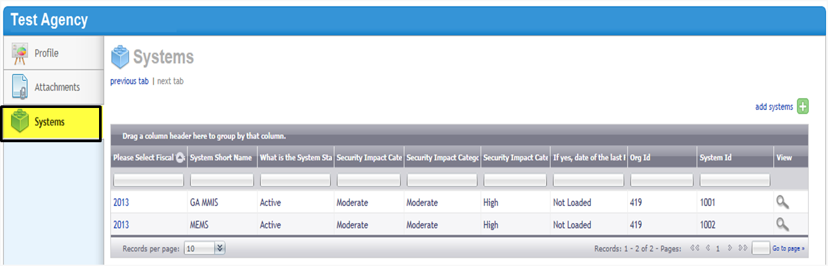
Systems Inventory
Add new Systems by clicking
on “add systems” link
Click on the Magnifying Glass to select the system to update
Select drop-down to view more records

Slide 17
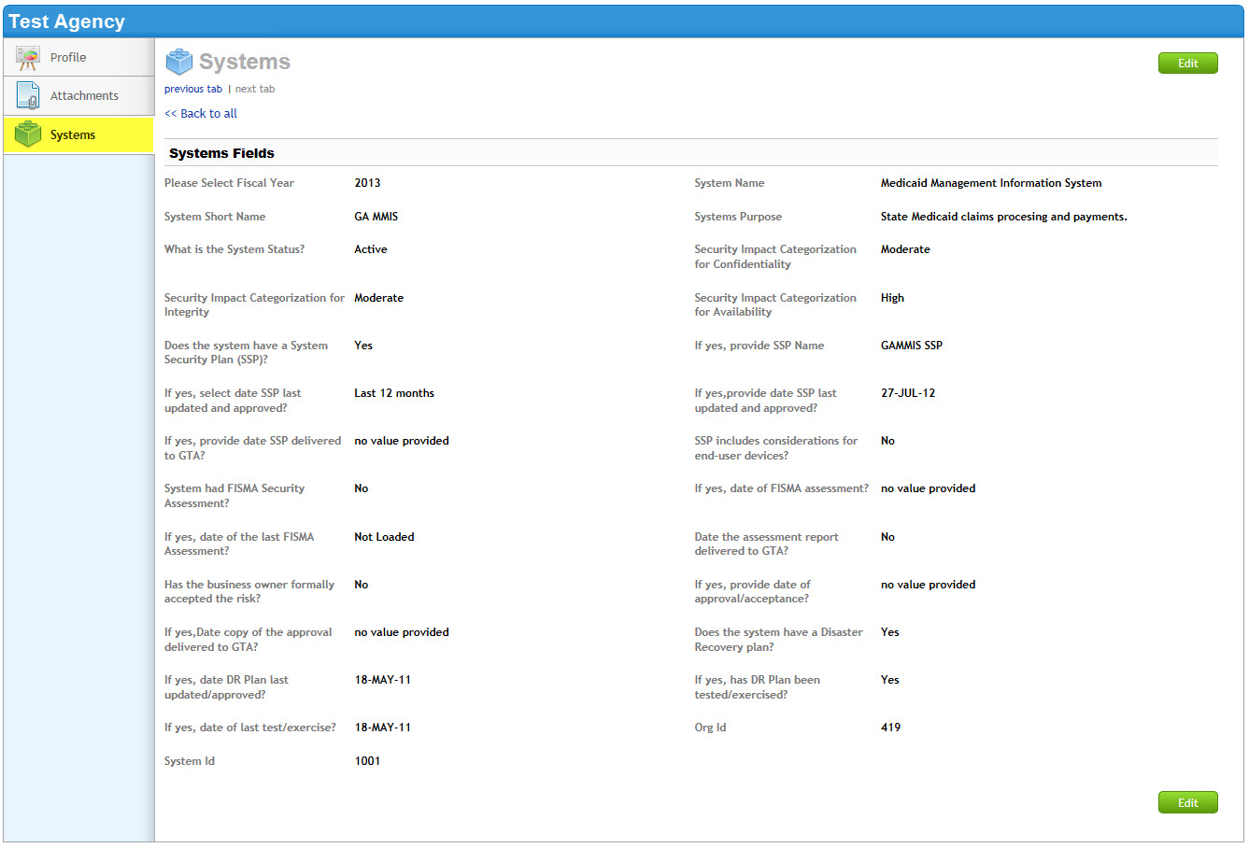
Systems Inventory
Click on “Edit” button to update information including the FY
This field MUST be changed to 2014
Save your Edits

Slide 18
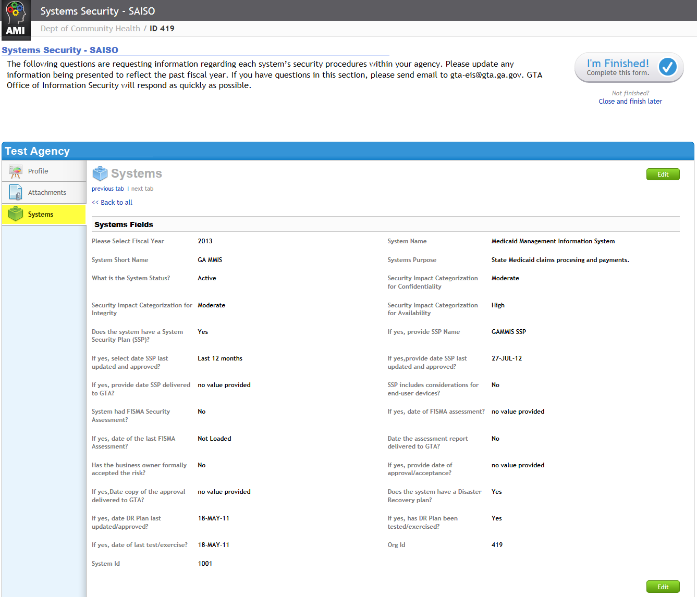
Systems Inventory
Once ALL Systems are updated & saved, click on the “I’m Finished” button to complete the questionnaire
Click on the “Back to all” link to review and update all of the Systems.

Slide 19
Systems Security Dashboard
The Systems Security Graph compiles a summary view of the Agency’s System Inventory Data segmented by:
System Security Risks
  Risk Score
Systems Categorization
  Confidentiality
  Integrity
  Availability
Security Plan
FISMA Independent
Business Owner Approval
Disaster Recovery Plan

Slide 20
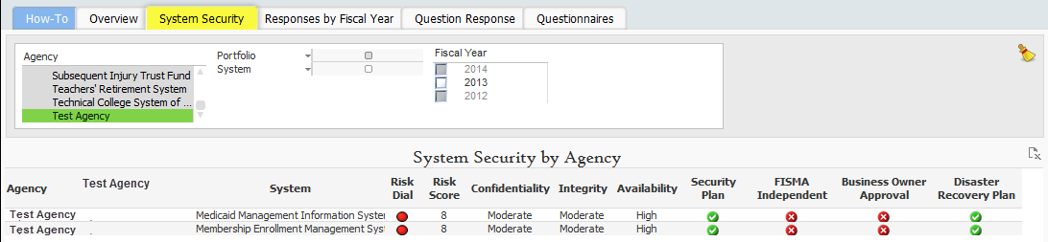
Sample System Security Dashboard

Slide 21
STARR Helpful Tips

Slide 22
Forwarding Questionnaires
  You can forward a questionnaire to another responsible party prior to your final submission; once a questionnaire is submitted the questionnaire cannot be re-launched
  If a questionnaire is forwarded to another party, your identity (original questionnaire recipient) remains linked to the questionnaire
  If a questionnaire has expired, you will not be able to launch the questionnaire; you will need to contact your Agency Super User to request a reissue

Slide 23
Helpful Tips
The STARR tool supports the following Browsers.
  Internet Explorer - 7
  Internet Explorer - 8 and 9 (Preference)
  Internet Explorer – 10 (works only in IE9 compatibility mode, by clicking F12 and choosing IE9)
  Firefox - 11 and higher
  Safari - 5 and higher
  Chrome - most recent production version

Slide 24
Helpful Tips
Make sure you complete your questionnaire prior to the expiration date
  Contact your Agency Super User to request a reissue of your questionnaire or to Request Copy of Agency Reports
Make sure your responses are saved prior to leaving your computer for an extended length of time. In a time-out scenario, your responses will not be saved

Slide 25
GTA Contact Information
STARR Admin Support (Tier 1):
Tometrice Strickland - (404) 463-8474
ITReports@gta.ga.gov
STARR Admin Support (Tier 2):
Hank Oelze - Hank.Oelze@gta.ga.gov
STARR Business Owner:
Teresa Reilly – Teresa.Reilly@gta.ga.gov

Slide 26


Questions

