Slide 1
Georgia EM Grants Manager State and Local Cybersecurity Grant Program
Preparedness Grants and Programs
HSGrants@gema.ga.gov
(404) 635-7095

Slide 2
How to complete the State and Local Cybersecurity Grant Program application

Slide 3
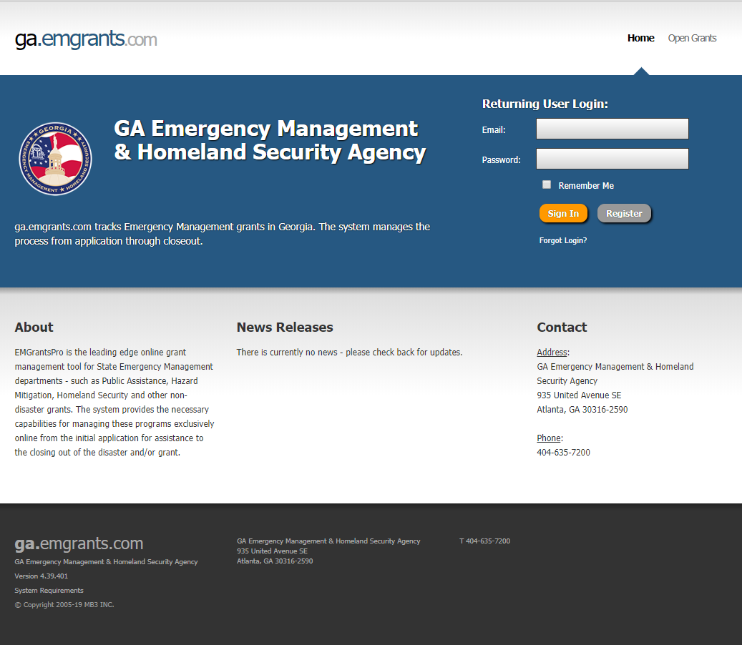
Please access Georgia EM Grants Manager portal by following the link provided: https://ga.emgrants.com
Enter your Email and Password
Select Sign-In

Slide 4
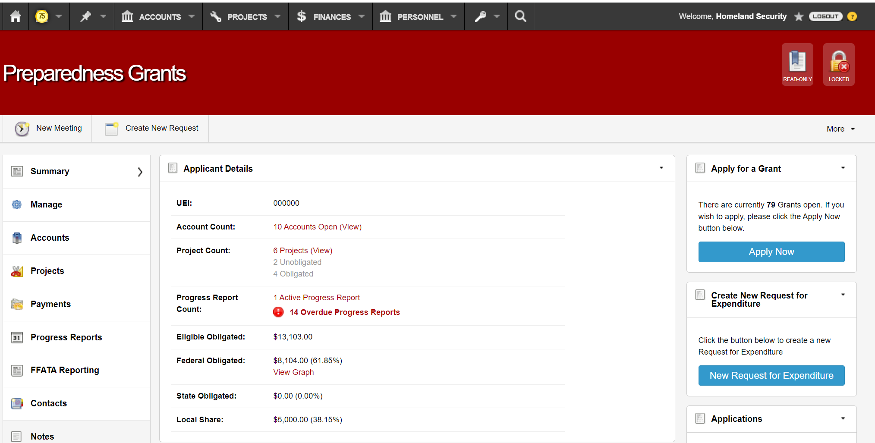
Select Apply Now

Slide 5
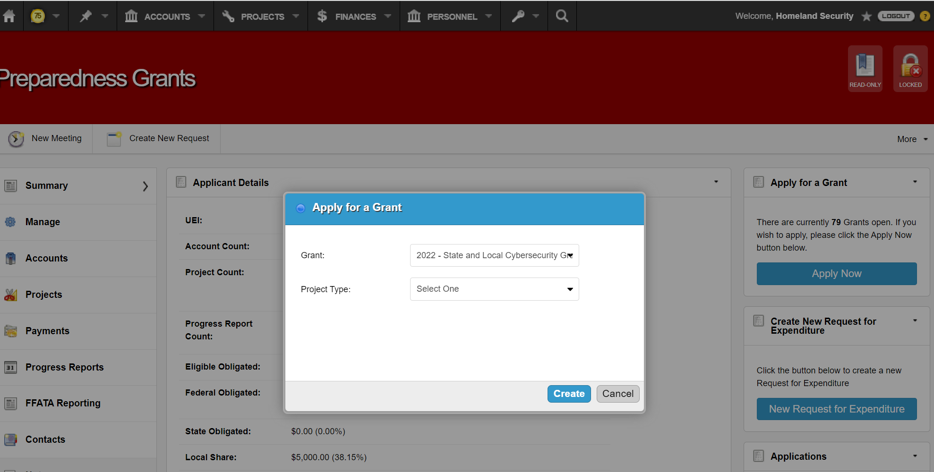
Select the “2022 – State and Local Cybersecurity Grant Program” from the Grant drop-down list.
Select the applicable Objective from the Project Type drop-down list.
Select Create

Slide 6
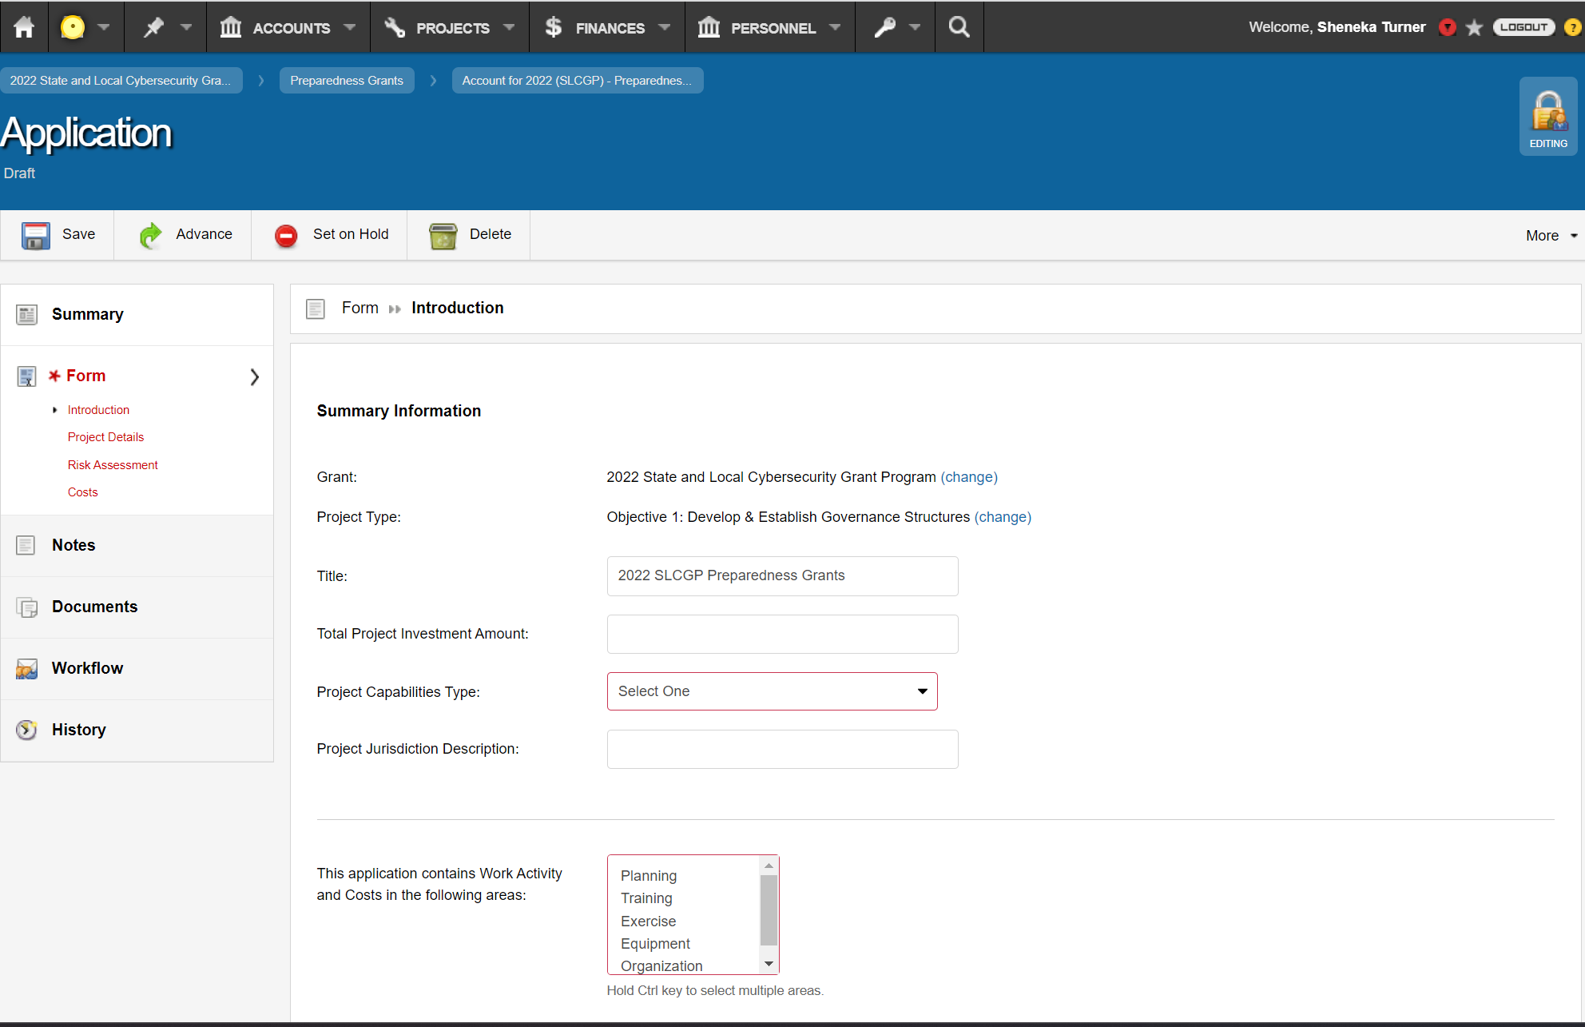
Complete each section of the application, including Introduction, Project Details, Risk Assessment, Costs, etc.
Select Submit/Advance.

Slide 7
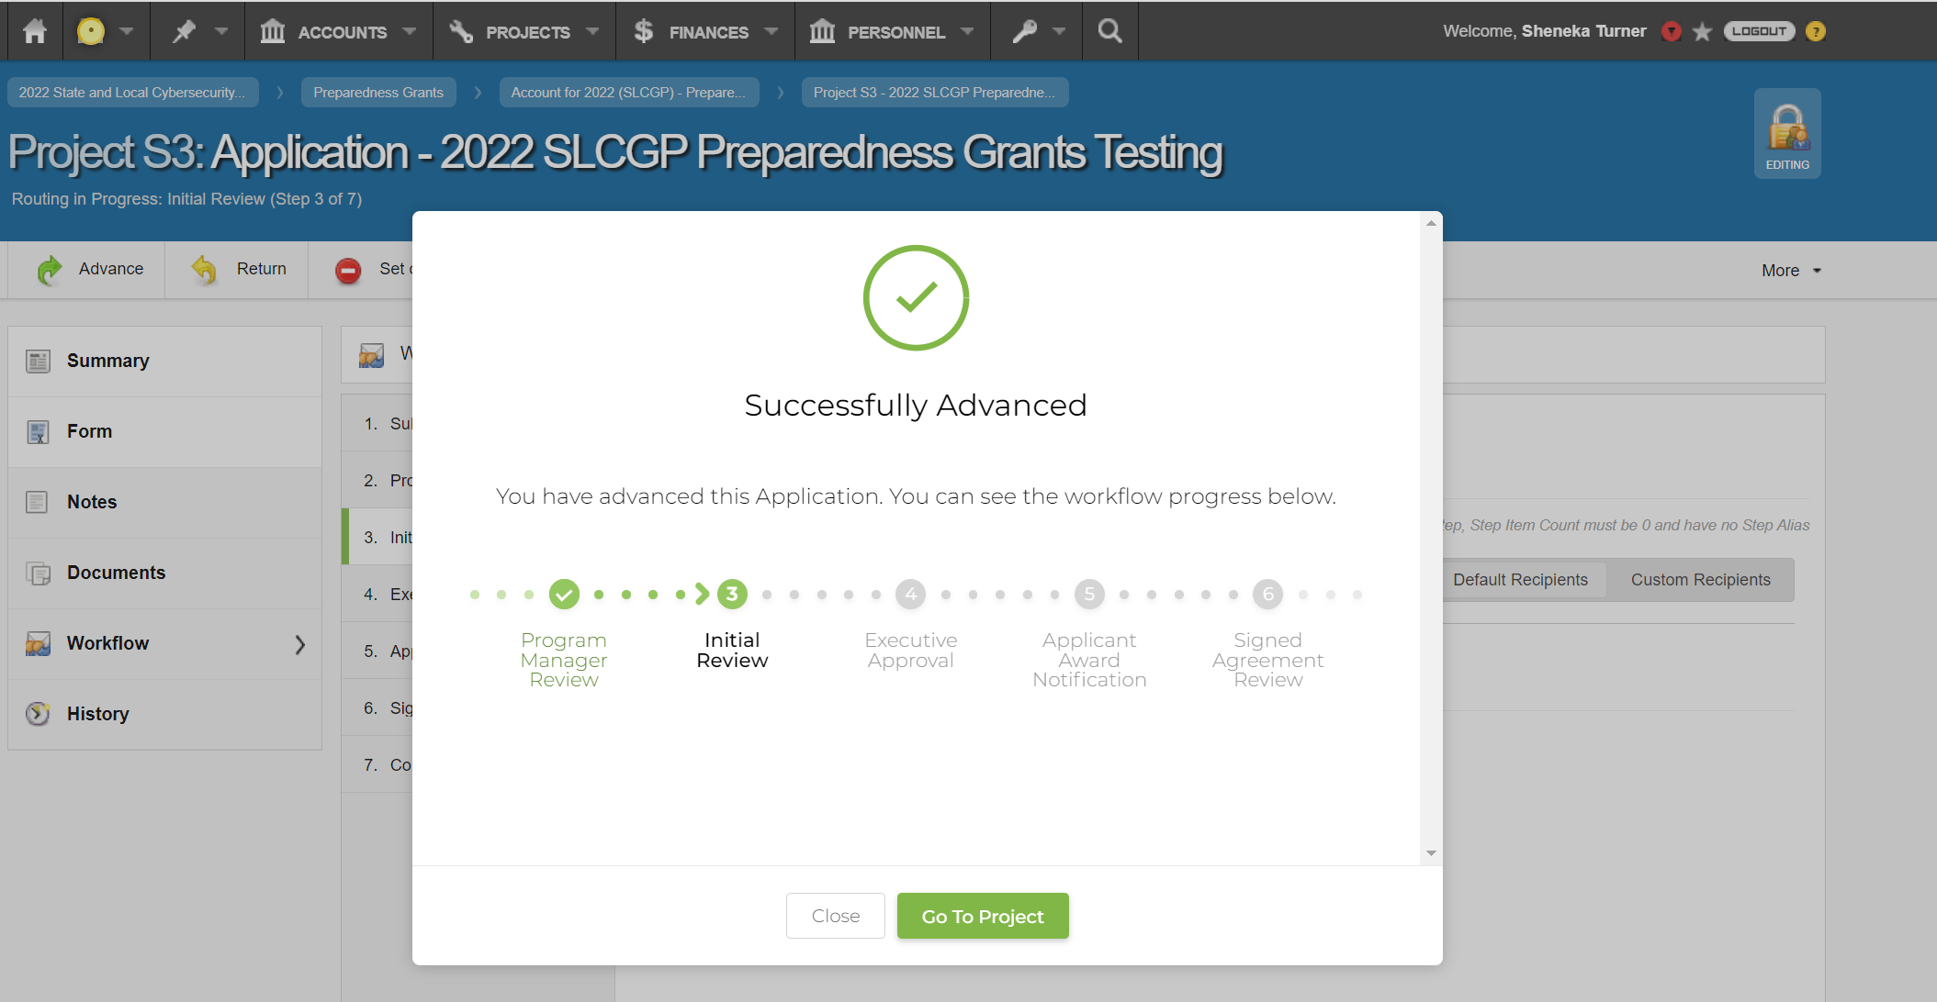
When you see “Successfully Submitted/Advanced” your Application has been submitted.
*This will notify your GEMA/HS team*

