Slide 1
Georgia Enterprise Management Suite (GEMS) Training
Created & Presented by GTA EPMO
Hank Oelze, PMP 404-782-2743
Version 4.2 3.12.18

Slide 2
What’s New in GEM Training Version 4.0?
Changes to login procedures
Separate AMI and APO Applications
Dashboard is completely revised
Questionnaire format has changed
Updated Issue & Risk sections
Reports have changed
Recommended browser is Google Chrome

Slide 3
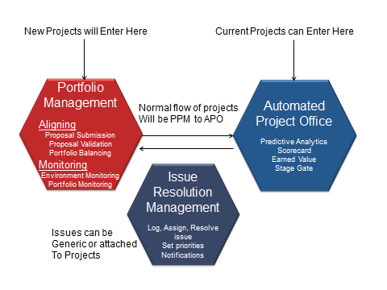
Process Flow
PPM
APO

Slide 4
Initial Login Screen
Enter your email and assigned password

Slide 5
Initial Login Screen
You will receive an email to verify your identity, click on hyperlink.

Slide 6
Initial Login Screen
Confirm data and Save You may need to log back In

Slide 7
AMI versus APO
AMI: The “Data Entry” portal for GEMS. This area is where you would:
Create Projects
Assign Resources
Send Questionnaires
Update Profile Information
Load your Project Schedule
Create or Update Risks & Issues
APO: The “Dashboard” portal of GEMS. This area is where you would:
Review Questionnaire Responses
Review KPI scores
Review Management Dashboards
Review Operational Data
Print Reports

Slide 8
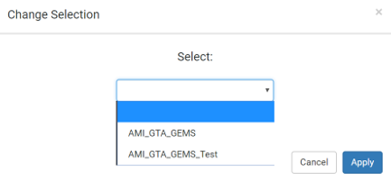
GEMS Entry Screen
Choose Production or Test

Slide 9
GEMS Entry Screen
AMI: Primary Focus

Slide 10
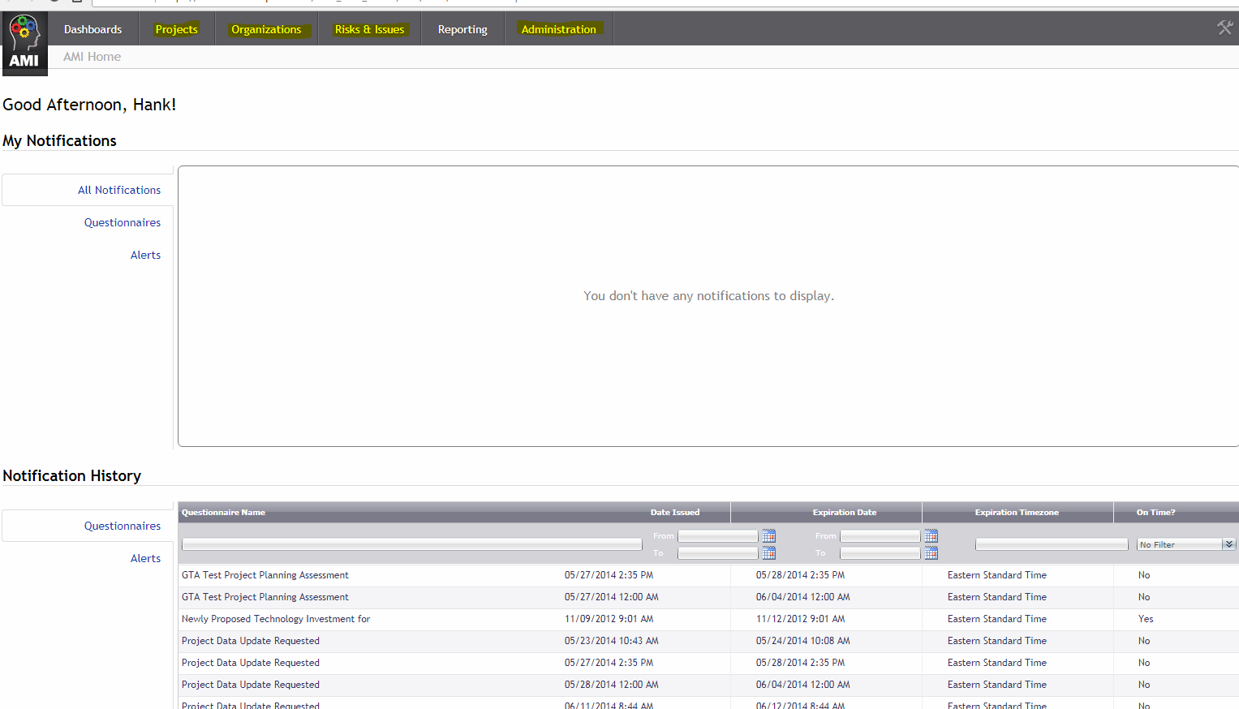
AMI Entry Screen
This tile will take you to AMI, this is similar from the previous version of GEMS. In AMI, you can add & edit projects, risks, issues and project assignments. In addition, this is where you would send manual assessments.

Slide 11
Project Selection or Creation

Slide 12
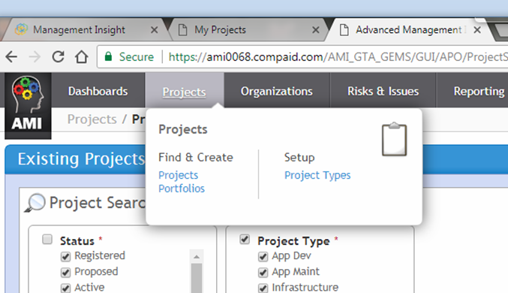
Select or Create a Project

Slide 13
Creating a Proposal or Project
Search Filters

Slide 14
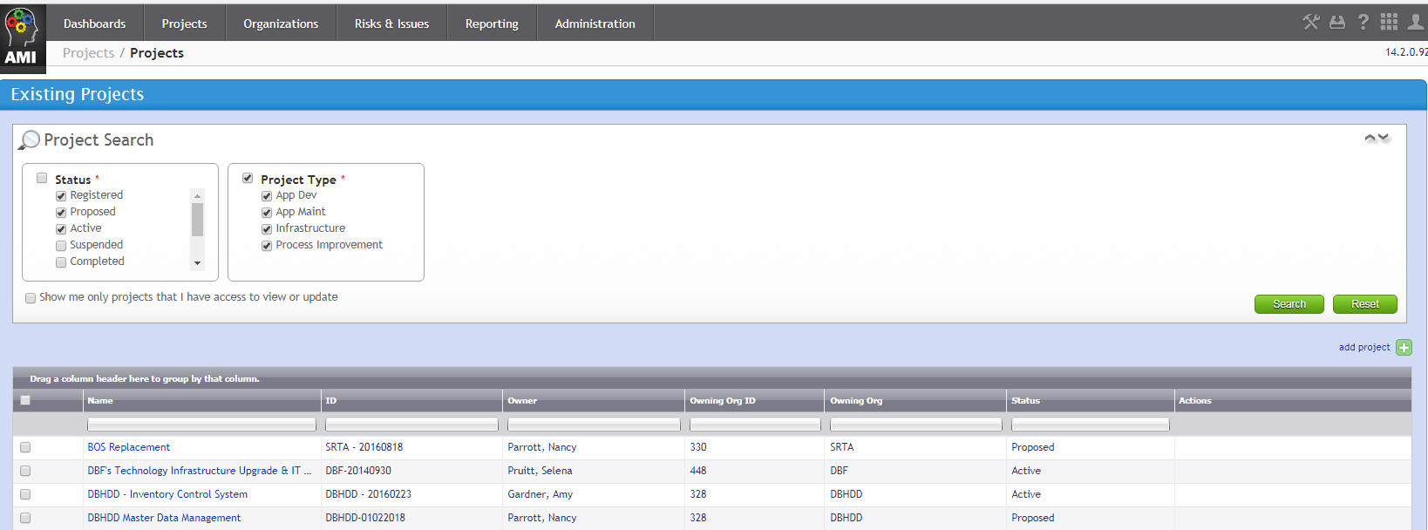
Create a New Proposal or Project
+
Select “add project”

Slide 15
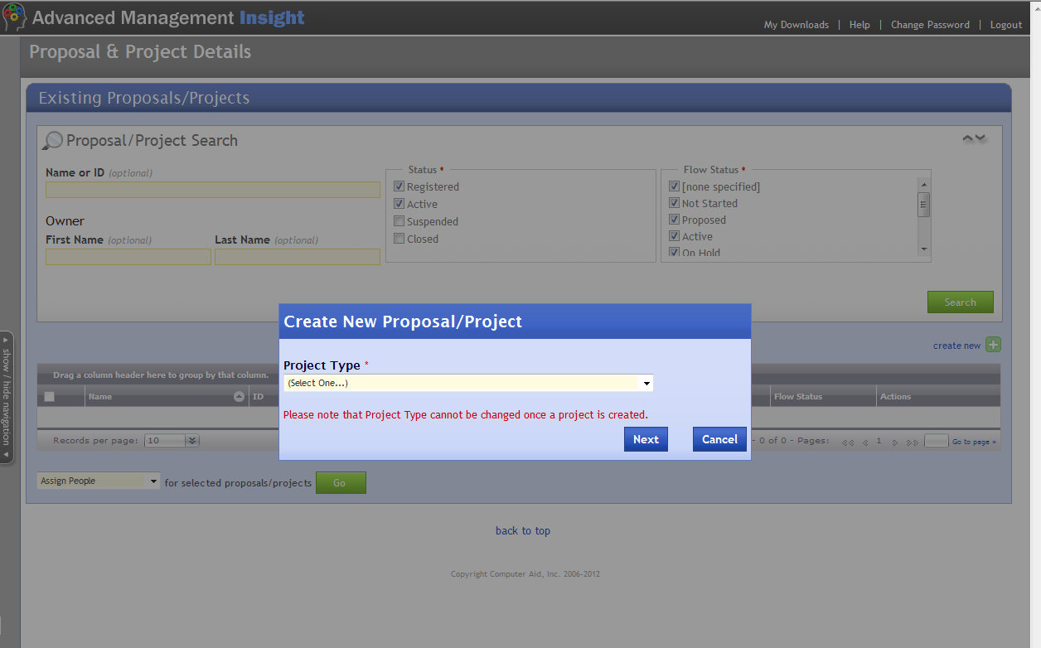
Select Project Type then Next
Select Type
IMPORTANT

Slide 16
Project Types
1. Select “Projects” Tab
2. Select “Project Types”

Slide 17
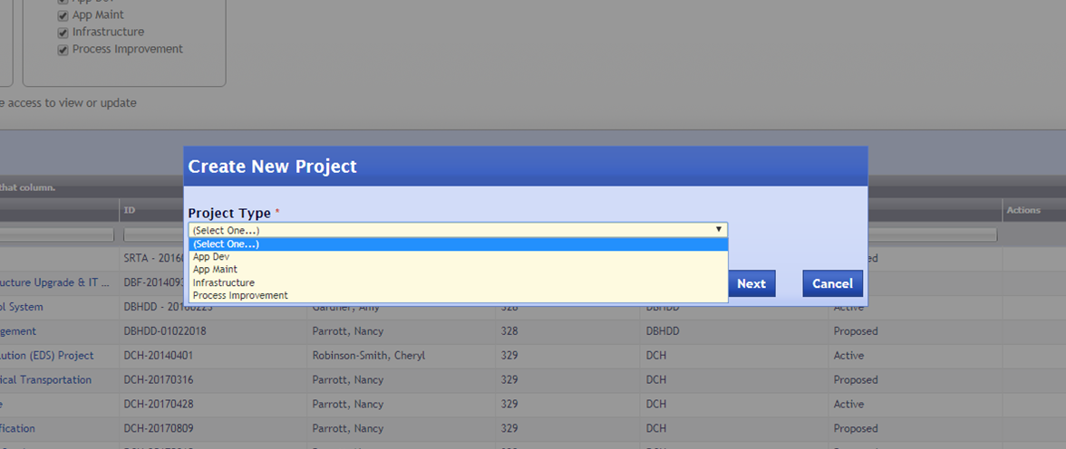
Project Types
Drop Down Choices

Slide 18
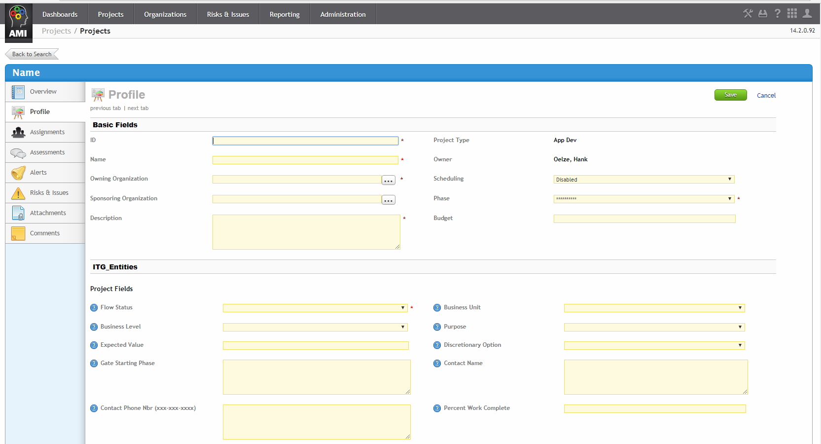
New Project Entry Screen Appears

Slide 19
Enter Profile Basic Fields
ID: Three/Four letter agency ID – YYYYMMDD (DDS-20180828)*
Name: Descriptive Name
Owning Organization: Select from Drop Down
Questionnaire Scheduling: Select “Enabled” from Drop Down
Sponsoring Organization: Select from Drop Down
Project Phase: Initiate, if this is a new project
Description: Short description of project
Budget: 1287345 ALL cost amounts are entered without $, no commas, whole dollars only.
* If multiple entries occur in one day add suffix(a,b,c etc.)
Fields with an asterisk (*) are mandatory.
Note: In most cases the Project ID and Name will be already established.
Notes:
Describe the difference between Owning and Sponsoring organizations (they can be the same)
The Sponsoring Organization is not a required field, but should be completed. The name is used in some e-mail notifications throughout the system.

Slide 20
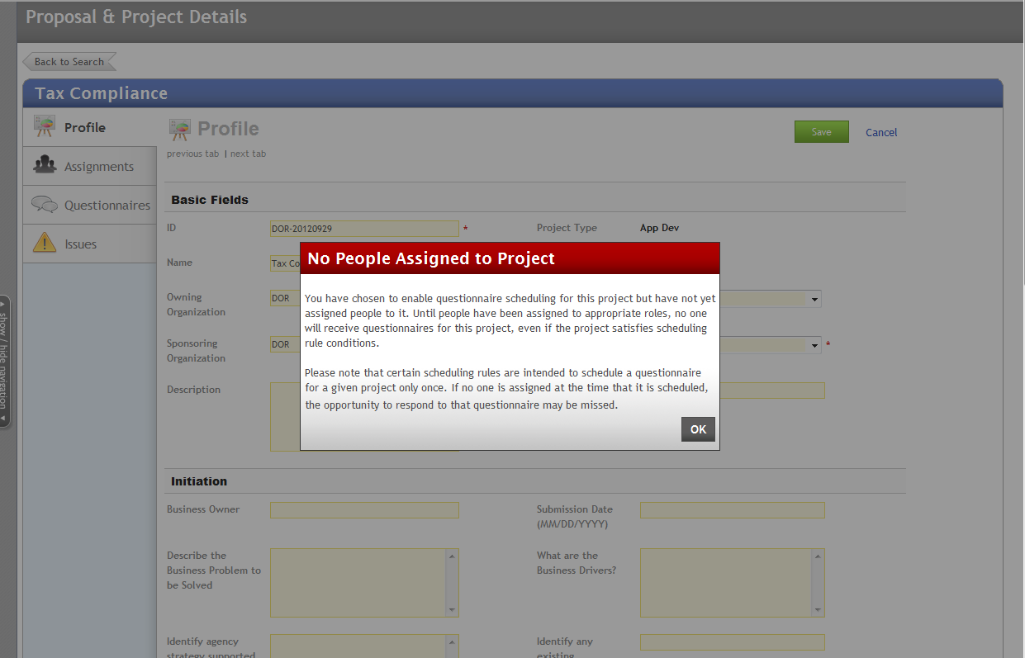
Warning Message, Select OK

Slide 21
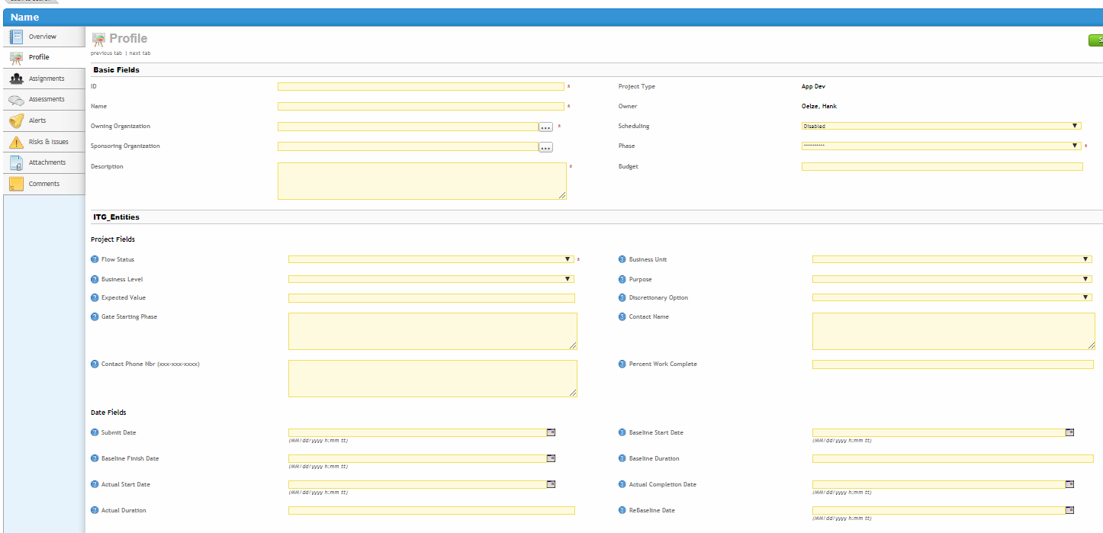
Profile Screens (1 of 2)
Basic Fields
Information Technology Governance
Date Fields
Notes:
The old APR form has been replaced by completing these fields
If you are using GEMS, you will no longer be required to submit a separate APR

Slide 22
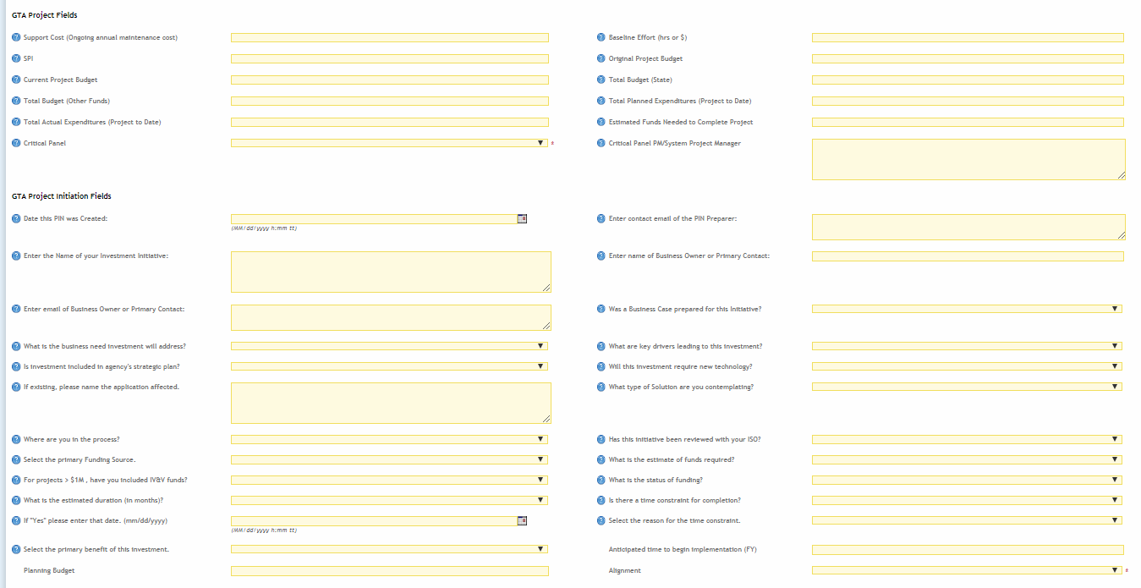
Profile Screens (2 of 2)
Critical Panel Fields
Initiation Fields
This initiation information was previously captured in the PIN if one was completed.
Notes:
The old APR form has been replaced by completing these fields
If you are using GEMS, you will no longer be required to submit a separate APR

Slide 23
Enter Initiation Data
Business Owner: Someone that “owns” the app or system
Submission Date: Today’s Date (6/21/2018 format)
Describe the Business Problems to be Solved: Enter Text
What are the Business Drivers: Enter Text
Identify agency strategy supported: Enter Text
Identify any existing application/system Impacted: Enter Text
Where are you in the process? Select from dropdown
What is the expected source of funds for this? Select from dropdown
Are the funds currently committed or requested? Select from dropdown
Anticipated time to begin implementation: Enter year YYYY
Is there a hard time constraint (deadline)? Select YES/No
If yes, what is the date: Enter 7/30/2018 format
What benefits will this investment provide? Enter Text
Planning Budget: Enter whole number Implementation Budget: whole number
Discretionary Option: Select from dropdown Alignment: Select from dropdown
Notes:
The Business Owner should be the business executive in your organization that is accountable for the success of the program this technology will support
You might want to highlight the fields that will populate the PPM dashboard so they can see the relationship later
Agency Strategy should be the strategy in your agency strategic plan that this proposal is aligned with (alignment with the state strategies is identified in a later field – “Alignment”)
Planning budget will be used primarily for federally funded projects where funding is provided through a PAPD or long-term
Define “Discretionary Option”

Slide 24
Enter Project Data
Many of these fields may be unknown during this planning phase of the project, if so, leave them blank.
Flow Status: Select “Proposed”* from the Drop Down
Planned Baseline Start: mm/dd/yyyy format
Planned/Baseline Completion Date: mm/dd/yyyy format
Original Project Budget:
Estimated Funds Needed to Complete Project: Enter whole dollars
Click “SAVE” on bottom right corner.
* Status must be changed to Proposed to view on Dashboard

Slide 25
Assign Resources & Roles

Slide 26
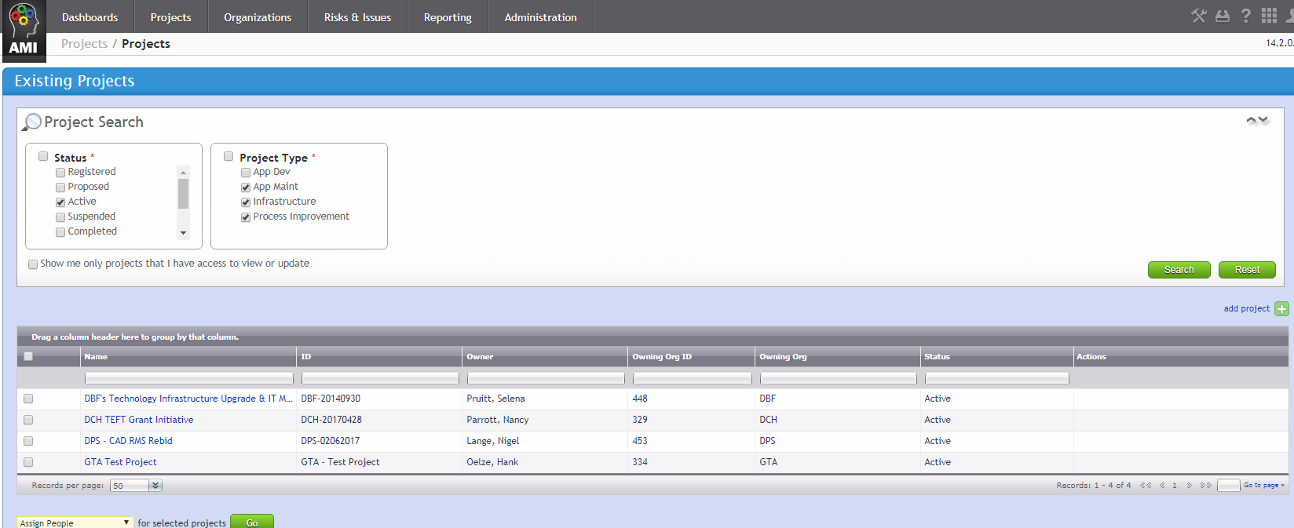
Search for a Project (Proposal)
1. Select “Projects”
2. Enter search criteria
3. Click Search
4. Results

Slide 27
Select Project
Double click the Project Name

Slide 28
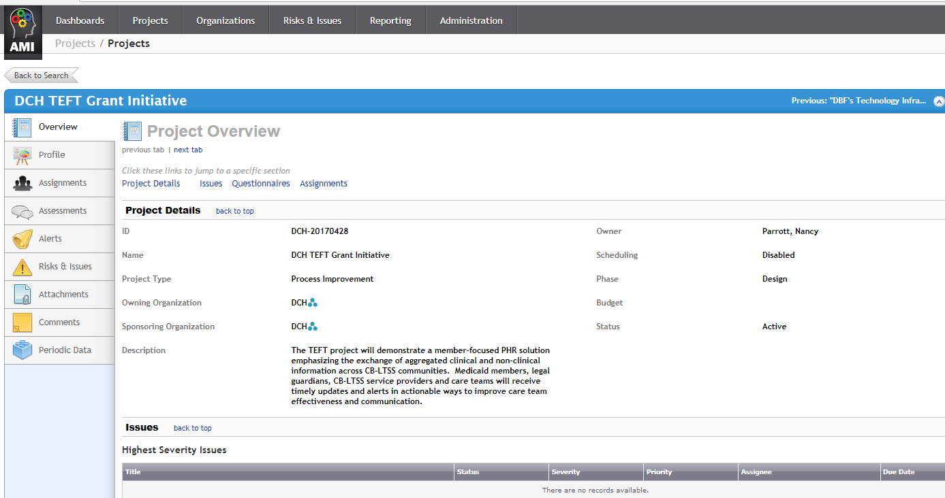
Select Assignments
Select “Assignments”

Slide 29
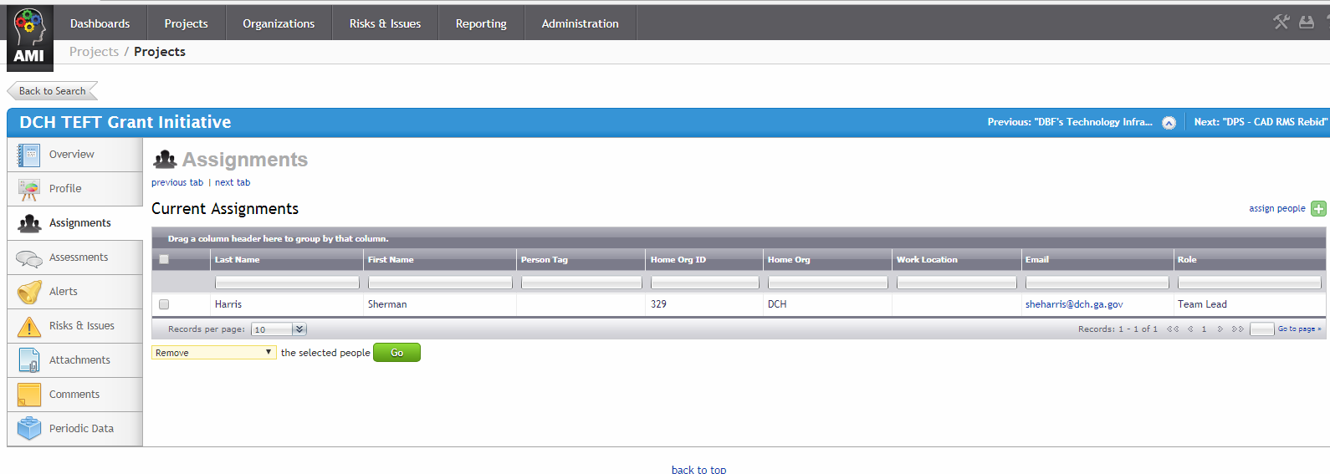
Select Assign People
Select assign people
Note: if the person you want to assign is not listed send their: first name, last name, organization and email address to the support team listed at the end of this presentation.

Slide 30
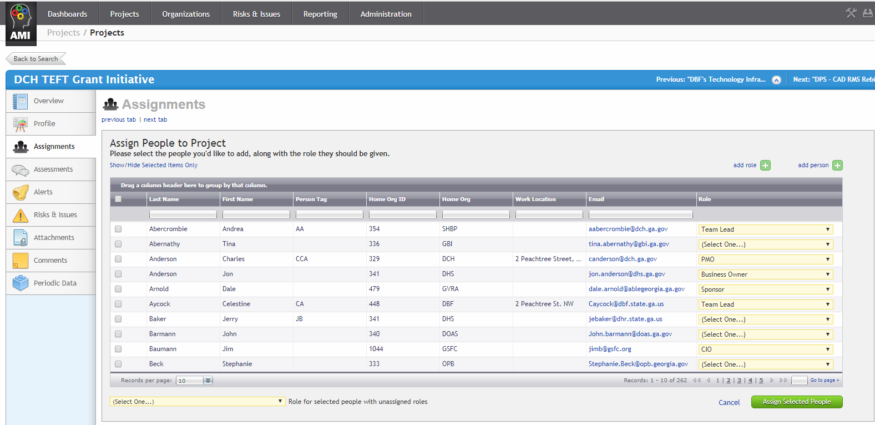
Select People & Roles
Select People and Role from Drop Down
Note: List contains all system resources
Select Assign Selected People
At a minimum, you MUST assign a Sponsor, System PM, CIO and a Business Owner

Slide 31
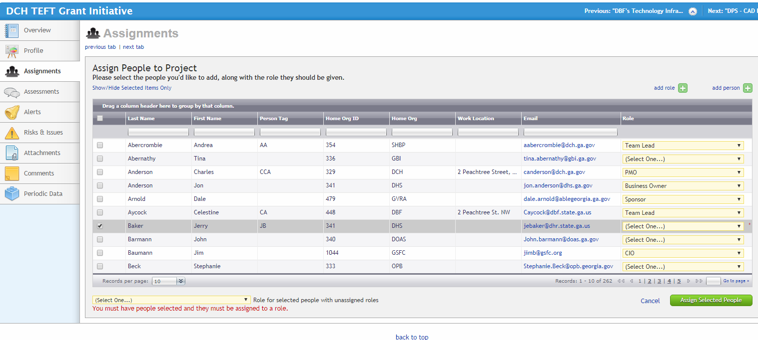
Assign All Roles and Save
All resources MUST be assigned a role in order to save.

Slide 32
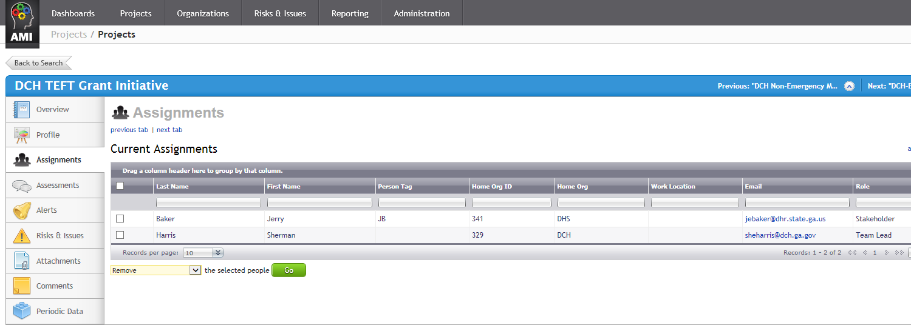
Validate Assignments
Verify People & Roles

Slide 33
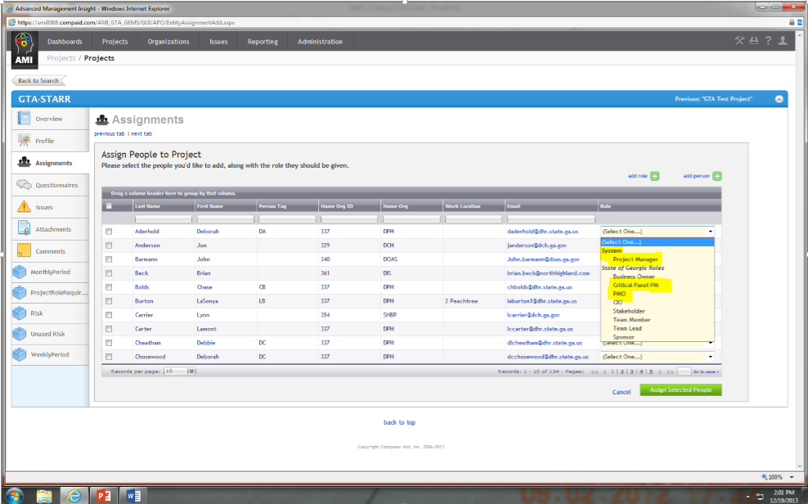
Adding a Critical Panel PM
The System Project Manager is the Critical Panel PM. You can also assign a PMO; however the PMO will not receive the monthly PM status and comments questionnaires.
3 Separate “PM” Roles

Slide 34
Manually Scheduling an Assessment

Slide 35
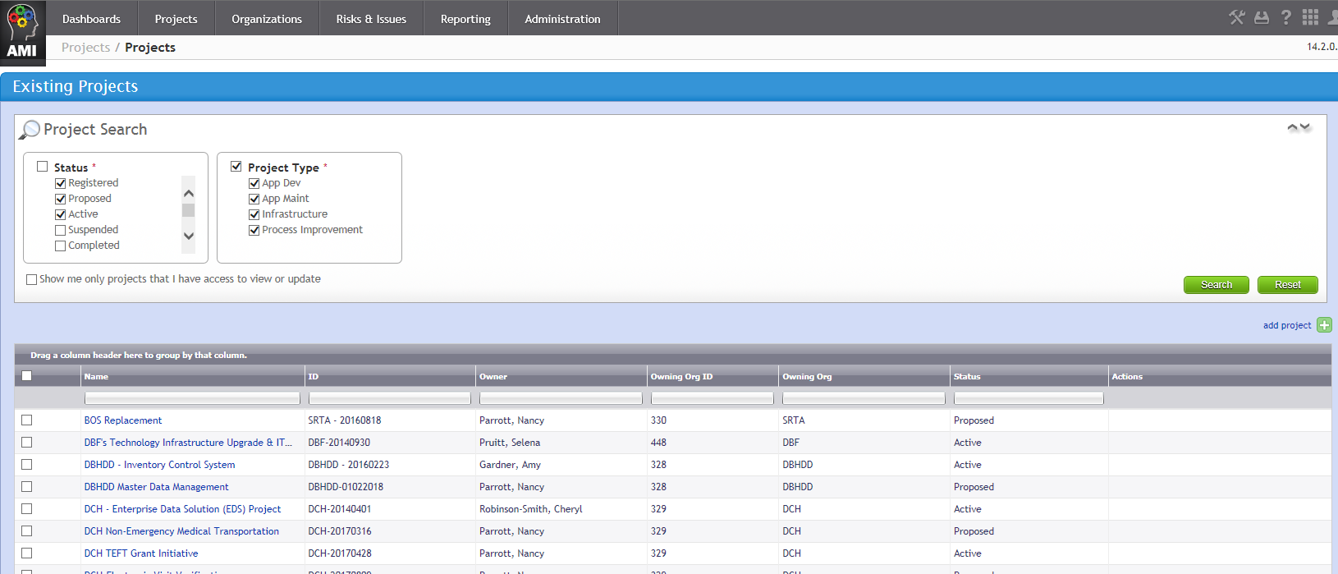
Select Your Project
1. Select Projects, Find/Create Projects
2. Enter your search criteria
3. Select Search
4. Double click on your project

Slide 36
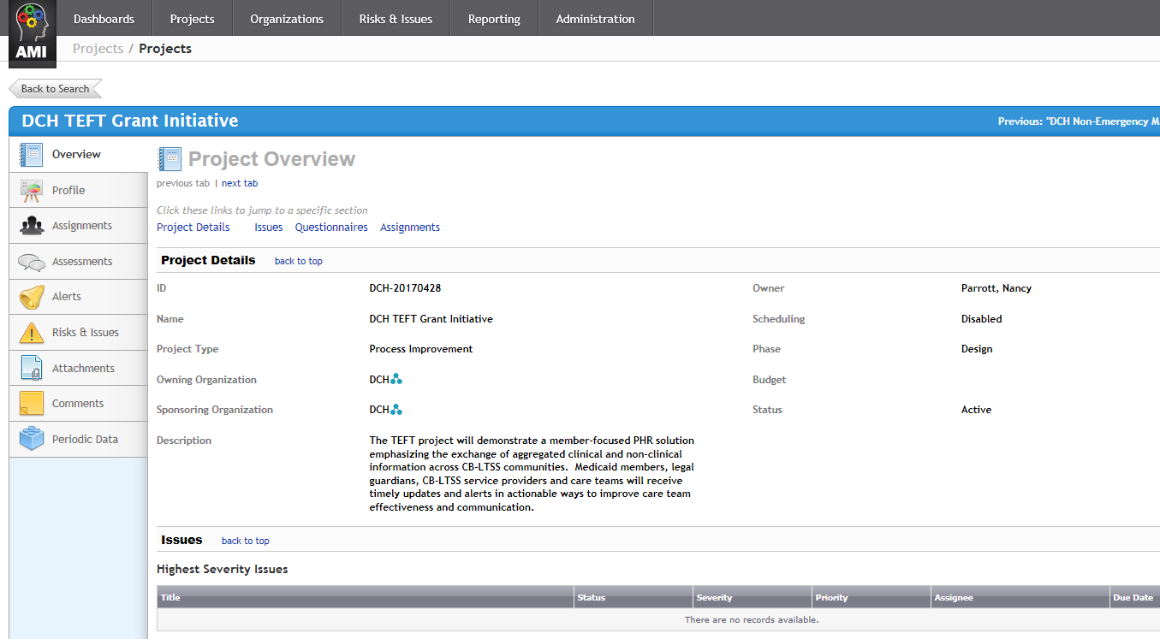
Schedule an Assessment*
Click on the Assignments Tab
* Note: In GEMS the terms Questionnaire and Assessment are both used interchangeably.

Slide 37
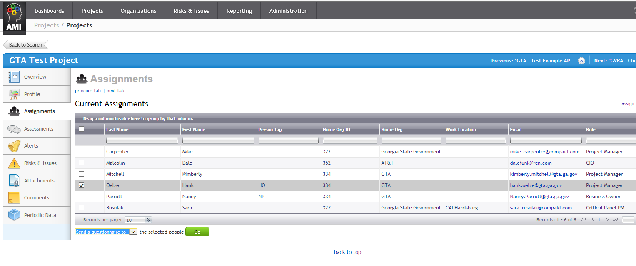
Schedule Questionnaire
Click on Name of the Recipient
Select “Send a questionnaire to” from the drop down
NOTE: You can select multiple people as long as they are all getting the same type of questionnaire. Agencies can only schedule questionnaires manually. Event-triggered questionnaires (CPR) will be managed by GTA

Slide 38
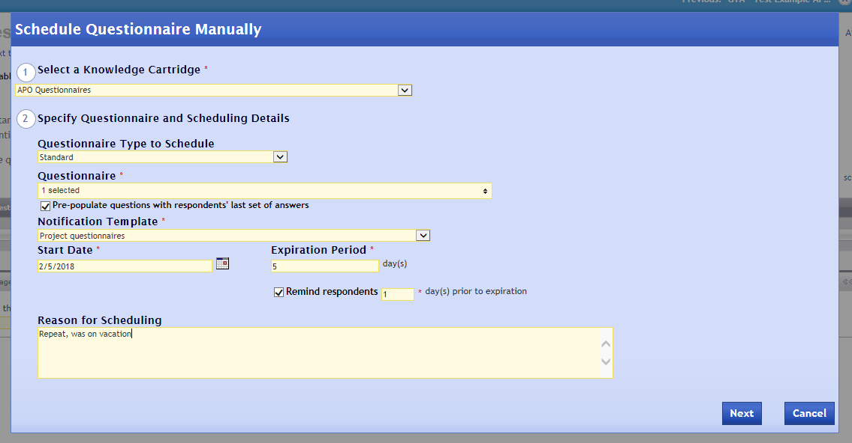
Complete Questionnaire Screen
Select Knowledge Cartridge:
APO = Standard drop-down questionnaires
ITG = Entity (free form) questionnaires
Select Standard or Entity
Select Questionnaire from drop-down
Select Project Questionnaire
Enter the number of days to expire
Insert start date
Enter “1”
Enter the reason for Questionnaire, Optional
NOTE: The system will default to having the questionnaires pre-populated with answers from earlier iterations. If you do not want this option, remove the checkmark.
Select Next

Slide 39
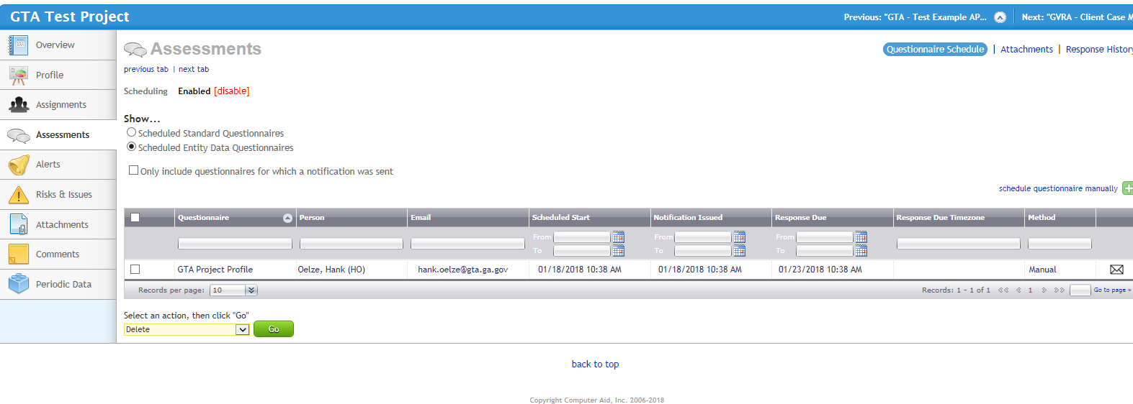
Questionnaire Validation
Verify the questionnaire was scheduled

Slide 40
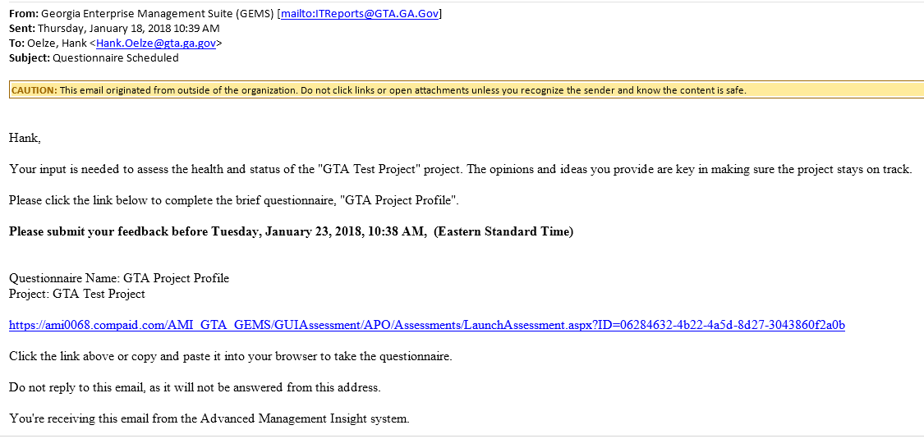
Questionnaire email
The recipient will receive an automated email from GEMS
Verify Project
Verify questionnaire
Verify Expiration
5. Click on this link

Slide 41
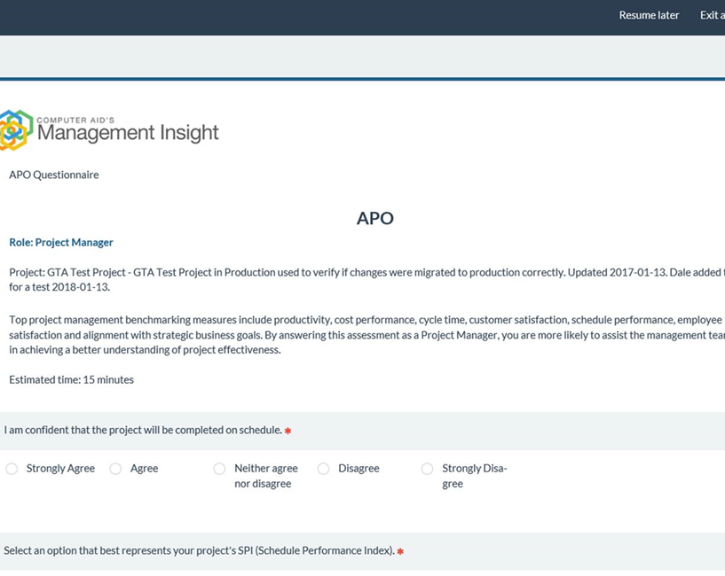
Questionnaire Response
Begin Assessment, the screen will roll upward as you respond to the questions.

Slide 42
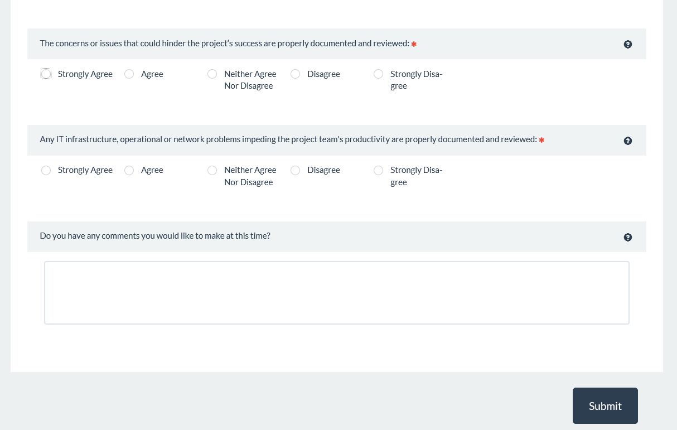
Questionnaire Response
Answer All questions
This comment box is optional in all assessments.
Click Submit

Slide 43
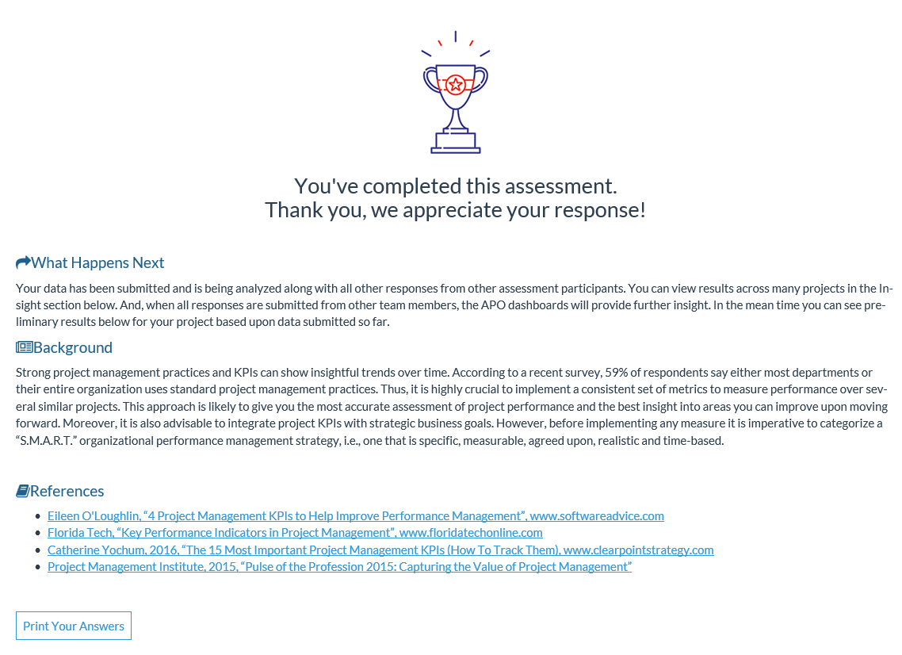
Assessment Complete

Slide 44
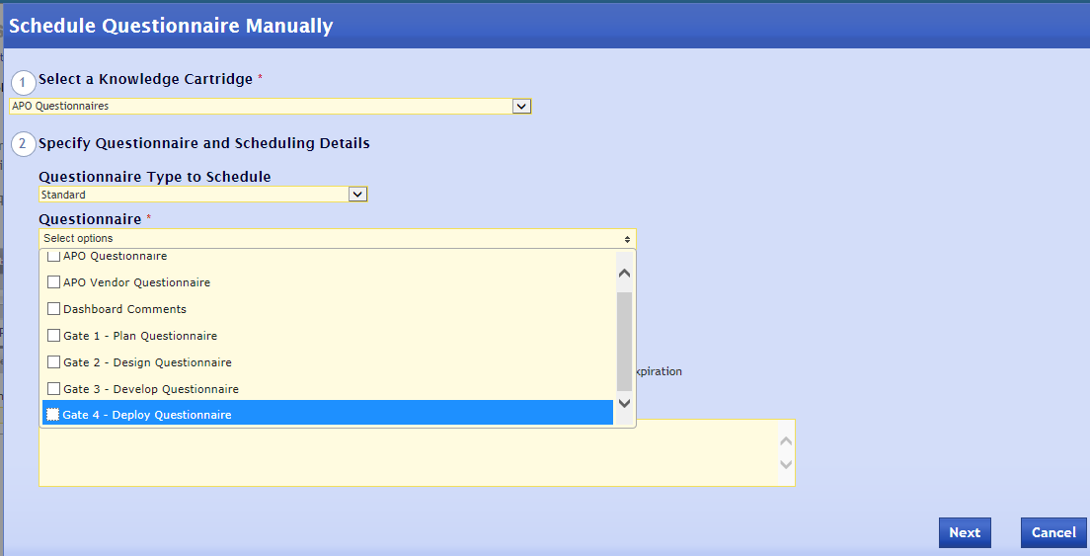
Complete Gate Questionnaires
NOTE: Two Options for Gate Questionnaires
Option 1:
Send a Manual Questionnaire for Gate to PM

Slide 45
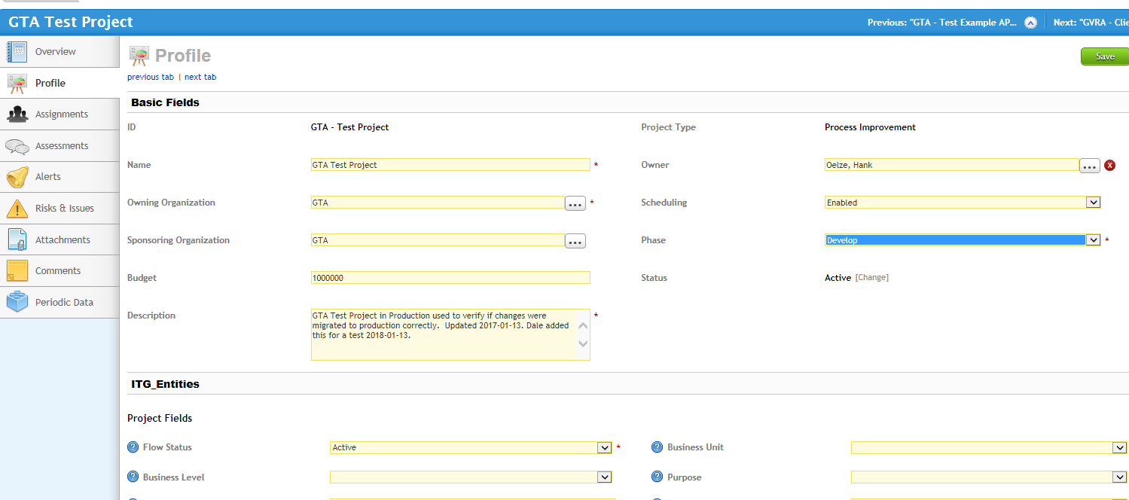
Complete Gate Questionnaires
Option 2
Change Project to Next Phase,
Questionnaire will automatically be sent to System PM.

Slide 46
PM Responsibilities
Monitor gate reviews
Create/change project assignments (at a minimum add a Team Lead and/or Team Member)
Review questionnaire responses
Evaluate project on APO Dashboard
Log and manage issues
Log and manage risks
Perform monthly project updates
Schedule
Budget
Critical Project Comments

Slide 47
Issue Management

Slide 48
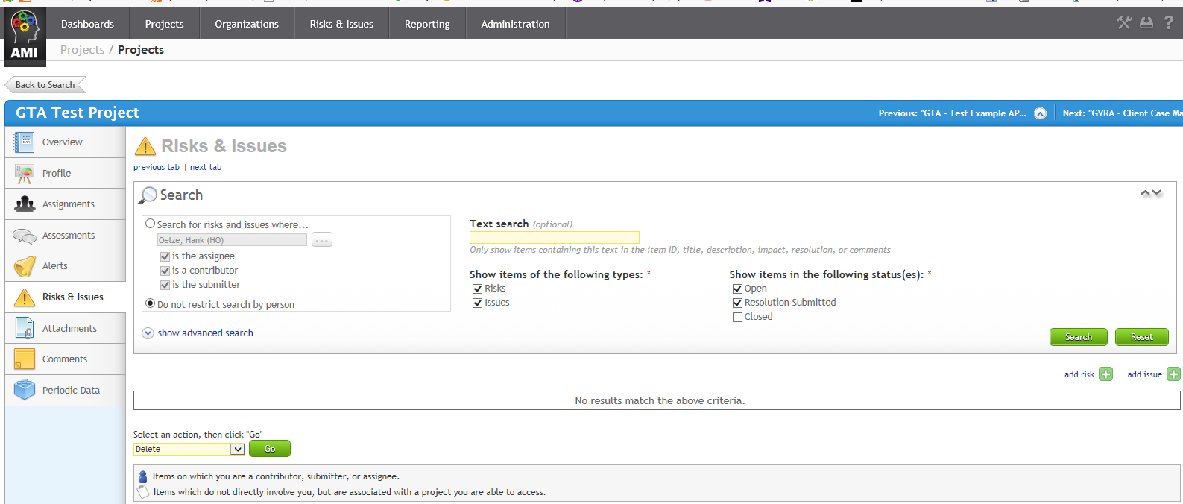
Manage Issues
Select your project
Select Risks & Issues

Slide 49
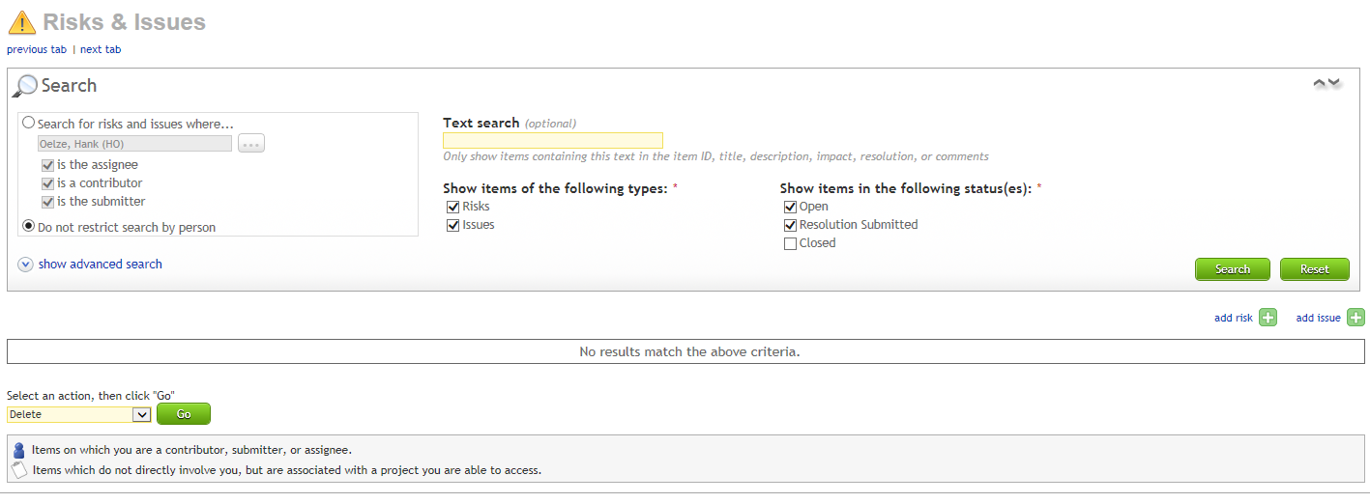
Create a New Issue
Select: add issue

Slide 50
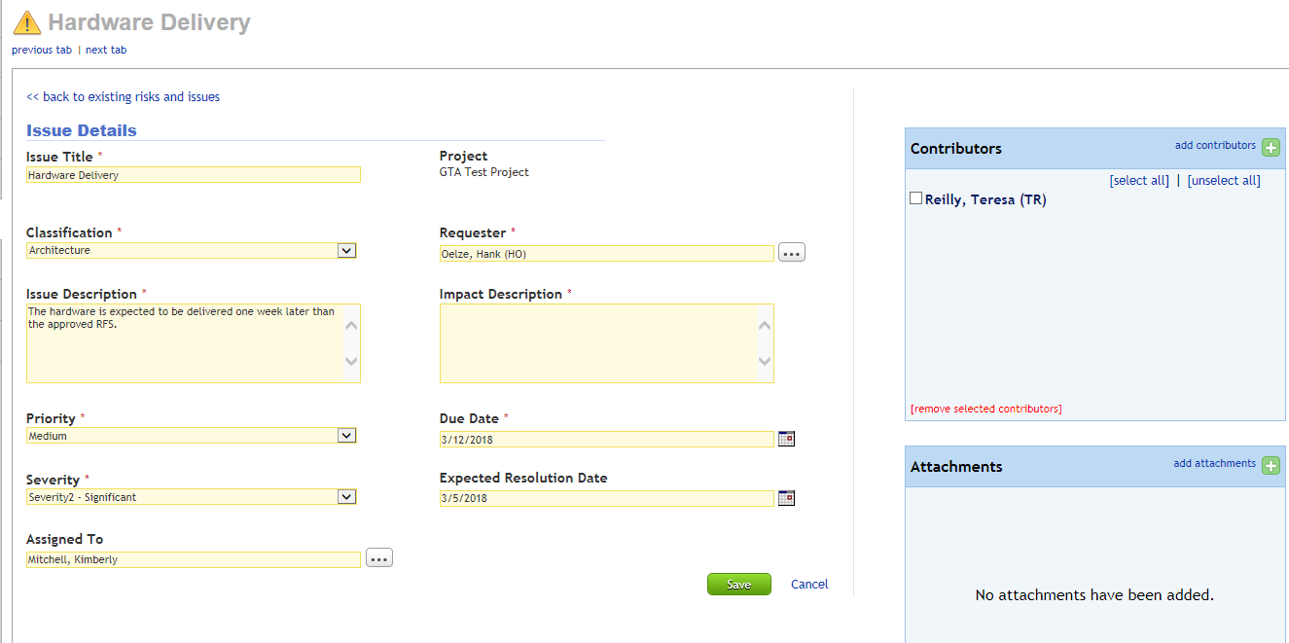
Enter New Issue
Enter Title
Enter Classification
Confirm Requestor
Enter Description
Describe Impact
Select Priority
Enter due date
Select Severity
Enter Resolution Date
Select person to resolve issue

Slide 51
Finalize Issue
Add additional contributors as necessary
Add attachments as necessary
Click Save

Slide 52
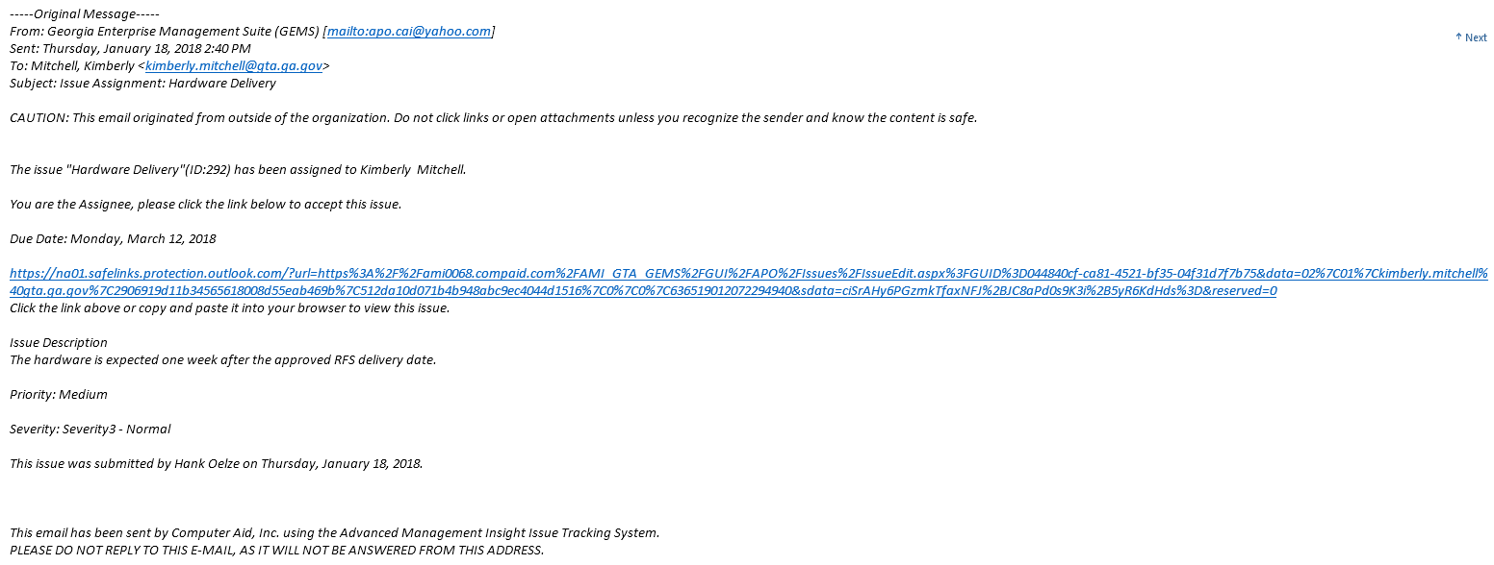
Issue Assignment email
The email is sent to the Issue assignee. The email explains the Issue and contains a hyperlink to GEMS so the assignee can make updates.

Slide 53
Responding to Issue email notification
If you receive a notification, you must either accept or reject the assignment by clicking the link on the email.
Anyone can be assigned an issue, you DO NOT need access to GEMS to accept, comment or close an issue.
Once you log in to GEMS, a dialog box will display and you may enter text describing the issue resolution.

Slide 54
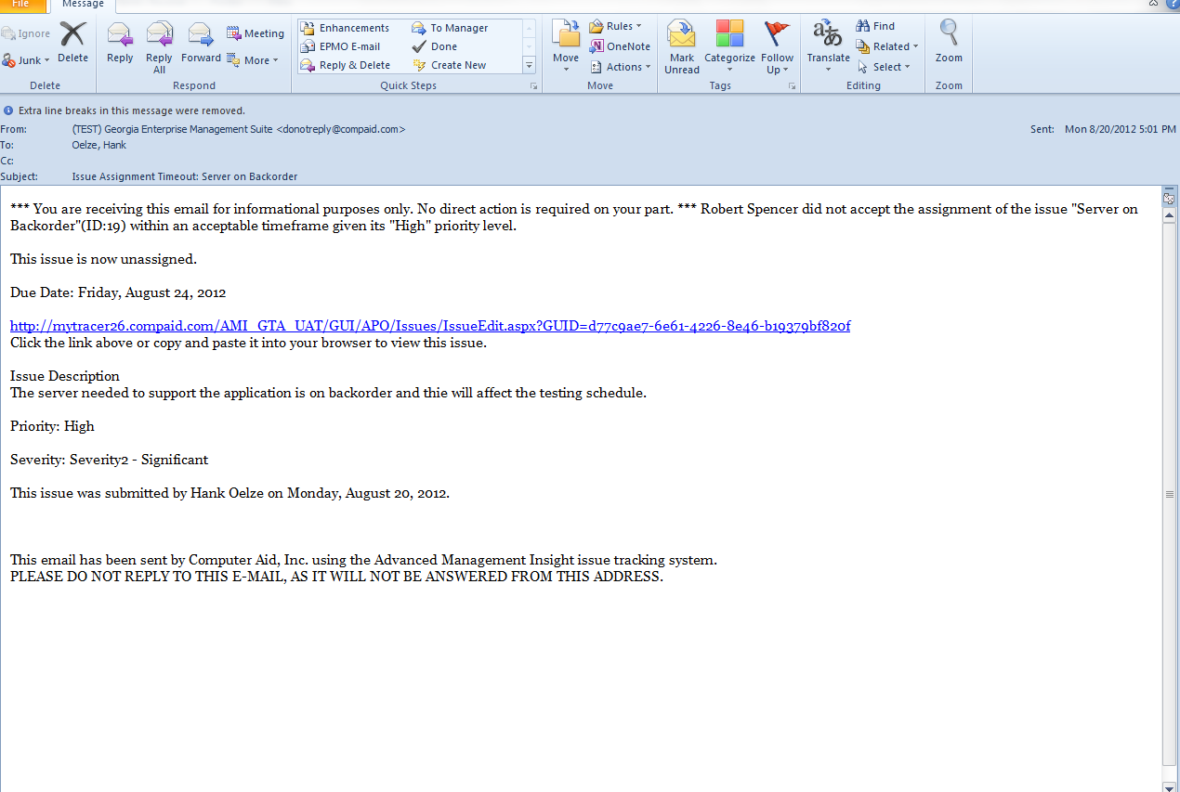
Notification of Unassigned Issue
Your action would be to reassign the Issue

Slide 55
Issue Management
If you need to close an issue and the assignee is no longer available, assign the issue to yourself (as PM). You then have the ability to reassign or close the issue.
Issues should be reviewed once a month, at a minimum.

Slide 56
Risk Management

Slide 57
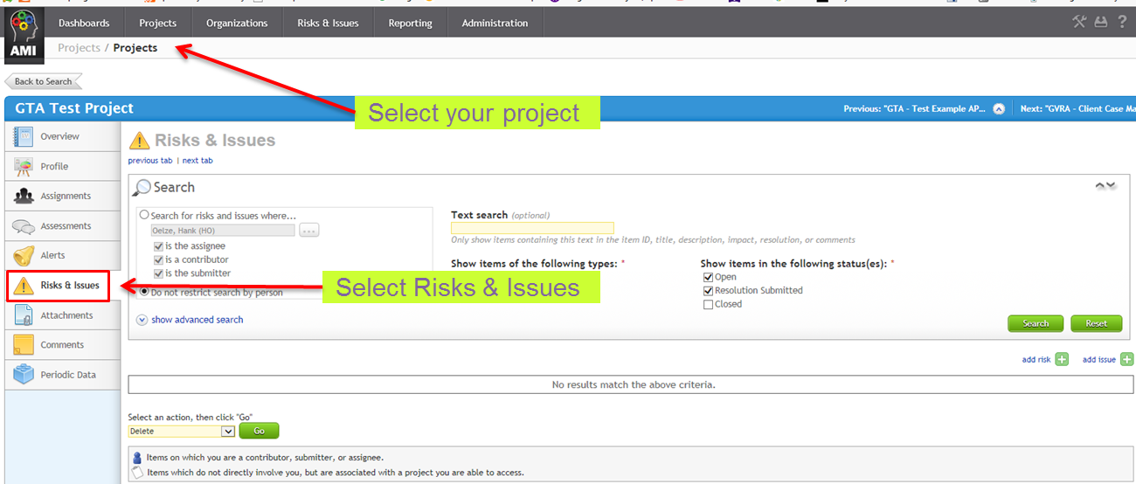
Select Project & Risk Tab

Slide 58
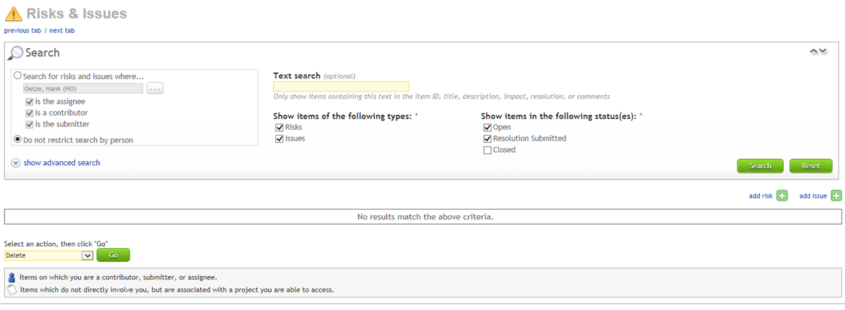
Add Risk
Select: add risk

Slide 59
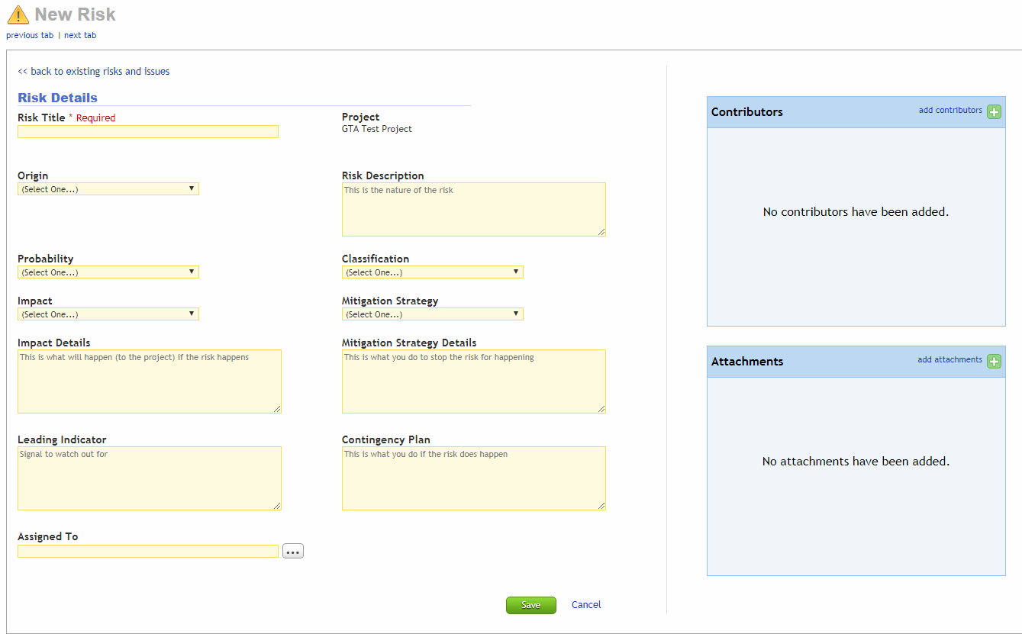
Complete Risk Template
Complete all fields and select save

Slide 60
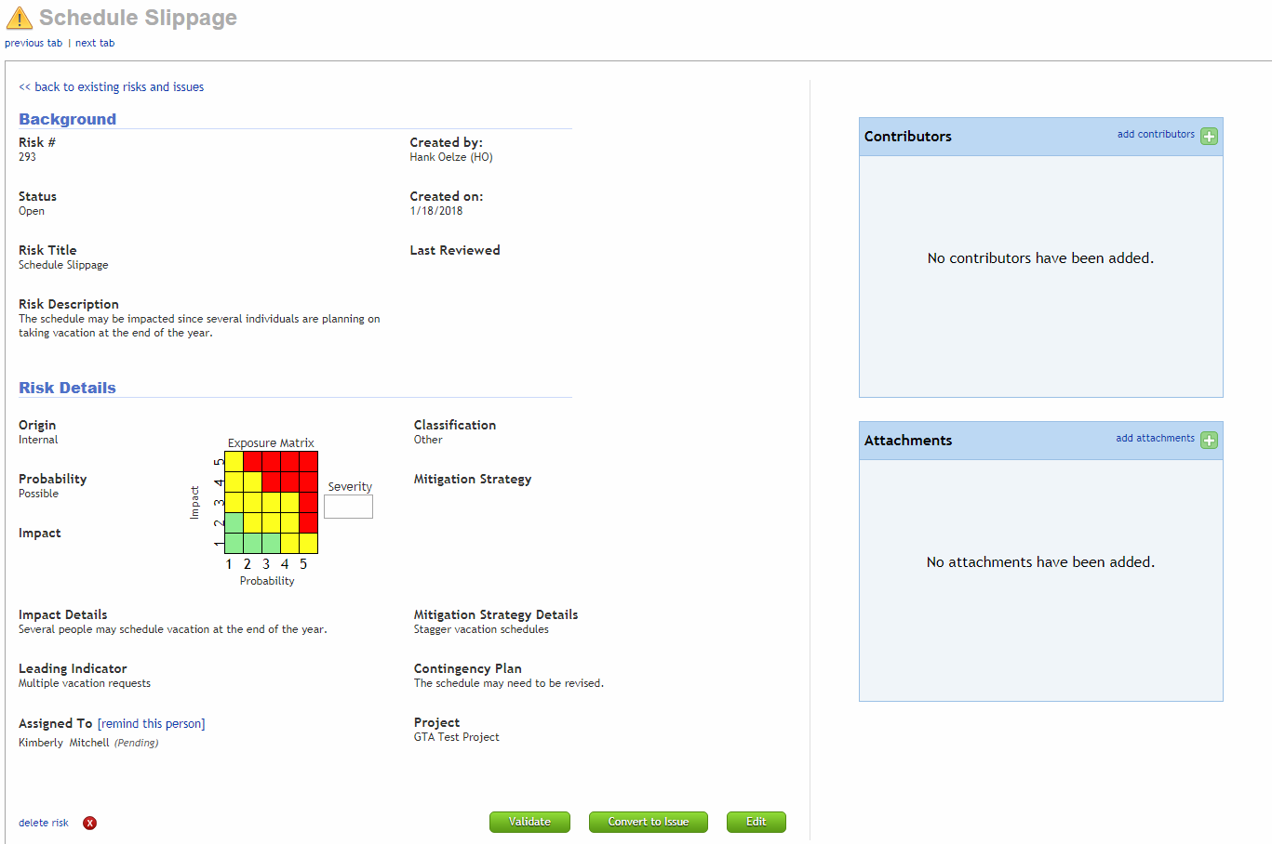
Validate Risk
Once reviewed, Validate Risk

Slide 61
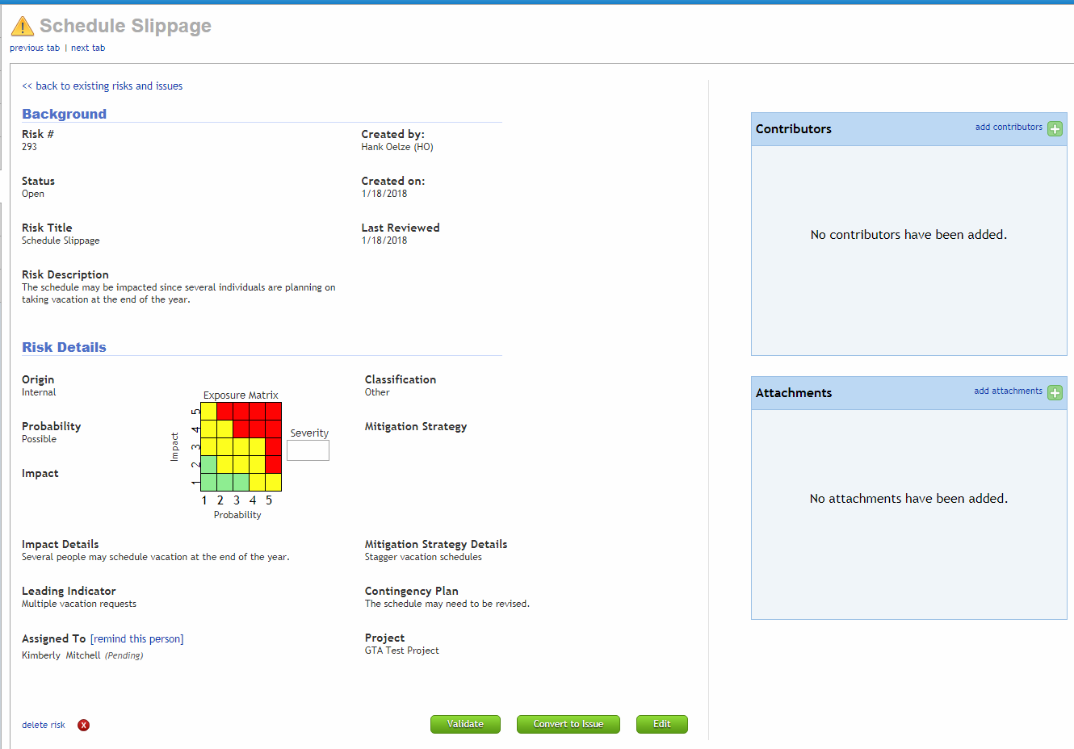
Last Reviewed Field & Convert to a Risk
The validation process updates the Last Reviewed Field
You can convert a Risk into an Issue

Slide 62
Risk Assignment email
The validation process updates the Last Reviewed Field
The email is sent to the Risk Owner. The email explains the Risk and contains a hyperlink to GEMS so the owner can make updates.

Slide 63
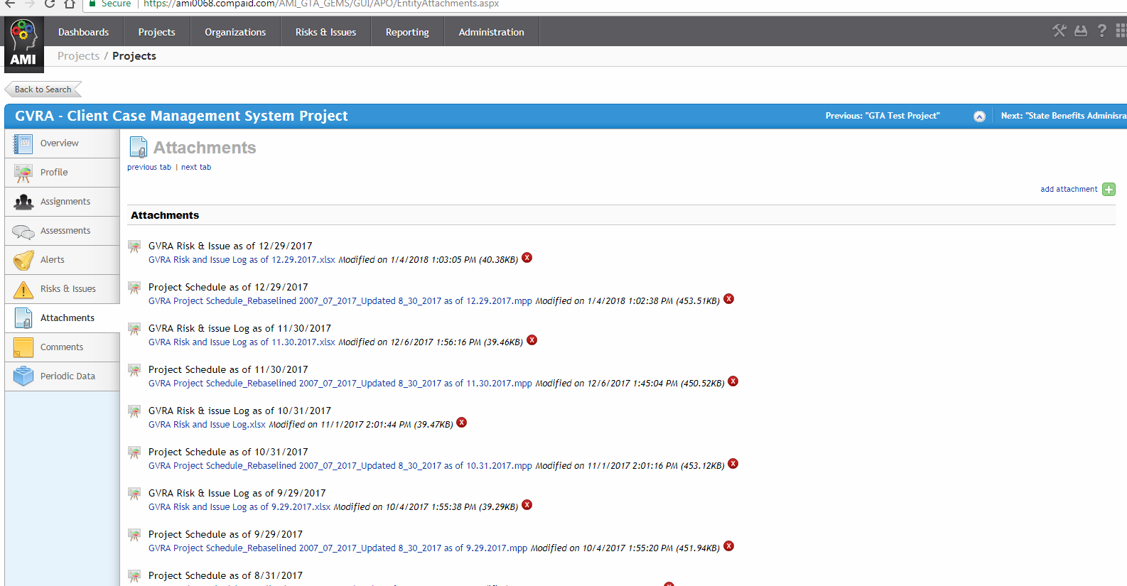
Issue & Risk Attachments
If you use the vendor’s Issue/Risk logs, they must be attached. This is an exception and must be approved by GTA.
Select: add attachment
Select: Attachments

Slide 64
PM Monthly Updates
Revise Project Assignments as Necessary
Schedule and Ensure Completion of Questionnaires
Update project (key project data or Profile Questionnaire)
Update Issues
Update Risks & validation process to update Last Reviewed Field
Complete Gate Reviews to align with Project Phase

Slide 65
Additional PM Monthly Updates
Update Project Schedule and Budget Data. Information can be keyed into the Project Data or loaded via the Project Profile Questionnaire.
Planned Baseline Start Date
Actual Start Date
Planned Baseline Finish Date
Actual Finish Date
Percent Work Complete
Baseline Effort
Duration
SPI
Total Budget (State)
Total Budget (Other Funds)
Total Planned Expenditures
Total Actual Expenditures
Estimated Funds Needed to Complete

Slide 66
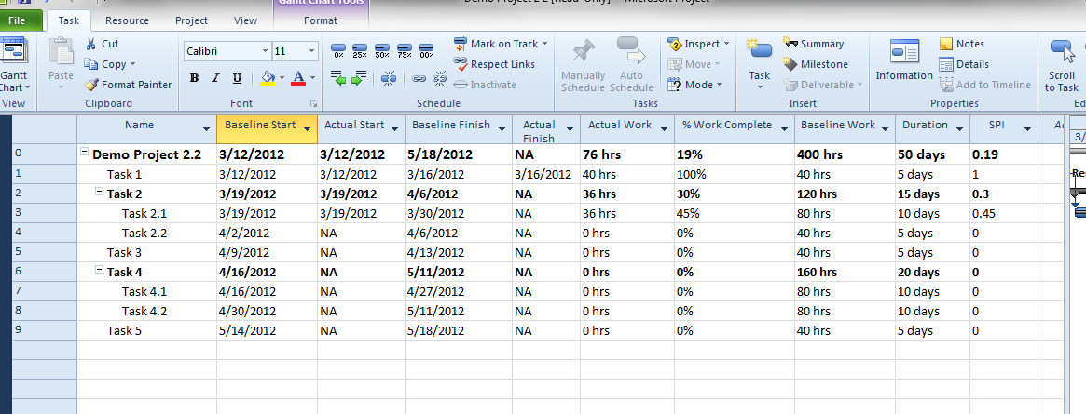
Required Project Schedule Data
Summary data from your project plan is entered into GEMS
Baseline Start
Actual Start
Baseline Finish
Actual Finish
% Work Complete
Baseline Work
Duration
SPI

Slide 67
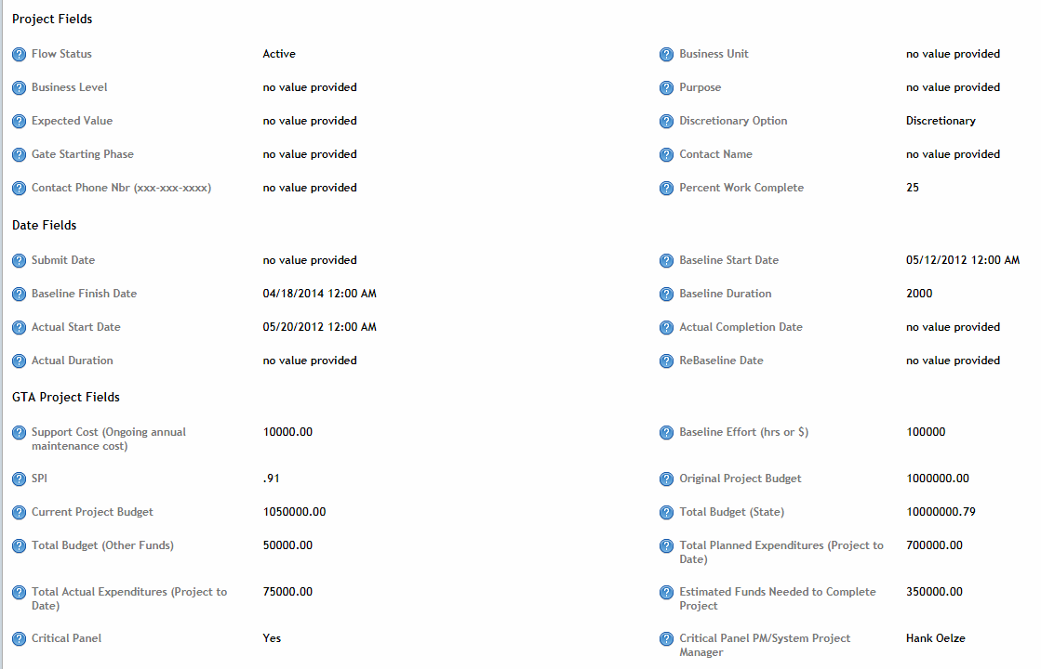
Schedule & Budget Data Entry in GEMS
Note: This information can be keyed or entered via the Project Profile Questionnaire
Fields Requiring Monthly Updates

Slide 68
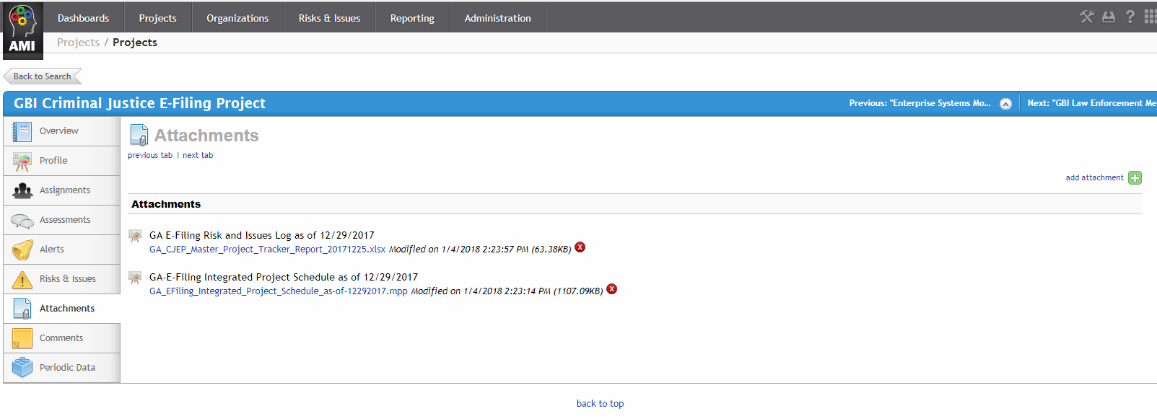
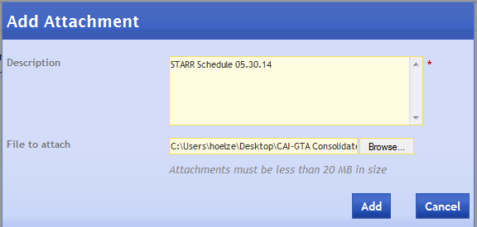
Project Schedule - Attachments
Note: For CPR projects, your project schedule must be attached once each month.
Select add attachment
Select the Attachments tab
Locate your project schedule via the Browse, change Description and Attachment name to reflect “GEMS Project Name & Date”, example, STARR 05.30.18. Select “Add”

Slide 69
Critical Panel Requirements
Revise Project Assignments as Necessary
Ensure Completion of Questionnaires
Update Risks
Update Issues
Update and Attach the Project Schedule
Update Project Data (Information can be keyed into the Project Data or loaded via the Project Profile Questionnaire)
Complete Gate Reviews to align with Project Phase
Complete Dashboard Comments Questionnaire

Slide 70
APO - Dashboards

Slide 71
GEMS APO - Dashboards
APO: Primary Focus

Slide 72
My Projects
Note Background Color: Blue = All Projects
Selecting APO will bring you to the “MY PROJECTS” page.

Slide 73
Apply Filters
Select the Filter Option to open the filter Screen
Apply your filters and select: Apply

Slide 74
Select Project
Select your project by clicking on name.

Slide 75
Overview of Project
Note Background Color: Grey = One Project

Slide 76
Apply Project Filters
You can set your project-level filters. The date range defaults to the last two full weeks so we recommend a full month.
Select: Apply

Slide 77
Project Overview
This is the new standard Overview project dashboard.

Slide 78
Tab Options
Overview is the Project Dashboard
Human Feedback is data points driven by Questionnaires
Operational Data is all project information including risks and issues
Participation is questionnaire response rates
Question Analysis is question response data
Diary is a project manager’s log
Reports is where you can print canned reports

Slide 79
Human Feedback Tab
This Dashboard is similar to the old CPR Dashboard. The KPIs are driven from the questionnaire responses.

Slide 80
Operational Data Tab
This tab displays all the operational data, project data, risks, issues, etc.

Slide 81
Operational Data Tab
You can scroll down to see other project-related information.

Slide 82
Operational Data Tab
You can scroll down to Risks and Issues.

Slide 83
Participation Tab
This Dashboard depicts the questionnaire response rates.
EDQ is Entity Data Questionnaire (free form data entry versus drop-down)

Slide 84
Question Analysis Tab
This tab displays the question responses that drive the KPIs.

Slide 85
Diary Tab
This tab is for the PM to document project comments.

Slide 86
Reports Tab
This tab is used to create & print project reports
Select the Report you want to print

Slide 87
Reports Tab - Select Filter Criteria
Select the filter parameters and click confirm

Slide 88
Reports Tab - Save Filter & Execute
You can save your filter settings if this is a repetitive request.
Then select Execute

Slide 89
Reports Tab - Print Options
Select your print option, recommend Export, PDF.

Slide 90
Reports Tab – Error Message
If you receive an error message, you can most likely fix the error by clearing the Google cache.
1. Select the Three Vertical Dots
2. Select More Tools
3. Select Clear browsing data

Slide 91
Reports Tab – Error Message
If you receive an error message, you can most likely fix the error by clearing the Google cache.
Select the Three Vertical Dots
Select More Tools
Select these two check boxes and then select Clear Data.

Slide 92
Monitor Questionnaire Responses
Remember – Questionnaires drive the dials.
You, as the PM, should monitor the responses to ensure there are no surprises.
The responses should be evaluated before you enter your monthly comments.

Slide 93
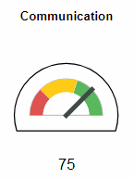
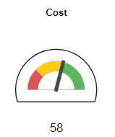
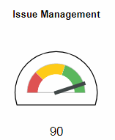
Key Performance Indicators
Communication
Quality of communication, both upwards and downwards
Level of training for customers/users
Sufficiency of project status reporting to all stakeholders
Requirements defined and communicated well enough to move forward
Cost
Confidence that budget contingency amount is sufficient
Sustainability model that is defined and regularly reviewed
Project-to-date costs meeting expectations
Issue Management
Effectiveness of issue management occurring
Escalation path in place for all issues
Timely resolution of issues

Slide 94
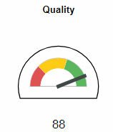
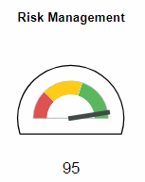
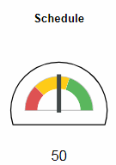
Key Performance Indicators
Quality
Acceptability of deliverables reviewed during last reporting period
Satisfaction with quality of work product to date
Success criteria well defined
Risk Management
Effectiveness of risk management occurring
Documented response strategies for risks
Level of risk carried by the project
Schedule
Confidence in viability of the schedule
Performance against the schedule (SPI)
Changes to schedule expectations
Submission of schedule into tool

Slide 95
Key Performance Indicators
Vendor
Alignment of vendor’s schedule with the State’s schedule
Communication between organizations
Resources are available as needed
Scope and schedule changes follow established control process

Slide 96
Critical Panel View
Dials are driven by Questionnaires ONLY
Six Month Trend
Comments Are Populated From Dashboard Comments Questionnaire
Comments on ALL KPIs are required.
250 Character Max

Slide 98
Critical Panel Timeline (Approximate)
7 days
Ensure All Questionnaires are Answered
5 days
Review Answers and Identify Exceptions
3 days
Review results with Management (and IV&V if applicable)
1 day
Complete Comments Questionnaire
CPR
GTA Dashboard Due Date

Slide 99
GEMS Quality Control
Sent monthly to the PM
Repeated errors are escalated to CIO, Agency Head
Checklist includes questionnaire respondent list
Schedule (.mpp) is also QC’d
Note: This is GEMS Reporting QC, not Project Health

Slide 100
Additional GEMS AMI Help
Online Help = ?

Slide 101
Additional GEMS AMI Help
AMI Online Help
Excellent Video Tutorials

Slide 102
AMI Video Tutorials
AMI Online Help
Excellent Video Tutorials

Slide 103
Additional GEMS APO Help
Online Help

Slide 104
Additional GEMS APO Help
Online Help

Slide 105
GEMS Support
Hank Oelze, hank.oelze@gta.ga.gov
C: (404) 782-2743
Kimberly Mitchell, kimberly.mitchell@gta.ga.gov
C: (404) 536-6004
Production Site:
https://ami0068.compaid.com/managementinsight

Slide 106
Questions

