Slide 1
Procurement’s Value Proposition
Kurt Albertson
Principal, Procurement Advisory
May 9th, 2016

Slide 2
Areas to explore
What is the role and associated priorities for Procurement and how do these evolve?
What is the potential impact of not involving Procurement formally?
What level of value does Procurement deliver?
What are the key capabilities within Procurement and associated trends?

Slide 3
Procurement's role in the organization generally evolves as organizational objectives change
Role
Procurement’s Evolving Role
+
Value
Mgmt.
Trusted business advisor and change agent
Demand
Management
Spend/ budget consultant & relationship manager
Total Cost of Ownership
Supply expert, supplier performance, team leader, project manager
Value
Price
Negotiator
Supply Assurance
Buyer / Planner

Slide 4
Specific objectives for Procurement in 2016: How do your objectives compare?
Priority
% of Respondents who Selected the Objective as having Critical or Major Importance in 2016
✓
✓
✓
✓
Top ten list for NASPO
Source: Key Issues Study, The Hackett Group, 2016

Slide 5
What capabilities does Procurement feel are critical or major to achieve its 2016 objectives?
Priority
% of Respondents who Ranked the Capability a Critical or Major Area of Focus to Support Procurement’s Objectives.
✓
✓
✓
✓
✓
✓
✓
✓
Top ten list for NASPO
Source: Key Issues Study, The Hackett Group, 2016

Slide 6
Top ten priorities for State Procurement in 2016
Priority
Process reform and reengineering ✓
Measuring performance ✓
Professionalization (e.g. talent development) (evolving process for Georgia)
E-Procurement/ERP solutions (e.g. technology) ✓
State-wide centralization (e.g. centralization of procurement) ✗
Information Technology procurement transformation ✗
Fair competition and ethics 
Contract management 
Staff recruiting and retention 
Sourcing Strategies (to drive efficiencies and savings) 
✓
Completed in Georgia
Georgia Priority
Will not implement in Georgia
★
✗
Source: NASPO

Slide 7
Lost savings is the most visible impact of informal procurement engagement by stakeholders
Impact
Percentage of targeted / negotiated cost reductions lost due to maverick buying
The Hackett Group Procurement Benchmark-2015
Notes:
Metric Ids:
143985 143986 143987 143988 143989 143990 143991 143992 143993 145736

Slide 8
But supplier proliferation also increases internal costs as well as adds to the risk profile of the organization
Impact
Procurement Cost vs. Supply Base Rationalization
Main drivers of supply risk management

Slide 9
Protecting the organization from risk is a key priority for Procurement. What risks impact you?
Impact
 | Top 10 events with the highest risk exposure
1 | Fiscal crises in key economies
2 | Unexpected regulatory changes, non-compliance
3 | Large-scale cyber-attacks
4 | Environmental disasters (e.g., storms, floods, fires, power outages)
5 | Supplier competitive events (acquisitions, mergers)
6 | Purchase price escalation (including currency/inflation) effects
7 | Price and supply volatility (sudden price and capacity changes)
8 | Unfavorable currency movements
9 | Loss/theft of sensitive/private data
10 | Data loss/theft (i.e., the unauthorized modification, deletion, or disclosure of confidential and/or personal information)
Hackett Risk Management Study

Slide 10
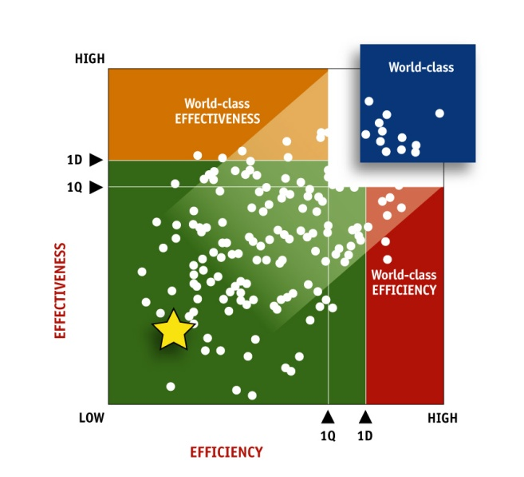
Value
World-class procurement organizations outperform their peers: What are your performance expectations?
Hackett Value Grid™ (Procurement Example)
EFFECTIVENESS
Economic return Role of procurement Process quality Supplier leverage & performance Information & analysis Business Integration Examples: Total spend cost reduction and avoidance as a % of spend % of suppliers comprising top 80% of spend % of transactions requiring post-issuance (i.e., rework) activity % of total spend under procurement management influence Internal customer satisfaction rating
EFFICIENCY
Process costs Staffing levels Productivity Cycle times Technology leverage Cost per transaction Examples: Cost as a % of spend By Geography, Business Unit FTEs per $1B of spend # of POs processed per FTE PO processing cycle time Staff time allocation by process Ratio of labor to technology cost

Slide 11
The highest level efficiency and effectiveness metrics for Procurement are savings and cost
Value
What measurements are important to the State of Georgia?

Slide 12
In 2016, procurement’s #2 priority was to elevate its role to a trusted advisor (e.g. professionalism)
Capability
Which capabilities will help the most to achieve trusted advisor status?
81%
Ranked elevating the role of procurement to a trusted advisor as a critical or major objective in 2016
Source: Key Issues Study, The Hackett Group, 2015
Source: The Hackett Group, 2015

Slide 13
Procurement needs a structured approach to improving the customer/stakeholder experience
Capability
Improving the customer experience
Customer segmentation
Identify
customers
Monitor
and inform
occasionally
Key players
Engage
actively and
keep satisfied
Improving
the customer
experience
Measure
success
Influence
Analyze
results
Minimal
effort
Keep
informed
Take
action
Importance

Slide 14
Strategic sourcing is a sub-set of a broader strategic category management framework
Capability
Category value objectives link to stakeholder objectives
Reduce TCO
Increase revenue
Support other goals
Reduce purchased costs
Improve quality
Improve marketing effectiveness
Improve flexibility/ responsiveness/delivery
Reduce logistics costs
Reduce working capital
Enhance new product development
Assurance of Supply Risk
Reduce internal process costs
Improve delivery performance
Enter new markets
Support sustainability goals
Reduce other costs
Reduce fixed costs
Enable new business capabilities
Strengthen the Brand and Brand Protection
Margin Stability
Regulatory Compliance Risk
Strategic Sourcing Primary Focus
Health & Safety
IP Protection
Category Strategies Pull Multiple Value Levers
Category Sourcing
Product/Service
Process
Supply Base
Overall
Competitive Bid
Value Engineering
Internal Compliance Management
SRM – Supplier Performance Mgmt
Risk Management
Best Cost Country Sourcing
Design for Supply Chain
Internal Demand Management
SRM – Restructure Supplier Relationship
Supply/Market Analytics
Outsourcing/ make vs. buy
Vendor Own Inventory
Purchase-to-Pay Channel Optimization
SRM - Supplier Collaboration & Dev
Contract Terms Optimization
Lease vs. Buy
Vendor Managed Inventory
Payment Term Optimization
SRM - Supplier Engagement in NPDI
Hedging Strategies
Direct Negotiation
Product Waste Elimination
Supplier Integration
Tier 2 Supply Base Mgmt/Collaboration
Demand Planning & Forecasting
Requirements Optimization
Process Audits
Value Chain Network Reconfiguration
Policy Optimization
Supply Certification/ Audits
Supply Chain Financing
Notes:
***Note that v10 of deck had duplicate grey boxes called “category value objectives….”. I have replaced the second gray box with the correct label.
…In other words strategic sourcing it comes merely one lever in a broader framework; and purchased cost reduction (and even TCO) becomes only one of many category objectives value by the stakeholders. These will vary by subcategory/commodity as will the levers.
We do multi-day training on this topic so obviously we cannot get too deep into this but let’s just take a lever called demand management, which is sometimes bundled in with strategic sourcing, and look at the value of involving procurement earlier to help shape demand and better organize sourcing activities around that earlier visibility into demand.

Slide 15
Source-to-pay supporting technology
Capability
Supplier Life Cycle Management
(Supplier master data, performance and risk)
Track performance, monitor risk, aggregate third-party data on suppliers, maintain master data, view performance
Automated spend analysis
Contract life cycle management
Maintain e-catalogs
Search approved suppliers
“Punch-out” to supplier catalogs
Create requisitions
Manage approval workflow
Auto-generate PO
Notify suppliers
Update receiving status
Automated spend
analysis
E-sourcing
Contract life cycle management
E-Procurement
Services
procurement
E-invoicing
Identify category opportunities
Aggregate and report on enterprise spend
Cleanse and rationalize spend data
Define requirements/ aggregate demand
Conduct RFX
Evaluate suppliers
Optimize bids
Conduct e-auctions
Create and store contracts
Maintain standard templates
Manage negotiation workflow
Alert on milestones
Manage requisition workflow
Benchmark rates
Maintain service agreements
Track time and approval workflow
Input/upload invoices
Match invoices
Manage discrepancy resolution
Approve payments
E-procurement software may be acquired either as a module within a broader ERP suite or as a standalone, procurement-specific solution.

Slide 16
What Is spend analysis?
Capability
Spend analysis is the process of aggregating, cleansing and analyzing corporate spending data for the purposes of reducing costs and improving operational performance
Spend analysis (and the visibility it enables) provides the necessary foundation for procurement organizations to make better, more informed sourcing decisions
Spend analysis enables one to answer the following questions:
Who is buying
What is being bought
From whom
When
Where (optional)
At what price
Benefits of spend analysis solution | Actually Achieved
Identified and reduced non-compliant spend by: | 18%
Identified cost savings opportunities leading to additional strategic sourcing savings of (on average): | 15%
Identified opportunities and was able to consolidate the supply base by: | 8%
Companies conduct analysis on an average of 73% of indirect spend

Slide 17
Top Performers drive nearly half of their indirect transactions through E-catalogs
Capability
Percent of Indirect Transactions thru E-catalog
Process Cost = Requisitioning & PO Processing (Labor + Outsourcing)

Slide 18
Contract management solutions automate the contract lifecycle
Capability
Contract Lifecycle Management
Contract Authoring
Contract Negotiation
Contract Repository
Contract Compliance
Contract Administration
Contract Analysis

Slide 19
Involving top employees, behavioural interviews, intern programs, and aptitude tests most effective for recruiting
Capability
Poor Performers
Underperformers
Second Tier
Top Tier
High
Ubiquitous
Internet job websites
Recruiting
from other parts
Search firms
Hiring from external service providers
Behavioral interviewing
Broadly Used
Social networking sites
Involving best employees
Referral programs
Utilization
Intern Programs
Majority
Niche
Aptitude tests
Signing bonuses
-
Psychographic profiling and testing
Low
Low
Effectiveness
High
RECRUITING
HIRING
Notes:
N=150
A crisis of leadership?
Keeping pace with changing demands on the function – do we have the right skills to succeed?
And will we be able to attract and retain the right people?
Can we offer them adequate career paths?
And what about forces driving change in our talent picture?

Slide 20
Informal performance conversations, flexible work scheduled, and career progression paths are most effective for retention
Capability
Poor Performers
Underperformers
Second Tier
Top Tier
Annual performance
High
reviews
Regular informal performance conservations
Ubiquitous
L & D
Career progression
Compensation/bonus
Broadly Used
Flexible working
Utilization
Recognition programs
Majority
360 degree appraisals
Niche
Forced Ranking Appraisals
-
Low
Low
Effectiveness
High
STAFF RETENTION
STAFF APPRAISAL

Slide 21
There are three key components of an SRM process along with supporting system functionality
Capability
SRM Definition & Best Practices
Supplier
Stratification
SRM
Governance
Performance Management
SRM Systems
We will discuss this more in session four

Slide 22
Trends with the greatest transformational impact on Procurement over the next ten years
Trend
Which trends will have the greatest transformational impact on the way procurement performs its job over the next decade?
Source: Key Issues Study, The Hackett Group, 2016
Notes:
Write in for “other”? Need to weave in predictive analytics into the priorities.

Slide 23
Contact information
Kurt Albertson
Principal, Procurement Advisory
The Hackett Group
770-225-7570 | office
kalbertson@thehackettgroup.com
Amsterdam | Atlanta | Frankfurt | Hyderabad | London
Miami | New York | Paris | Philadelphia | San Francisco | Sydney

