Slide 1
GTA's Technology Summit Sharing Information to Advance Citizen Services
May 11, 2015
Making shared accountability work in a
multi-provider environment

Slide 2
Agenda
Shared Services Platform
  Evolution
  Key Elements
Services Integrator
  Key Elements
  Process Responsibilities
Lessons Learned / Best Practices
Questions

Slide 3
The sourcing model is evolving …
Division & Substitution
Collaboration & Optimization
Transactional
Defined Scope
Defined Objectives
Integrated Platform
Standards Based
Shared Goals
One time project savings
Sustained savings
Low change risk
Accountability to results
… from substitution and re-organization to integration

Slide 4
The Evolving Shared Services Platform
Maturity Model Stages for Services Sourcing
Stages
Stage 5: Fully Integrated Shared Services Platform
Stage 4: Integrating Services
Stage 3: Managed Portfolios (Sophisticated Customers)
Most clients operate at stage 2 or stage 3
Stage 2: Managed Services Silos
Stage 1: Staff Augmentation
Key Characteristic
Labor arbitrage model
Outcomes pricing
Intro multi-supplier environment
Process alignment
Increasingly complex multi-supplier environments
Process integration
Intro Plug & Play capability
Process optimization
True Plug & Play capability
Time
Goal / Benefit
1st level cost savings
Quality and price control
Unlock 2nd level cost savings
Next level quality control / productivity
Flexibility
Cost and quality maintenance
Efficiency and productivity gains

Slide 5
A Successful Shared Services Platform
A Service Integration function can be successful only if key elements are present and active in the organization.

Slide 6
Key Elements – Shared Services Platform
A well defined and transparent rules based environment
Capable of making equitable adjustments among competing interests
A learning environment that can adapt to change and adopt valuable custom and practice on a consensual basis
Able to balance the interests of the enterprise with the exceptions of the custom project
Maintains competitive pressure through low barriers to change and an effective capability to ‘plug & play’

Slide 7
Services Integrator – Key Elements
Facilitates an open platform for any vendor and any scope
Presents a seasoned process management methodology acceptable to all
Embraces shared accountability for performance in a shared environment
Operates as a subject matter expert for the cross functional services disciplines
Supports the ‘plug & play’ objectives of a shared services platform through proactive engagement in change management

Slide 8
Services Integrator Responsibilities
Building on the ITIL v3 Framework of Processes across five Service Management Areas
Service Strategy | Service Design |  | Service Transition |  | Service Operation
Strategy Generation and Management | Design Coordination |  | Change Management |  | Service Desk (Current IBM Service Tower)
Financial Management for IT Services | Service Catalog Management |  | Release and Deployment Management |  | Incident Management
Service Portfolio Management | Service Level Management |  | Project Management Transition Planning and Support |  | Event Management
Demand Management | Availability Management |  | Service Asset and Configuration Management |  | Problem Management
Business Relationship Management | Capacity Management |  | Knowledge Management |  | Request Management and Fulfillment
 | IT Service Continuity Mgmt. |  |  |  | Access Management
 | Information Security Mgmt. |  |  |  | Service Provider IT Operations
 | Risk Management
Continuous Service Improvement
Service Review and Reporting |  | Process Evaluation and Currency |  | Service Measurement

Slide 9
Lessons Learned over the last 6 years
Separation of roles – extracting cross-functional adds value
An optimal sequence – incremental transitions
Need proper balance of Governance & Operations
It is all about the Shared Services Delivery Platform not the MSI
Solutions need to be able adjust during the bidding process and throughout the term (to evolve the best service for the benefit of the Customer and Provider)
Shared accountability can lower risk for all parties
The SOW and SLAs are not the right management tools
Process needs to be continually addressed
Custom and Practice need to be managed
Flexibility requires hard rules and muscle memory

Slide 10
Emerging Best Practices for Service Integration
Inclusive v. Exclusive definition of scope/services
Re-wiring standard sourcing contracts to address continual change
Both inputs and outcomes documented in the contract structure
Operating Level Agreements that include the customer
Shared Service Levels as an extension of reporting
Integration Sessions to delineate separation and hand-off
An Operating Council to represent the Platform v. the parties
Ongoing Steering and Strategy to allow a ‘voice at the table’ for Customers, Agencies and Providers using the Platform
A Precedent Library – story telling in a shared environment
Unbundled pricing
Termination rules for “Plug & Play”

Slide 11
Advice on How to Get There
Get the deal structure right up front (flexibility requires well understood rules)
The procurement needs room for alignment of shared solutions
Pilot for ‘proof of life’ to bring the stakeholder community with you
Knowledge capture and knowledge transfer is important early and always
  Tribal knowledge needs to be converted into the new delivery paradigm
  Fact based decision making requires a shared set of facts
You need forums as much or more than you need rules - It is all about change management and preserving an equitable outcome for all sides
  Manage the environment
  Focus on Business Continuity - to ensure business processes remain operating, the Service Integrator should have intimate knowledge of the current state from an operational perspective
  Forums for Transition of the Operating Model (ability of the Service Integrator to work collaboratively and partner with the client to move from current to future desired state)

Slide 12
Deal Process
Typical
Requirements Gather
Response, Evaluation, Amendment
Selection & Due Diligence
Negotiation & Finalization
Transition & Knowledge Transfer
GTA Approach
Set
Strategy
Requirements Gather
Requirements Response
Evaluation & Amendment
Selection & Finalization
Transition & Knowledge Transfer
Solution-Based Negotiation
  2-stage solution development – pre & post RFS (RFS becomes RFP Part 1)
  Solution Integration Sessions – multiple providers as applicable
  Due Diligence sequenced to pricing responses
  Solution finalization coordinated between providers

Slide 13
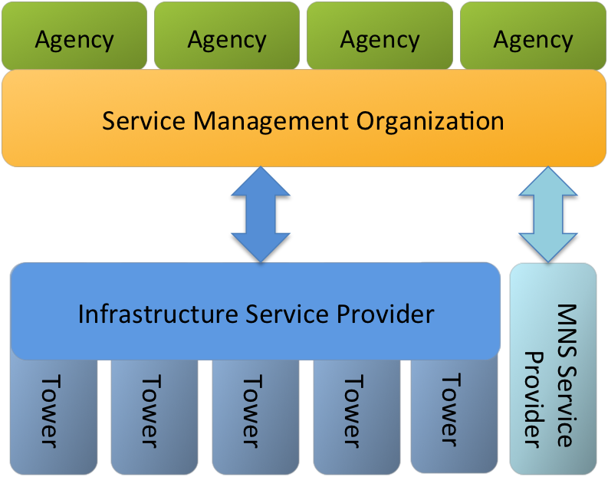
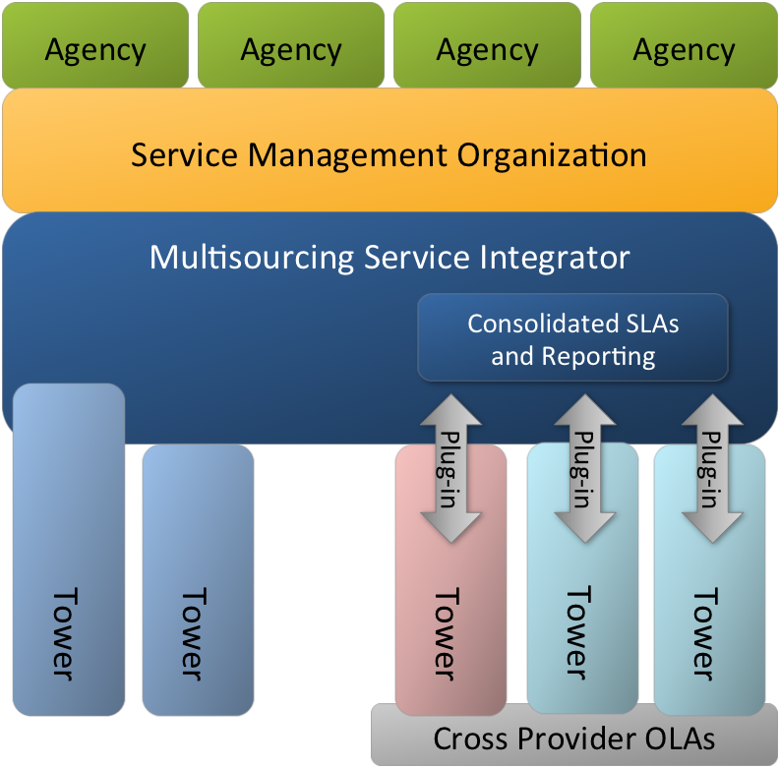
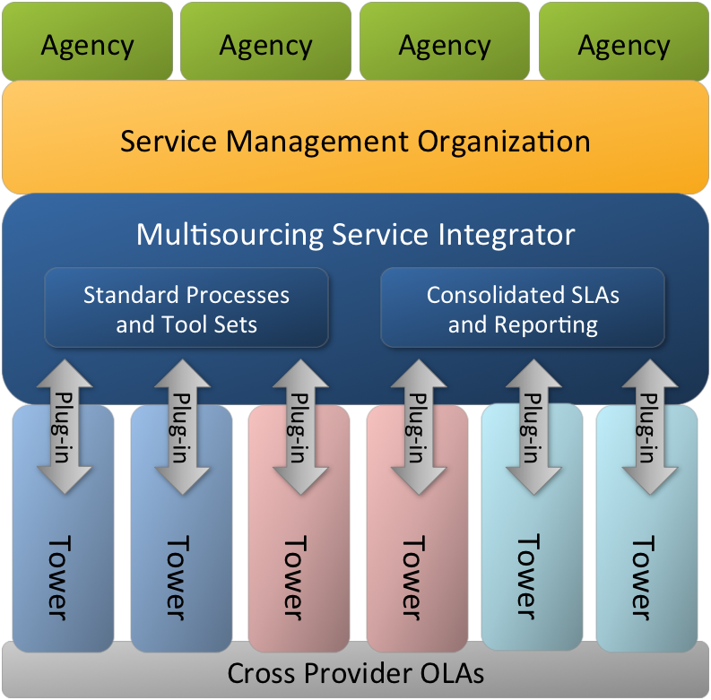
The Path to a Future State
Enterprise contracting
Integrated Services Platform: iterative build
Sourcing Management Organization
Sourcing Management Organization
Sourcing Management Organization
Transition
Incumbent Realignment
Shared Platform
Plug & play capability
Process improvement
Program of Parallel Procurements
SMO maturation
TODAY
Transition
Flexible State

Slide 14
What is unique about integrated services contracts?
A formal acknowledgement of the interdependence of all participants in a shared services framework
  Shared deal structure and common documents
  Shared solution elements and SMM
  Shared accountability reflected in shared service levels
  Shared operating assumptions reflected in OLAs
The MSI - A separate role for coordination and communication that is not Governance
  Investing in the functions that are common to all service elements, independent of the enabling technologies
A rule set to promote equitable changes and more effective change management
  Accounting for re-investment and continuous change

Slide 15
Contractual <-> Operational Fit
Operating Level Agreements (OLAs)
describe process commitments between providers
  One document for each Service Provider relationship
  Interdependency commitments between each Service Component
Service Management Manual (SMM) describes enterprise processes – a single document for the client
Client
MSA
Solution Requirements
OLA Contractual Obligations
MSA
Solution Requirements
OLA Contractual Obligations
SMM
Provider
OLA
Interdependency Commitments
Provider

Slide 16
Service Provider 1 | Service Provider 2 | Service Provider 3
Master Services Agreement | Master Services Agreement | Master Services Agreement
Exhibit 1: Integration and Change
Attachment 1-A (Definitions)
Attachment 1-B (Change and Acceptance)
Attachment 1-C (Governance Structure and Dispute Resolution)
Attachment 1-D (Service Management Manual Outline)
Attachment 1-E (Operating Level Agreement Outline)
Exhibit 2 (Statement of Work and Solution)
Exhibit 2.1 (MSI Statement of Work) | Exhibit 2.2 (Tower 1 Statement of Work) | Exhibit 2.3 (Tower 2 Statement of Work)
Attachments 2.1-A thru n (MSI-specific solution, transition, transition-out, etc.) | Attachments 2.2-A thru n (Tower-specific solution, transition, transition-out, etc.) | Attachments 2.3-A thru n (Tower-specific solution, transition, transition-out, etc.)
Exhibit 3 (Reporting and Service Level Management)
Exhibit 3.1 (MSI-specific SL req’ts) | Exhibit 3.2 (Tower 1-specific SL req’ts) | Exhibit 3.3 (Tower 2-specific SL req’ts)
Attachments 3.1-A thru n (MSI-specific reports, metrics, critical deliverables) | Attachments 3.2-A thru n (Tower 2-specific reports, metrics, critical deliverables) | Attachments 3.3-A thru n (Tower 2-specific reports, metrics, critical deliverables)
Exhibit 4 (Pricing and Financial Provisions)
Exhibit 4.1 (MSI-specific provisions) | Exhibit 4.2 (Tower 1-specific provisions) | Exhibit 4.3 (Tower 2-specific provisions)
Attachment 4.1-A thru n (MSI-specific pricing units, volumes, prices, assets, etc.) | Attachment 4.2-A thru n (Tower 1-specific pricing units, volumes, prices, assets, etc.) | Attachment 4.3-A thru n (Tower 2-specific pricing units, volumes, prices, assets, etc.)
Exhibit 5 (Human Resources Provisions)
Exhibit 5.1 (MSI-specific HR provisions) | Exhibit 5.2 (Tower 1-specific provisions) | Exhibit 5.3 (Tower 2-specific provisions)
Attachments 5.1-A thru C (affected persons, projection matrix, key persons) | Attachments 5.2-A thru C (affected persons, projection matrix, key persons) | Attachments 5.3-A thru C (affected persons, projection matrix, key persons)

Slide 17
OLA Structure
Content
Development
Part A
Contracting Framework
Obligations of service provider to client
Established in initial RFP release – part of contracting framework
Defines the relationship between the Parties
Part B
Between Providers
Negotiate in context of integration sessions – pre-transition
Part C
Intersects Between Components
Identifies the obligation of the Parties to support the dependencies between the towers
Initially drafted in integration sessions (pre-transition)
Edited throughout contract life, with client approval

Slide 18
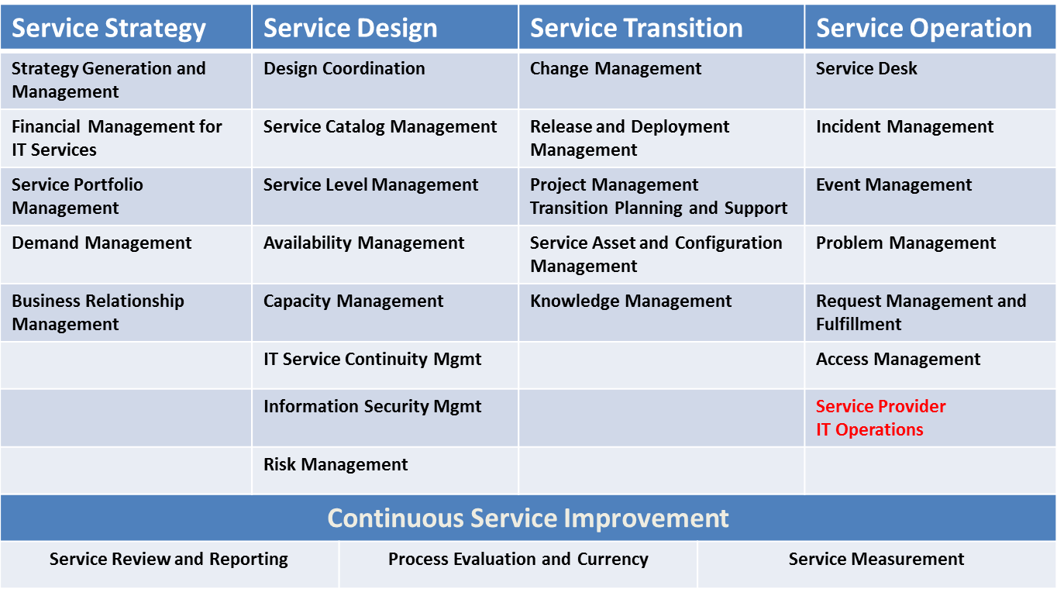
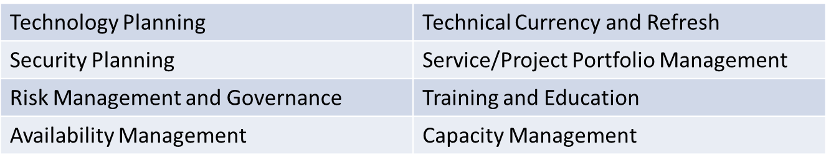
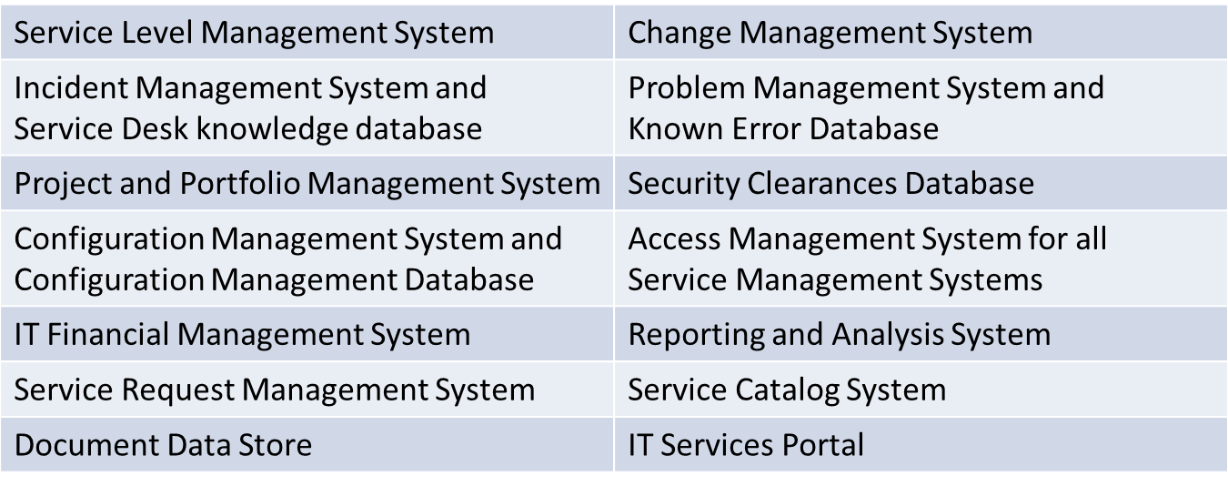
OLAs with the Service Integrator
SMM includes ITIL and defined enterprise processes
MSI OLAs with the MSI are based on the SMM plus SOWs & SLAs
Part B
Between Providers
ITIL Processes
Part C
Intersects Between Components
Service Management
Manual
On-Going
Programs
Statements of Work
Tools
SLAs

Slide 19
OLAs Govern how Parties Work Together
OLAs ensure service provider’s actions are compatible
Operating Level Metrics ensure measurements are compatible
Service Management
Manual
Part C
Intersects Between Components
Each Process defined the same
Handoff’s are agreed
Measured the same way
Agreed tolerance (time)
Statements of Work
Example - Shared Response Time Service Level
The calculation of response time is the same
Hand-offs are agreed
Maximum tolerance for each supplier is documented
SLAs

Slide 20
Q&A and Closing

Slide 21
Randy Tucker
Principal
Integris Applied
6641 Whispering Woods Ct
Plano, Texas 75024
Randy.Tucker@integrisapplied.com
214-675-9147

Slide 22

Dean Johnson
Chief Operating Officer
Georgia Technology Authority
47 Trinity Avenue
Atlanta, GA 30334
Dean.Johnson@gta.ga.gov
404-463-4409

